Slide 1









Negotiations
November 18, 2025
Day 1
Supported by:
Led by:
In partnership with:

Slide 2
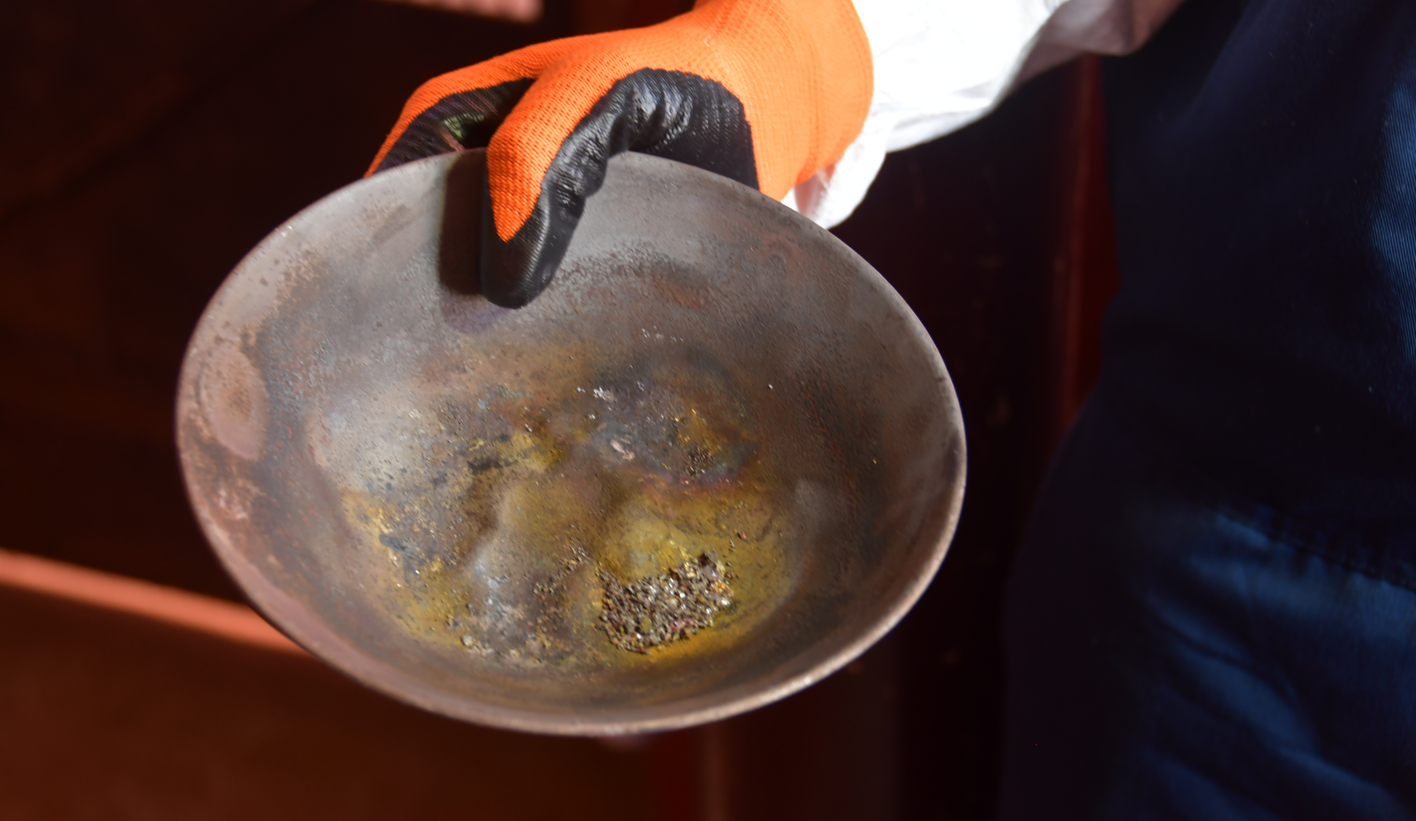
Global Coordination, Knowledge Management and Outreach
Supported by:
Led by:
In partnership with:
©CONSERVATION INTERNATIONAL - GUYANA

Slide 3

Welcome to the Phase 2 Webinar Series – Introductions
Participant Introductions
Let’s get to know each other!
Please share in the chat or open your microphone:
Your Name
Your Country
Your Role or Position
And one point you’d like to share (e.g., your interest in the topic, your expectations for the session, or a connection to ASGM)

Slide 4


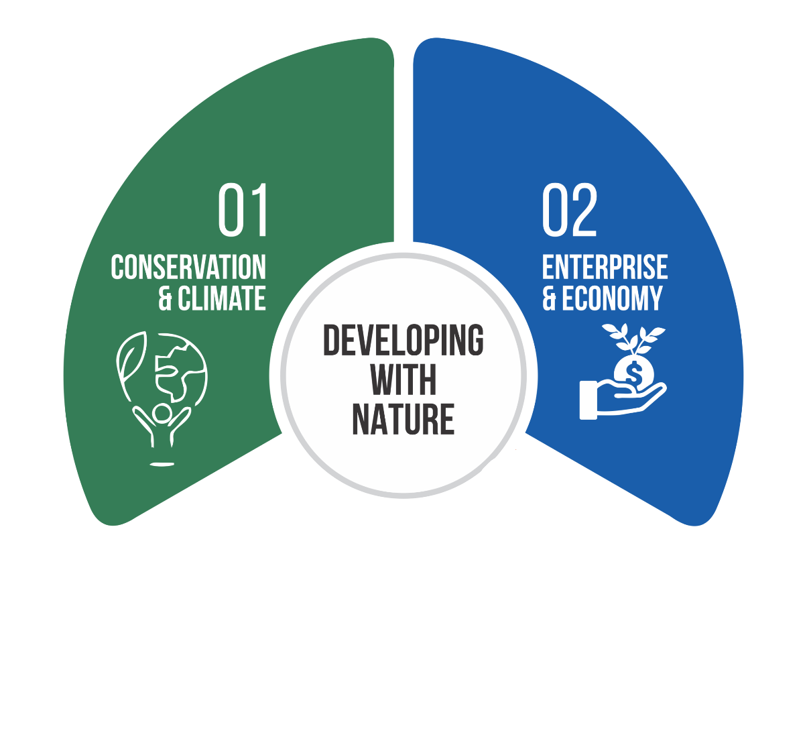
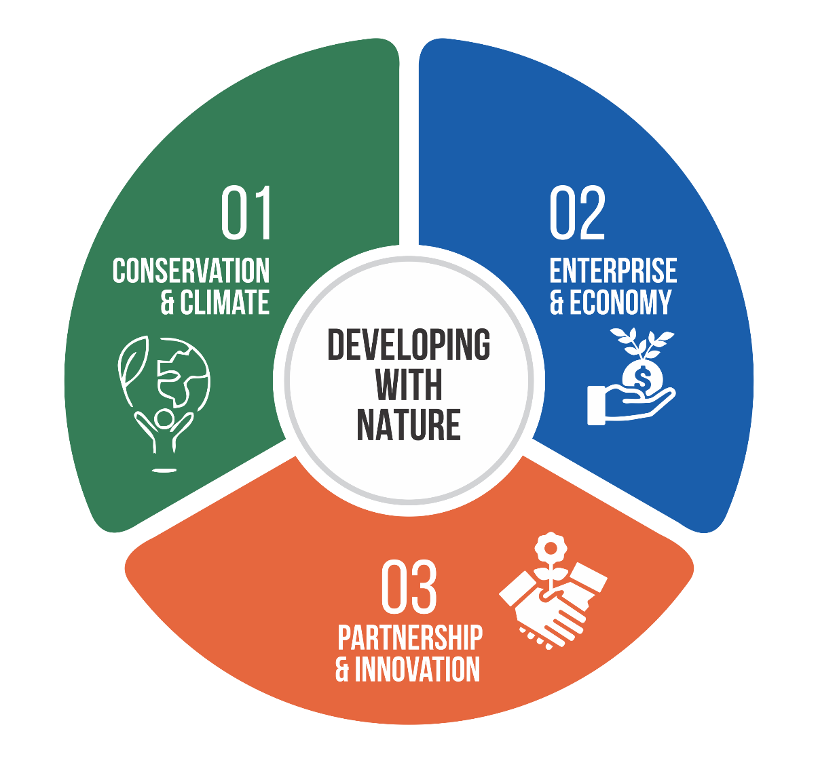
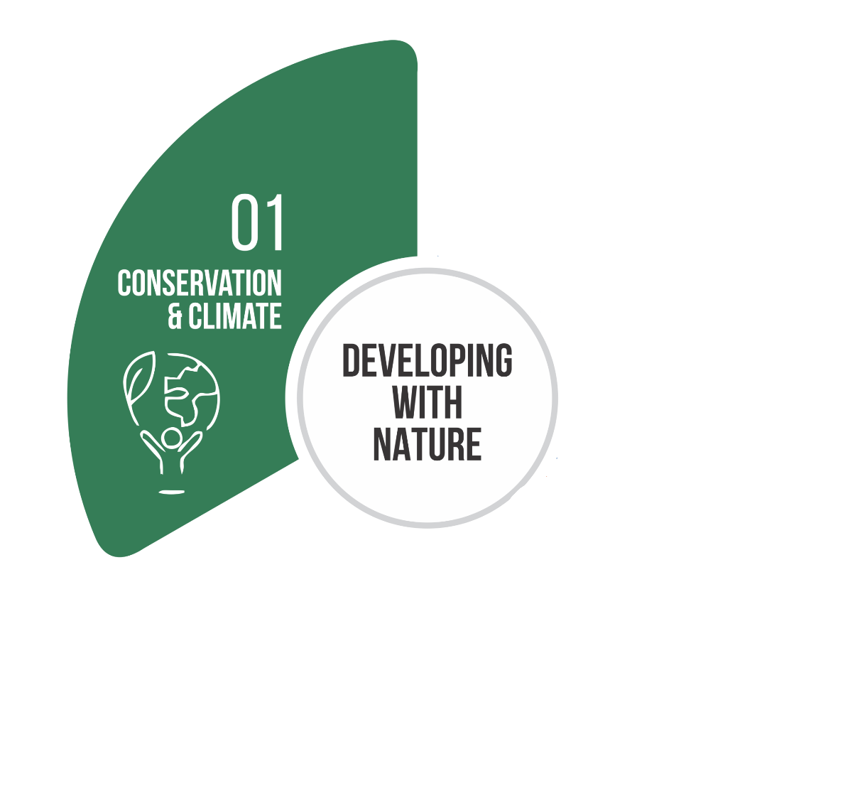
Who We Are
Area-based Conservation
Building with Nature
REDD+, Forest Carbon and other PES
Sustainable Rupununi
Sustainable Villages
Sustainable Sectors
Responsible Mining
Stronger Partners for Lasting Impact
Working Together for a Sustainable Future
Information for Improved Decision
Notes:
Guyana’s LCDS 2030 emphasizes developing with nature to build a resilient, prosperous future. CI-Guyana supports this by applying 30 years of experience in conservation, sustainable economies, and strong partnerships to create lasting, nature-based benefits for people.
CI-Guyana’s work centers on: (1) nature conservation and climate, (2) building sustainable economies, and (3) amplifying impact through information and partnerships.

Slide 5
Welcome & Objectives
  Introduce RMI (Responsible Mining Initiative)
  Introduce CI Guyana
FPIC: Beyond the Checkbox
  A legal & moral right, not just a formality.
Power Imbalances
  Companies/governments often have more resources & influence.
Meaningful Participation = Resources
  Communities need support, time, info, and capacity to engage.
Transparent Information Sharing
  Use accessible, culturally relevant communication.
Building Inclusive Agreements
  Ensure all voices (women, youth, elders) are included.
Risks of Getting It Wrong
  Legal, reputational, and community trust consequences.
Good Practice Case Studies
  Real examples from RMI and CI Guyana showing what works.
What is Responsible Mining?
Responsible mining is commonly defined as mining that involves and respects all stakeholders, minimises, and takes account of its environmental impact, and prioritises a fair division of economic and financial benefits. There is a strong focus on stakeholder engagement, involving governments and the affected communities.
Responsible Mining Initiative (RMI)
To foster greater responsibility and sustainability in Guyana’s Artisanal Small-scale Gold Mining sector by reducing the negative effects of the sector – impacts on forests and the use of mercury – and improving productivity and profitability.

Slide 6
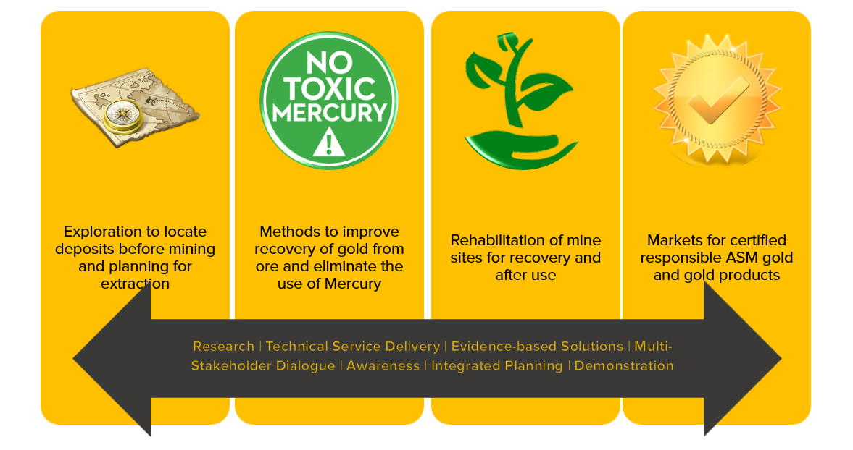
Welcome & Objectives
  Introduce RMI (Responsible Mining Initiative)
  Introduce CI Guyana
FPIC: Beyond the Checkbox
  A legal & moral right, not just a formality.
Power Imbalances
  Companies/governments often have more resources & influence.
Meaningful Participation = Resources
  Communities need support, time, info, and capacity to engage.
Transparent Information Sharing
  Use accessible, culturally relevant communication.
Building Inclusive Agreements
  Ensure all voices (women, youth, elders) are included.
Risks of Getting It Wrong
  Legal, reputational, and community trust consequences.
Good Practice Case Studies
  Real examples from RMI and CI Guyana showing what works.

Slide 7
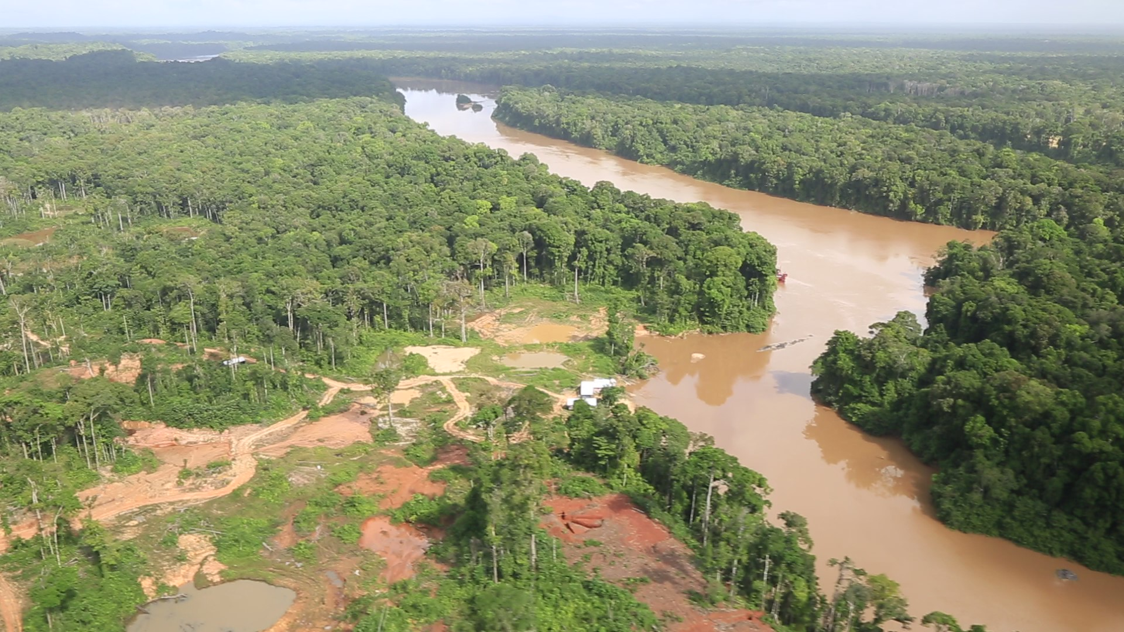
Why Negotiations Matter
©CONSERVATION INTERNATIONAL - GUYANA

Slide 8
Why Good Faith Negotiations Matter
Without good faith negotiations, many things can go wrong. It prevents:
Legal Risks
• Lawsuits, project delays, or cancellations
• Breach of national or international obligations (e.g., UNDRIP, IFC)
Reputational Damage
• Loss of social license to operate
• Negative media coverage, public backlash, investor concerns
Environmental/
social impacts
• Mitigate negative environmental and social damages
Loss of Community Trust
• Long-term resentment and resistance
• Conflict, protests, and breakdown of relationships
• Harder to work in the area again in the future
Respecting FPIC and engaging communities properly isn't just the right thing to do:
it's smart risk management
©CONSERVATION INTERNATIONAL - GUYANA
Notes:
What is "Loss of Social License to Operate"?
Social License to Operate (SLO) is unwritten, ongoing community approval for a project or company to operate in a specific area. It's not a legal license, but it's just as important — especially for projects that directly impact local communities.
✅ When a company has social license:
The community feels respected, informed, and involved
There is trust between the community and the company
The project can move forward without major opposition

Slide 9
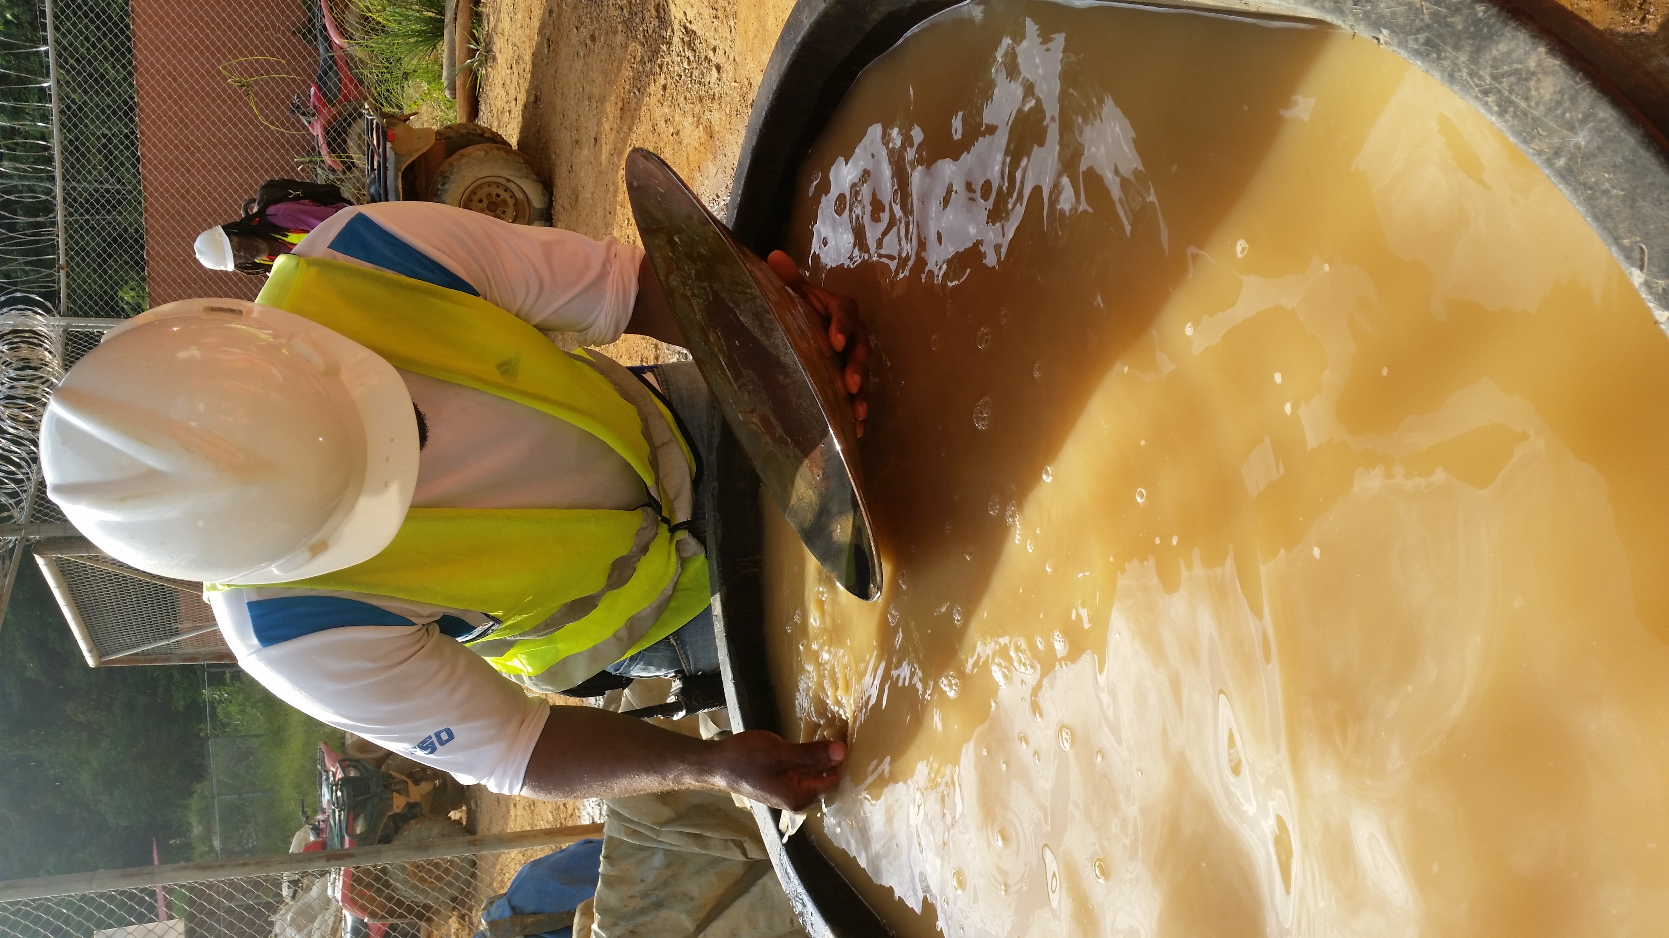
FPIC – Free, Prior, Informed Consent
Welcome & Objectives
  Introduce RMI (Responsible Mining Initiative)
  Introduce CI Guyana
FPIC: Beyond the Checkbox
  A legal & moral right, not just a formality.
Power Imbalances
  Companies/governments often have more resources & influence.
Meaningful Participation = Resources
  Communities need support, time, info, and capacity to engage.
Transparent Information Sharing
  Use accessible, culturally relevant communication.
Building Inclusive Agreements
  Ensure all voices (women, youth, elders) are included.
Risks of Getting It Wrong
  Legal, reputational, and community trust consequences.
Good Practice Case Studies
  Real examples from RMI and CI Guyana showing what works.
"Free" means that indigenous peoples' consent cannot be given under force or threat.
"Prior" indicates that indigenous groups must receive information on the activity and have enough time to review it before the activity begins.
"Informed" means that the information provided is detailed, emphasises both the potential positive and negative impacts of the activity, and is presented in a language and format understood by the community.
"Consent" refers to the right of the community to agree or not agree to the project before it begins and throughout the life of the project.
©CONSERVATION INTERNATIONAL - GUYANA
Notes:
What is FPIC (Free, Prior, Informed Consent)?
Legal, ethical, and operational significance
FPIC vs. traditional consultation
Global standards (UNDRIP, IFC, etc.)

Slide 10




FPIC – Free, Prior, Informed Consent
FPIC is a Right, Not a Request
  Grounded in international law and Indigenous rights (e.g., UNDRIP, ILO 169).
Beyond Traditional Consultation
  Consultation = informing or asking for input.
  FPIC = consent must be free, prior, and informed — with the right to say no.
Global Standards Require FPIC
  UNDRIP (United Nations Declaration on the Rights of Indigenous Peoples)
  IFC Performance Standards (World Bank/IFC)
  Voluntary Principles on Security and Human Rights, etc.
Ethical & Practical Value
  Builds trust, reduces conflict, strengthens long-term project outcomes.
  Enables inclusive, rights-based development.
©CONSERVATION INTERNATIONAL - GUYANA
Notes:
What is FPIC (Free, Prior, Informed Consent)?
Legal, ethical, and operational significance
FPIC vs. traditional consultation
Global standards (UNDRIP, IFC, etc.)

Slide 11
Power Imbalance in Negotiations
Unequal Access to Resources
Knowledge &
Information Gaps
Time & Decision Pressure
Cultural &
Historical Context
Addressing the Imbalance
©CONSERVATION INTERNATIONAL - GUYANA
Notes:
Techniques to deal with strong actors (e.g., miners in Bolivia, gov’t in Ghana)
Coalition-building within communities
Unequal access to resources:
Project proponents often have legal, financial, and technical advantages.
Communities may lack access to independent advice, data, and legal support.
Time & Decision:
Project timelines often prioritise speed over meaningful engagement.
Communities may feel rushed or pressured into decisions.
Address the imbalance:
Ensure independent support for communities (legal, technical, translation).
Create space for dialogue, not just information delivery.
Respect community timelines and decision-making processes.
Cultural & Historical Context:
Past exploitation or exclusion can lead to mistrust.
IPLCs have different worldviews or governance systems.
Knowledge & Info Gaps:
Technical processes often exclude communities.
Unequal control of information reinforces power gaps.

Slide 12
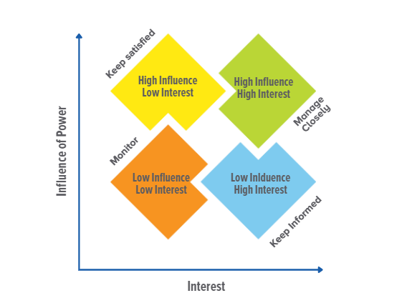
Understanding Power & Stakeholders
Notes:
- Analyze stakeholder power (gov't, miners, communities)
- Address imbalance (e.g., Bolivia, Ghana)

Slide 13
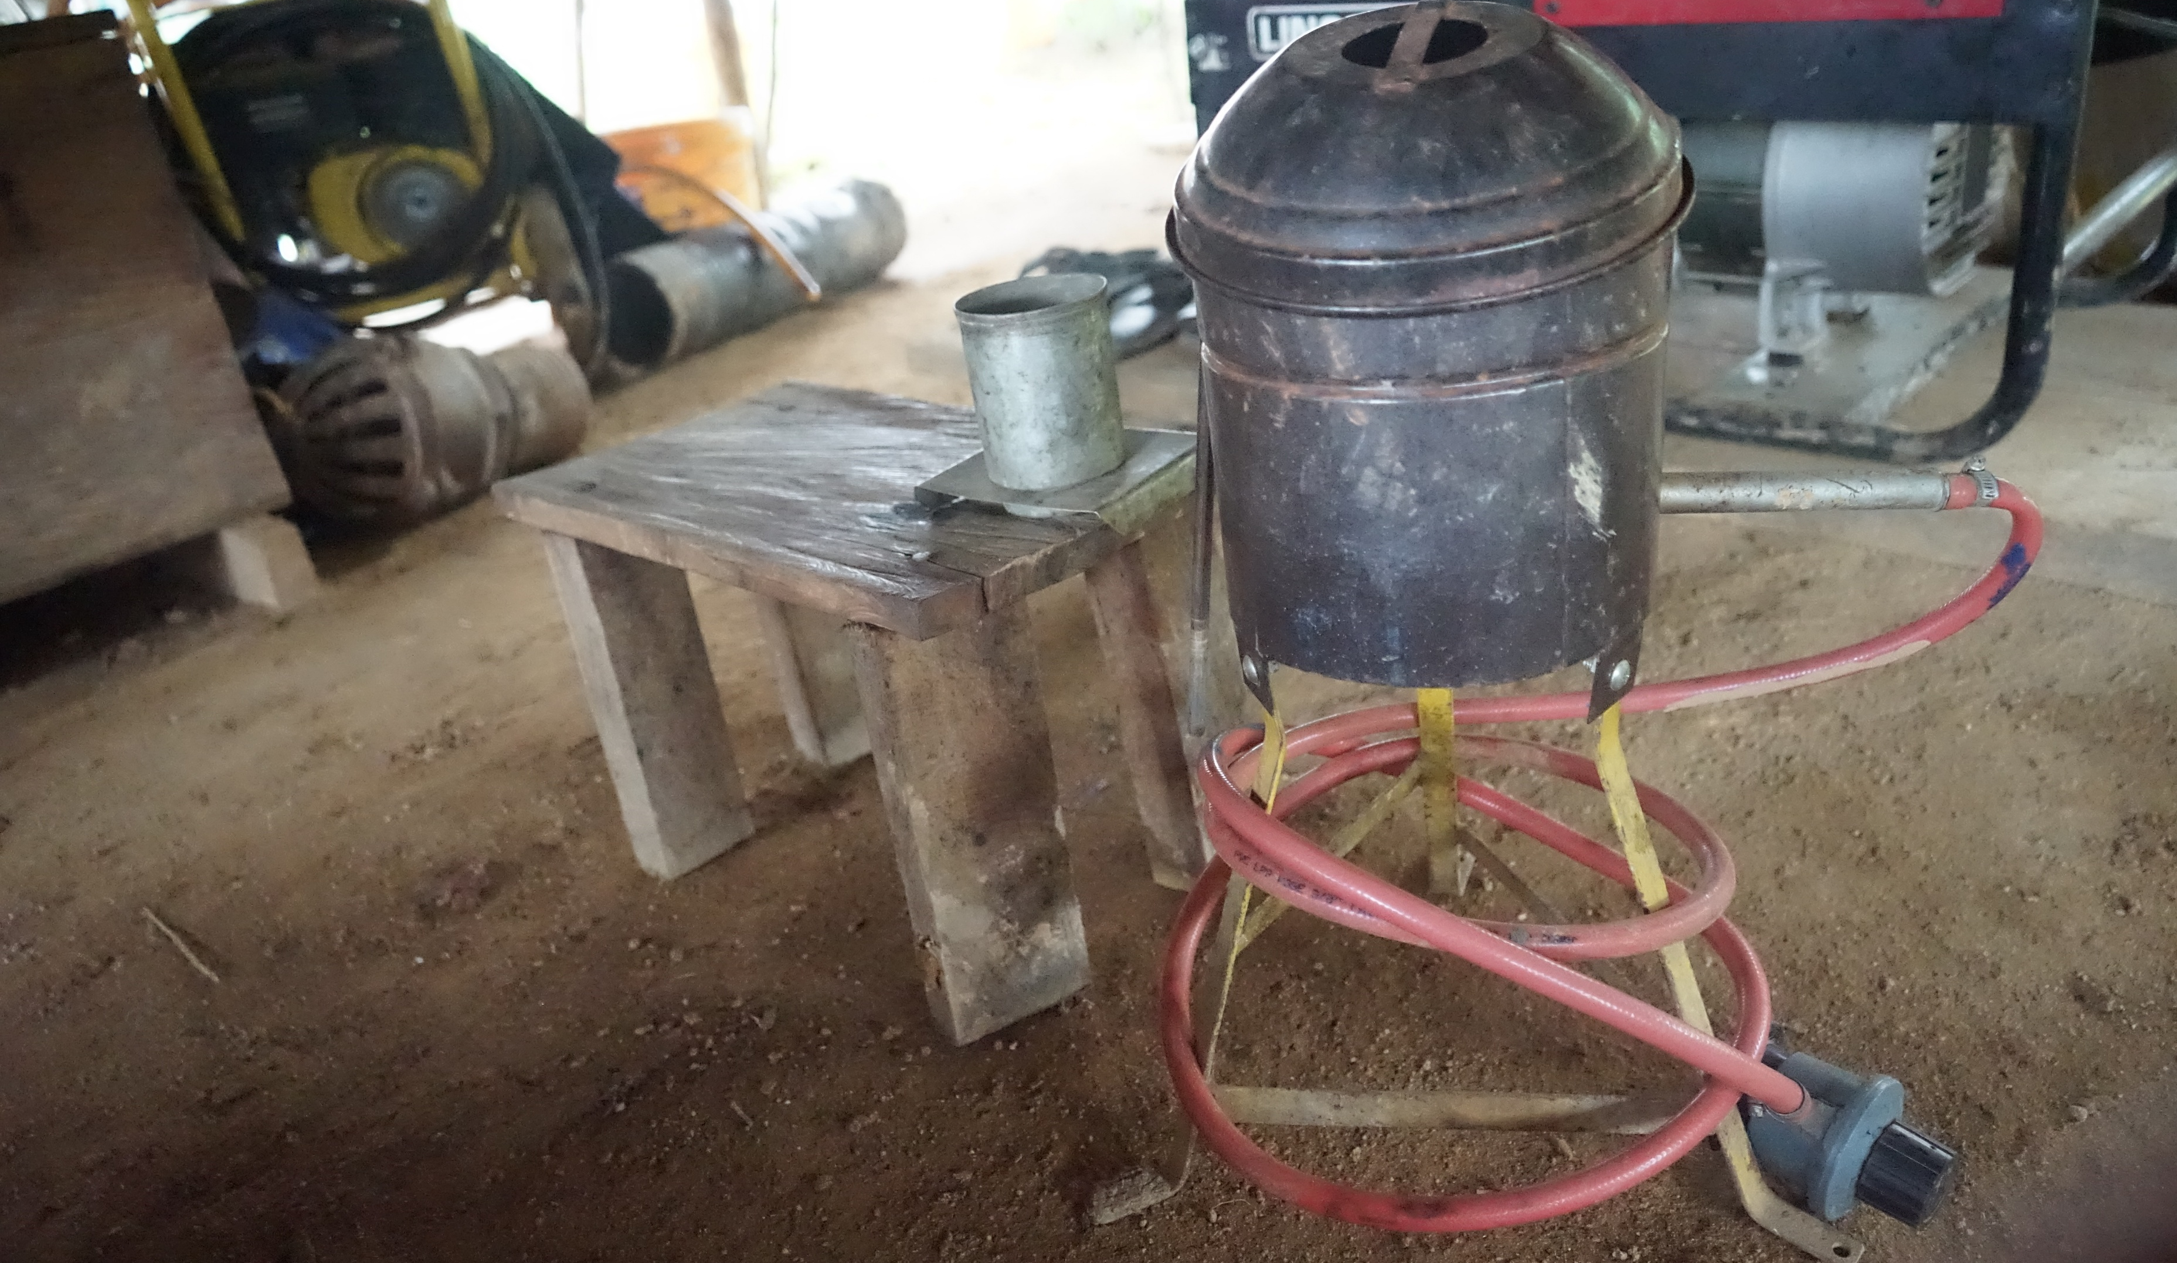
Effective Negotiation Process
©CONSERVATION INTERNATIONAL - GUYANA

Slide 14
Principles of Effective Community Negotiation
Notes:
- Mutual gains approach
- Interest-based negotiation
- Building trust

Slide 15
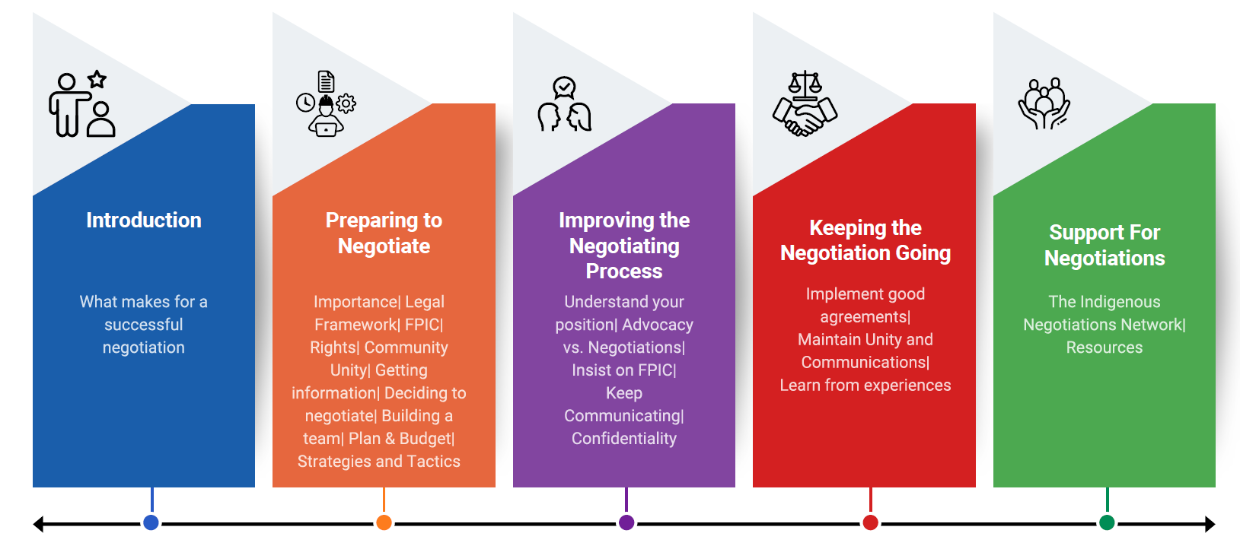
Community Negotiations Process
Notes:
Training community leaders to speak confidently (as Ghana is doing)
Incorporate feedback mechanisms (like in Madagascar)

Slide 16
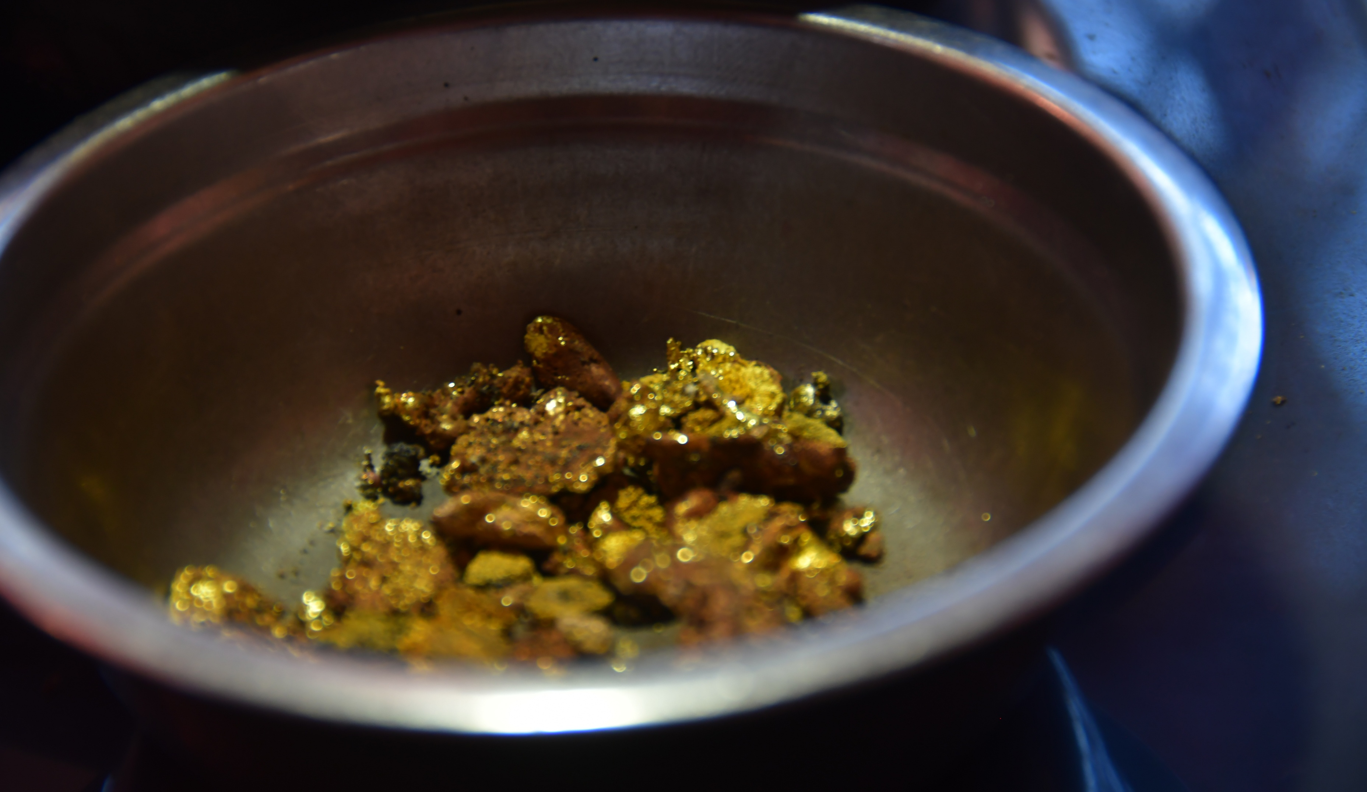
How to Do Negotiations Better
©CONSERVATION INTERNATIONAL - GUYANA

Slide 17



Enabling Participation Through Resource Support
to consult internally and make collective decisions
to understand complex project details
Where necessary
Information
Legal advice
Inclusive support
Translation or interpretation
Technical support
Time
in accessible language and formats
to protect rights and interests
Travel, meeting spaces, childcare, or meals
Proponents Should Consider Budgeting for This
Participation is a Right, Not a Favour
©CONSERVATION INTERNATIONAL - GUYANA
Notes:
Communities must be fully informed and actively involved in decisions that affect their land, lives, and future.
Supporting participation is part of doing responsible, inclusive business
Budgeting for community engagement builds trust and improves outcomes for all

Slide 18
Transparent Information Sharing
Key Principles for Sharing Information:
Accessibility
Use local languages & formats (visuals, oral, etc.)
Clarity
Use plain, non-technical language
Timeliness
Share info before decisions are made
Relevance
Focus on impacts, benefits, risks, timelines
Consistency
Ensure everyone gets the same message
Two-Way
Create space for questions & feedback
When these principles are followed:
🤝 Trust and credibility are built 🚫 Confusion, rumors, and conflict are reduced 📜 Supports FPIC
©CONSERVATION INTERNATIONAL - GUYANA

Slide 19
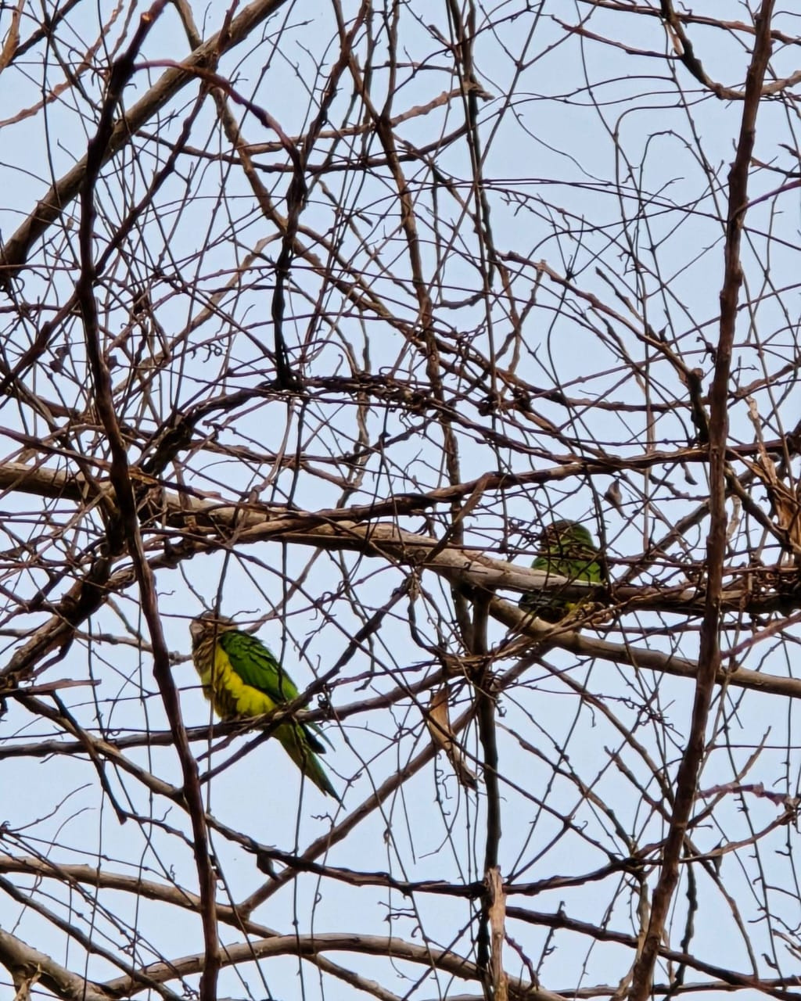
WHAT DO GOOD AGREEMENTS SATISFY?
Good agreements satisfy two principal interests of Indigenous people.
Benefits
Provide the greatest possible control over project benefits.
Reduce negative impacts
Minimize or reduce negative project impacts e.g. environmental, social, cultural and economical.
(c)Marcelle Chan-A-Sue

Slide 20

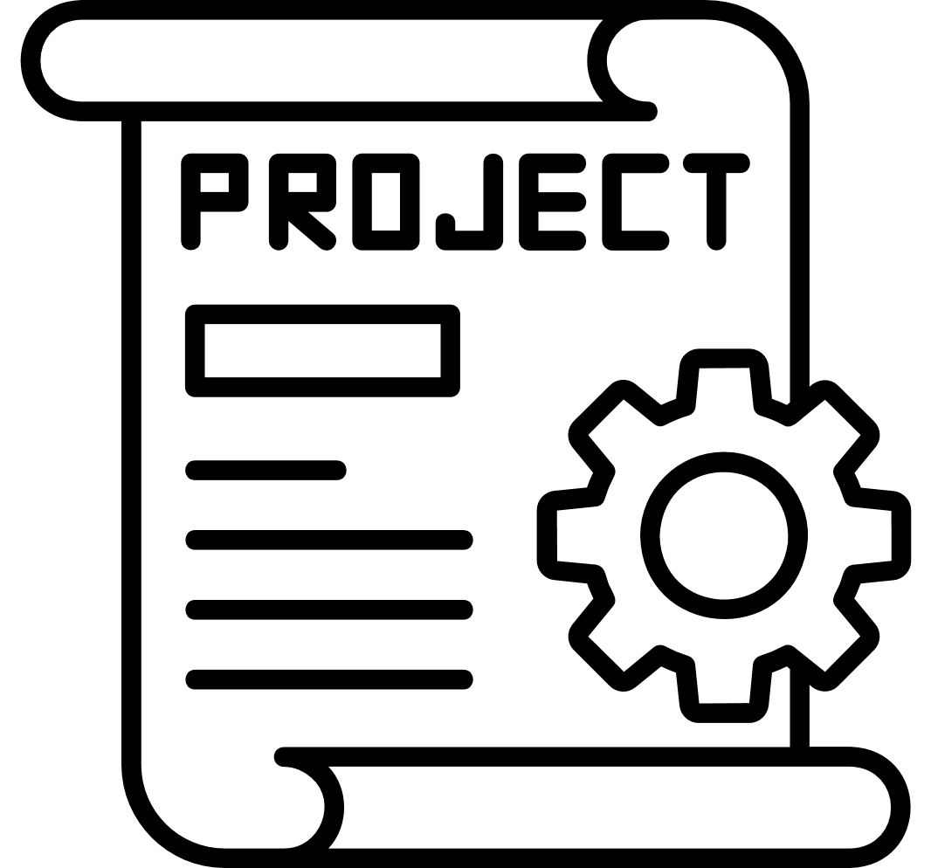

BASIC PRINCIPLES OF AGREEMENTS
Agreement provisions vary, no single template.
Various agreements may apply to the same project.
Agreements can be good or bad.

Slide 21
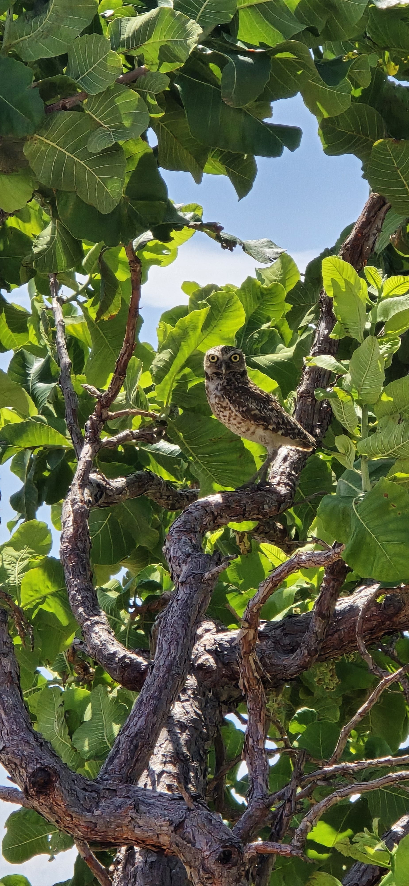

WHAT ARE GOOD AGREEMENTS
  Legally binding
  Based on community consent
  Community shares in project benefit
  Negative impacts are avoided or mitigated
  Covers entire life of the project
  Adaptable mechanism
A Good Agreement never gives up rights!
(c)Marcelle Chan-A-Sue

Slide 22


WHAT IS A BAD AGREEMENT?
A bad agreement LIMITS EXISTING RIGHTS!
As an example, in one agreement, there was a clause that stated ​an Aboriginal group must not:​
  lodge any objections, claims or appeals to any Government authority … under any [state] or Commonwealth legislation, including any Environmental Legislation …’.
Do you know of a local example of a bad agreement?

Slide 23

CRITICAL QUESTIONS TO ASK YOURSELF
  Are existing rights protected?​​​
  Does it satisfy what the community wants most?​​​
  What are the costs and who pays?​​​
  Is it enforceable?​
​Have these issues come up in your experiences with Negotiated Agreements?

Slide 24
FPIC IN AGREEMENTS SHOULD ADDRESS KEY QUESTIONS
SUBSTANTIVE ISSUES
  What are the full range of project costs and who pays for these costs?
  What are the full range of benefits, and who is entitled to share in these benefits?
  How is the agreement between investor and community related to other agreements (power purchase agreement etc.)?
  What level of certainty is there about the estimates of costs and benefits?
  Do these estimates seem fair?
  What are the alternatives of a proposed cost and benefit sharing arrangement.
Communication
01
02
Access to sacred sites
Unforeseen event
03
Community goals
04
(c)Jeremy Melville

Slide 25

CHECKLIST OF LEGAL PROVISIONS
STANDARD PARTS OF AN AGREEMENT
  Background information or recitals ore preamble or objectives
  Parties
  Definitions and interpretation
  Definition of project area
  Principles and goals
  Consent and Consultation
  Independent legal advice
  Liability for expenses
  Commencement and expiry
  Warranties and authorities and succession
  Dispute resolution
  Confidentiality
  Enforceability
  Assignment: sale or transfer of project or company
  What happens if no mining occurs?
  Unforeseen circumstances and force majeur
  Suspension of agreement or operations
  Notice
  Amendment
  Change in law
  Waiver
  Severability
  Indemnity
  Non-employment or relationship of parties
  Attorneys
  Counterparts
  Execution of agreement
  Further action
  Review
Terms and Conditions
01
02
Project Scope
Review and Amendment
03
Confidentiality Clauses
04
Implementation Enforceability
05
(c)Jeremy Melville

Slide 26








ELEMENTS OF A GOOD AGREEMENT
Protection of Cultural Heritage
Compensation
Employment and Job Training
Avoidance or reduction in negative environmental impacts
Business contracts
Role in agreement compliance monitoring and corrective action
Land Tenure Security
Access to health, education, housing services

Slide 27
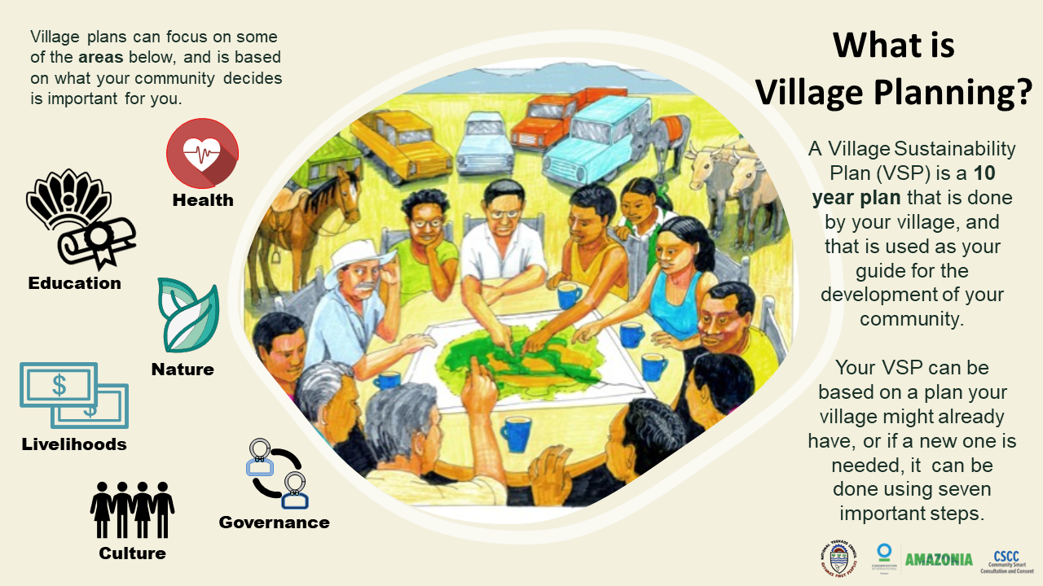
RE-NEGOTIATING BAD AGREEMENTS
  Good agreements should include a component to work in the steps under which, review and re-negotiation of the agreement can take place. Before finalising the agreement, communities should be sure it:
    Ensures there is funding set aside for the review.
    Has a conduit for dispute resolution.
    Specifies who is responsible for what in the review.
Often, re-negotiating an agreement is not in the interest of the company (i.e. the agreement is in their favour).
(c)Marcelle Chan-A-Sue

Slide 28
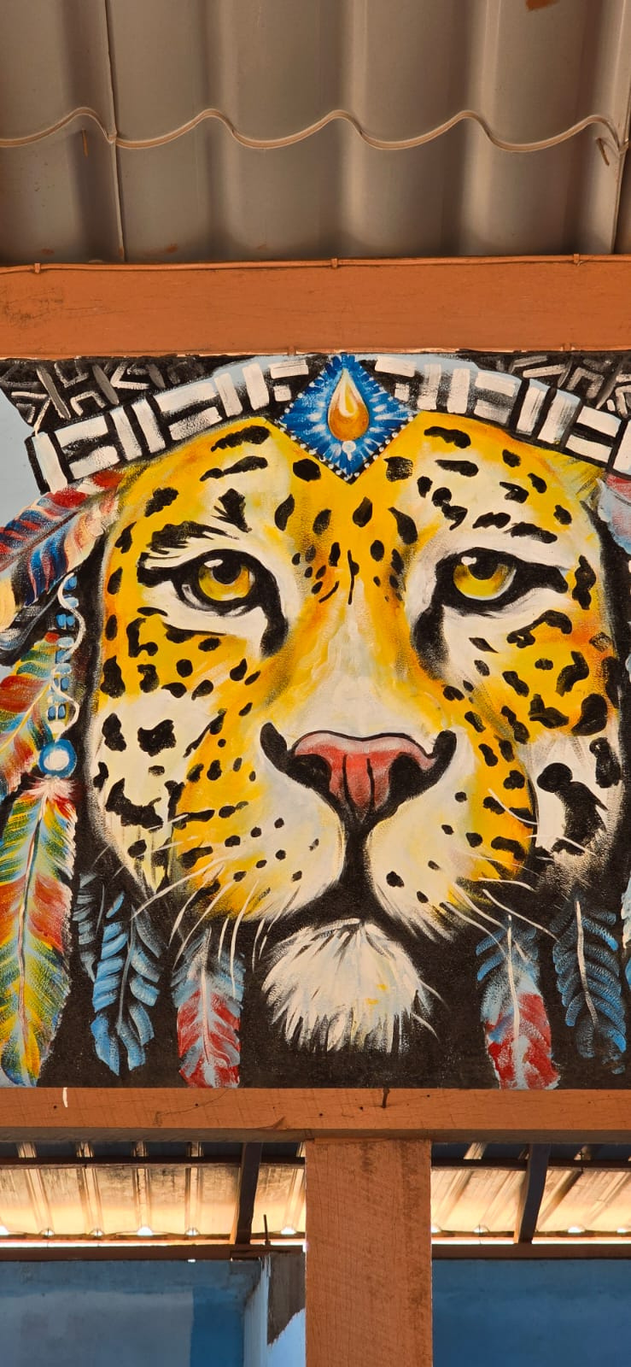
DISPUTE RESOLUTION AND
GRIEVANCE REDRESS MECHANISM
  Corporate Policy mandated GRMs ​
  Negotiated project impact –benefit agreement GRMs ​
  Community driven grievance mechanisms
  Traditional & Customary dispute resolution systems​
    Preferred option for many​
    Viewed as most legitimate​
    Often faster results
(c)Marcelle Chan-A-Sue

Slide 29
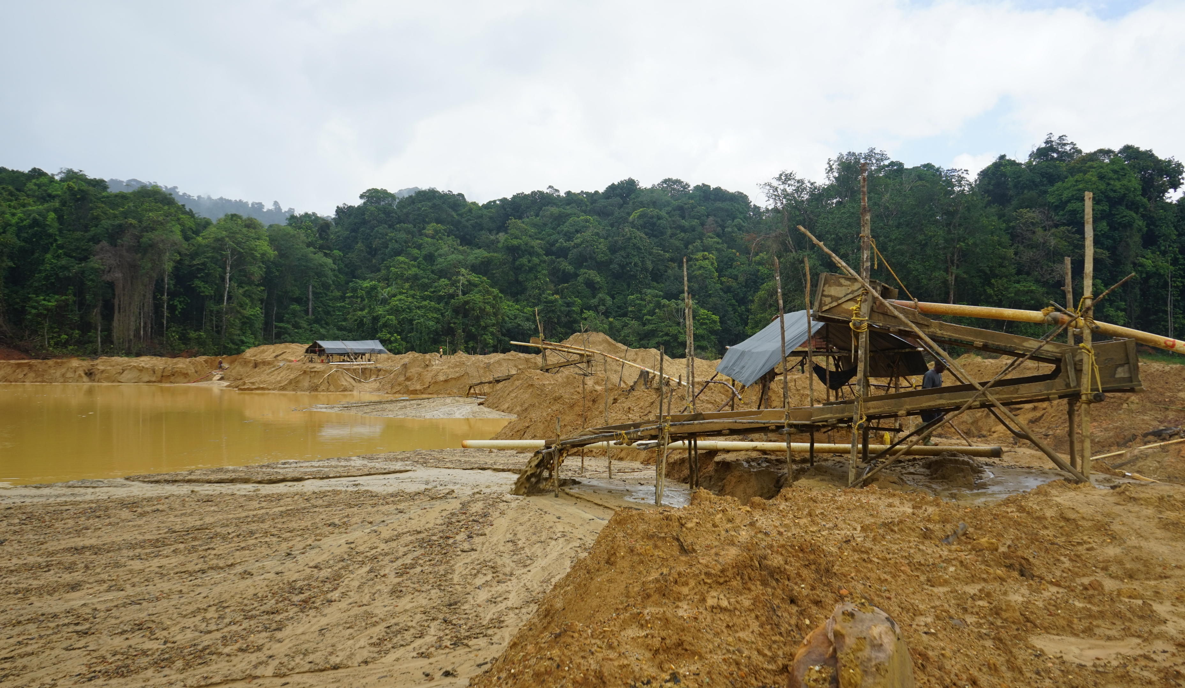
CASE STUDY
Karrau Village
©CONSERVATION INTERNATIONAL - GUYANA

Slide 30
Mini break
5 minutes

Slide 31
Discussion

Slide 32
Thank you.

