Slide 1









Economic valuation of the impact of illegal gold mining
October 7th 2025
Assessment of Impacts of Artisanal Gold Mining
Day 1
Supported by:
Led by:
In partnership with:

Slide 2

Welcome to the Phase 2 Webinar Series – Remember Phase 1
Phase 1: June 10th and June 14th (2024)
  Explain how the Mining Impact Calculator (MIC) works
  Describe the different types of impacts measured
  Present exercises to explore different contexts for the MIC use.
Phase 2: Deep Dives on Artisanal and Small-Scale Gold Mining (ASGM)
  Strengthen participants' understanding of the environmental and social impacts of gold mining.
  Improve the usability of the Mining Impact Calculator (MIC), including exploring potential adaptations for different PlanetGOLD country contexts.
  Identify key challenges for MIC adoption and application through practical exercises and interactive discussions.

Slide 3
Welcome to the Phase 2 Webinar Series – Introductions
Participant Introductions
Let’s get to know each other!
Please share in the chat or open your microphone:
Your Name
Your Country
Your Role or Position
And one point you’d like to share (e.g., your interest in the topic, your expectations for the session, or a connection to ASGM)

Slide 4
Welcome to the Phase 2 Webinar Series – Rules
While we will have a few presentations, this session is designed to be interactive and engaging.
We’ll use a variety of approaches, including:
  Group dynamics to encourage participation and exchange
  Hands-on exercises to explore key concepts and tools
  Open discussions to share experiences and reflect together
  Mentimeter to capture your impressions and inputs in real time

Slide 5
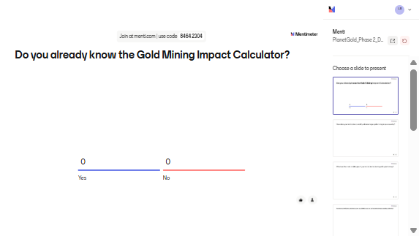
Do you already know the Gold Mining Impact Calculator?

Slide 6
Mining Impact Calculator
An overview

Slide 7
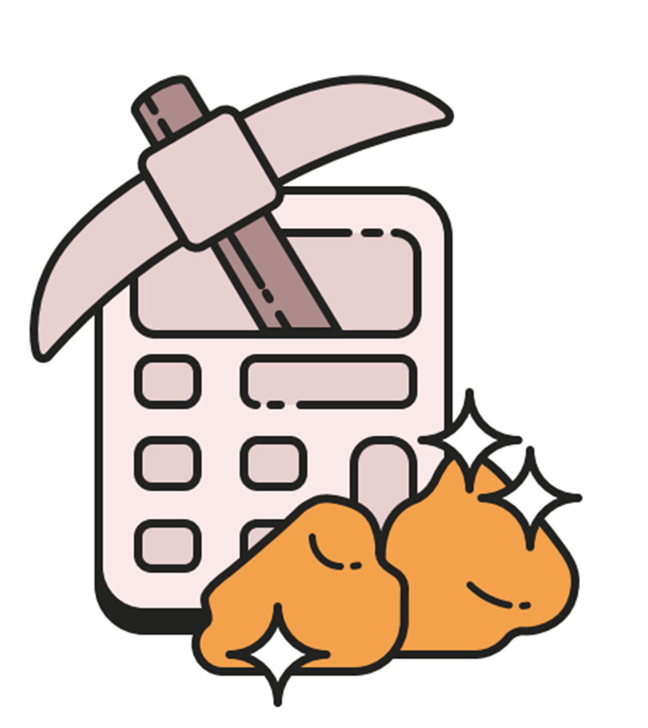
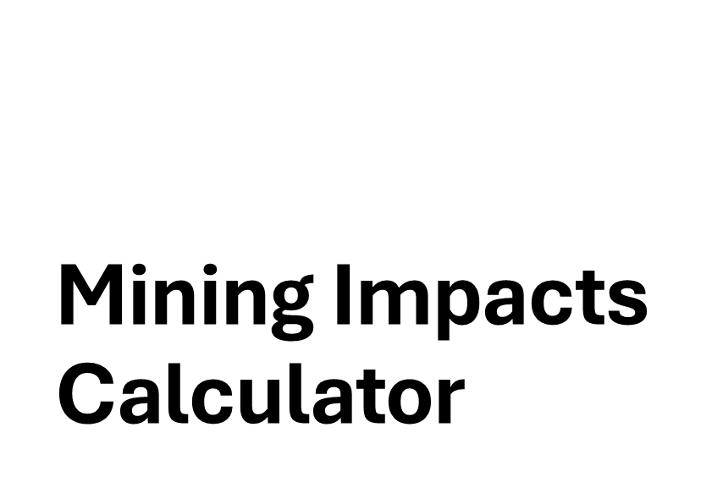

Slide 8
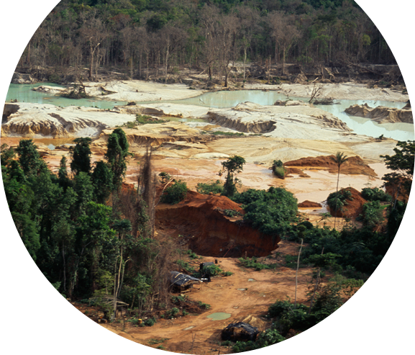
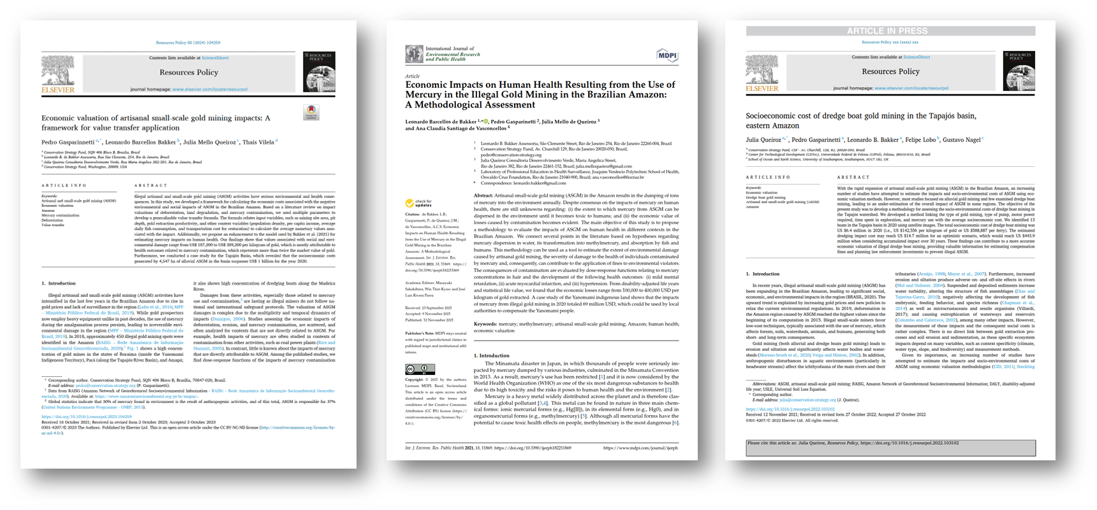
Mining Impacts Calculator
•Launched in Brazil in 2021
•Partnership with Public Prosecutors Office (MPF)
•Supporting government to calculate
•Environmental fines
•Benefits of improved protection
•First tool to value mercury impacts + erosion + deforestation
•Methodology published by academic journals (3)

Slide 9
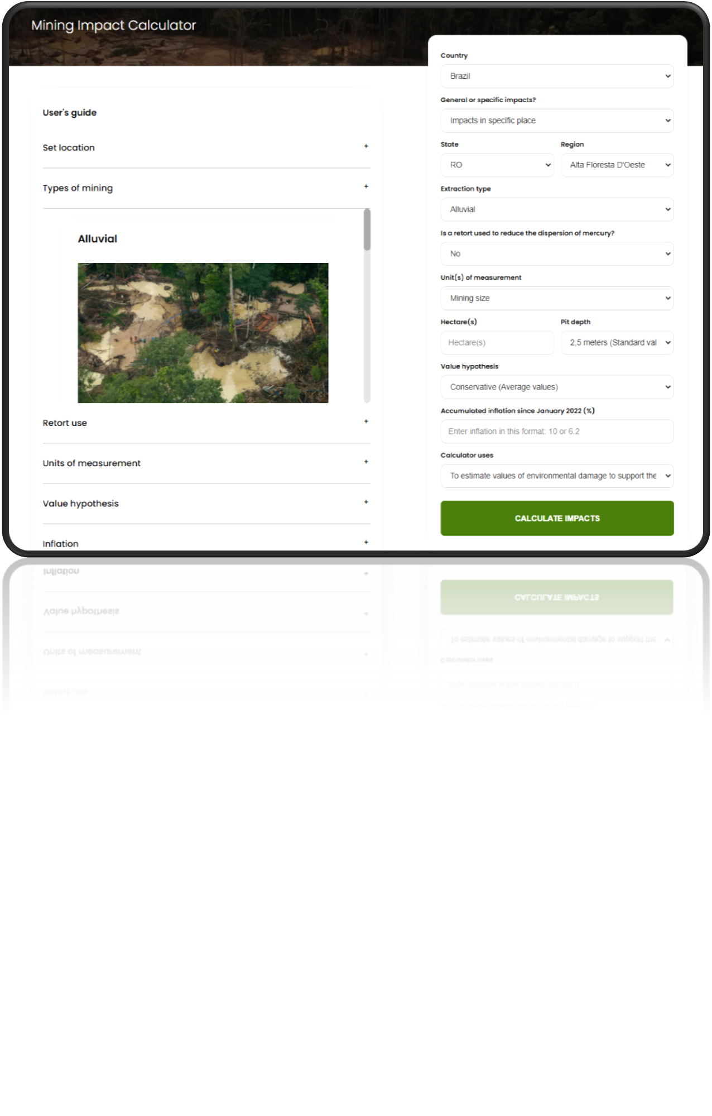

Slide 10
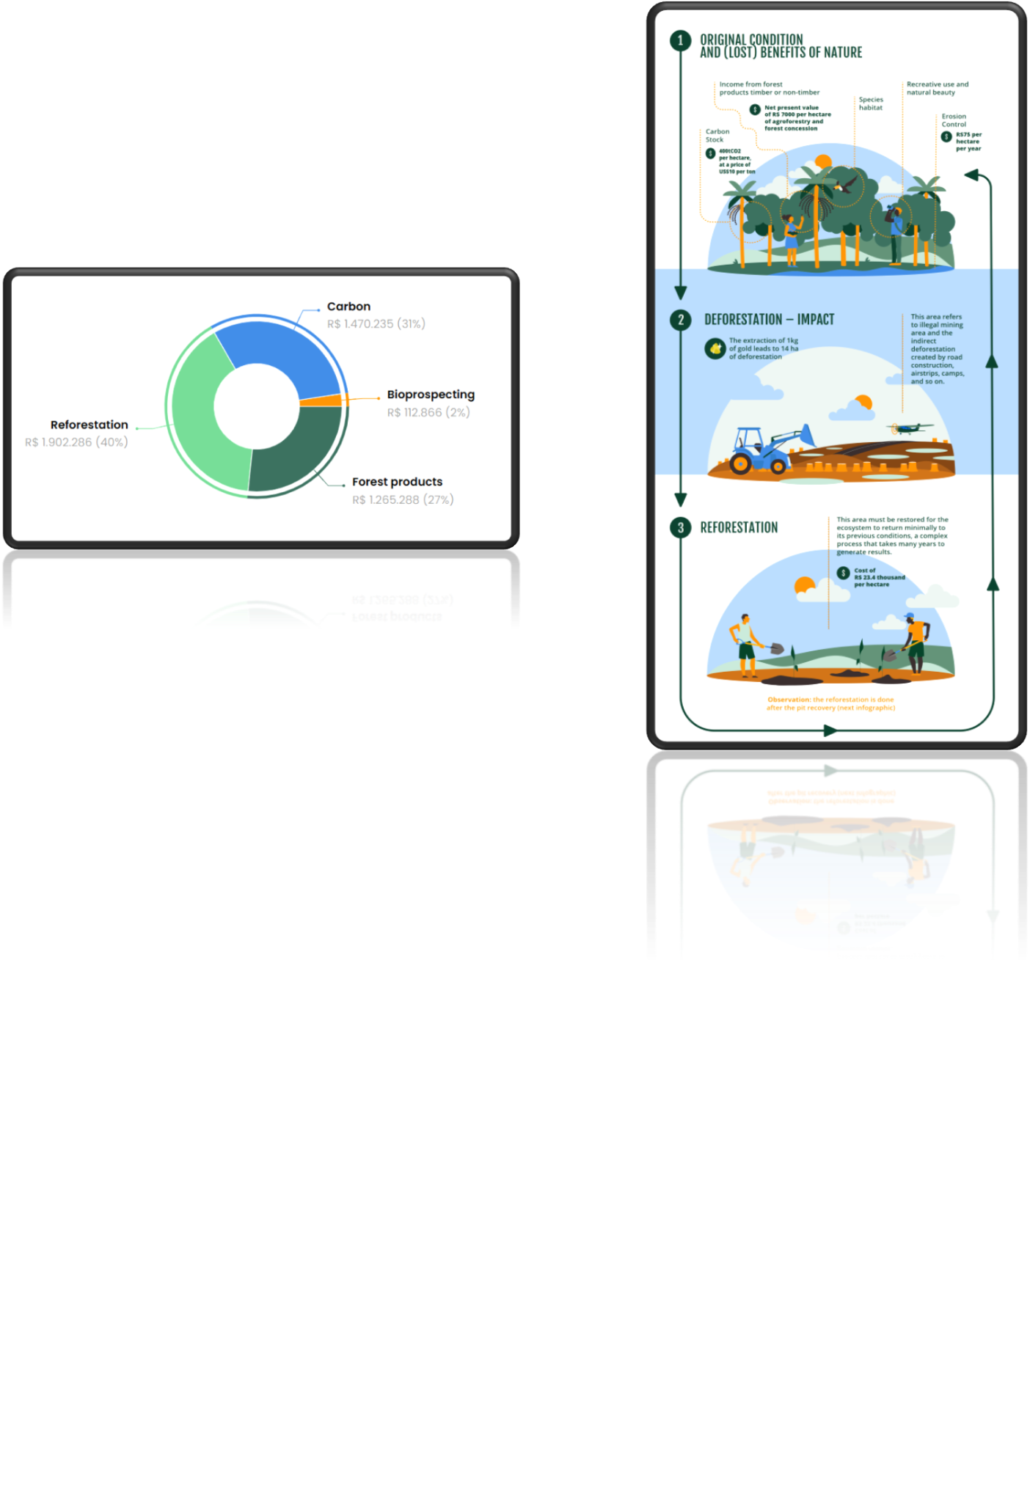
Impact: Deforestation

Slide 11
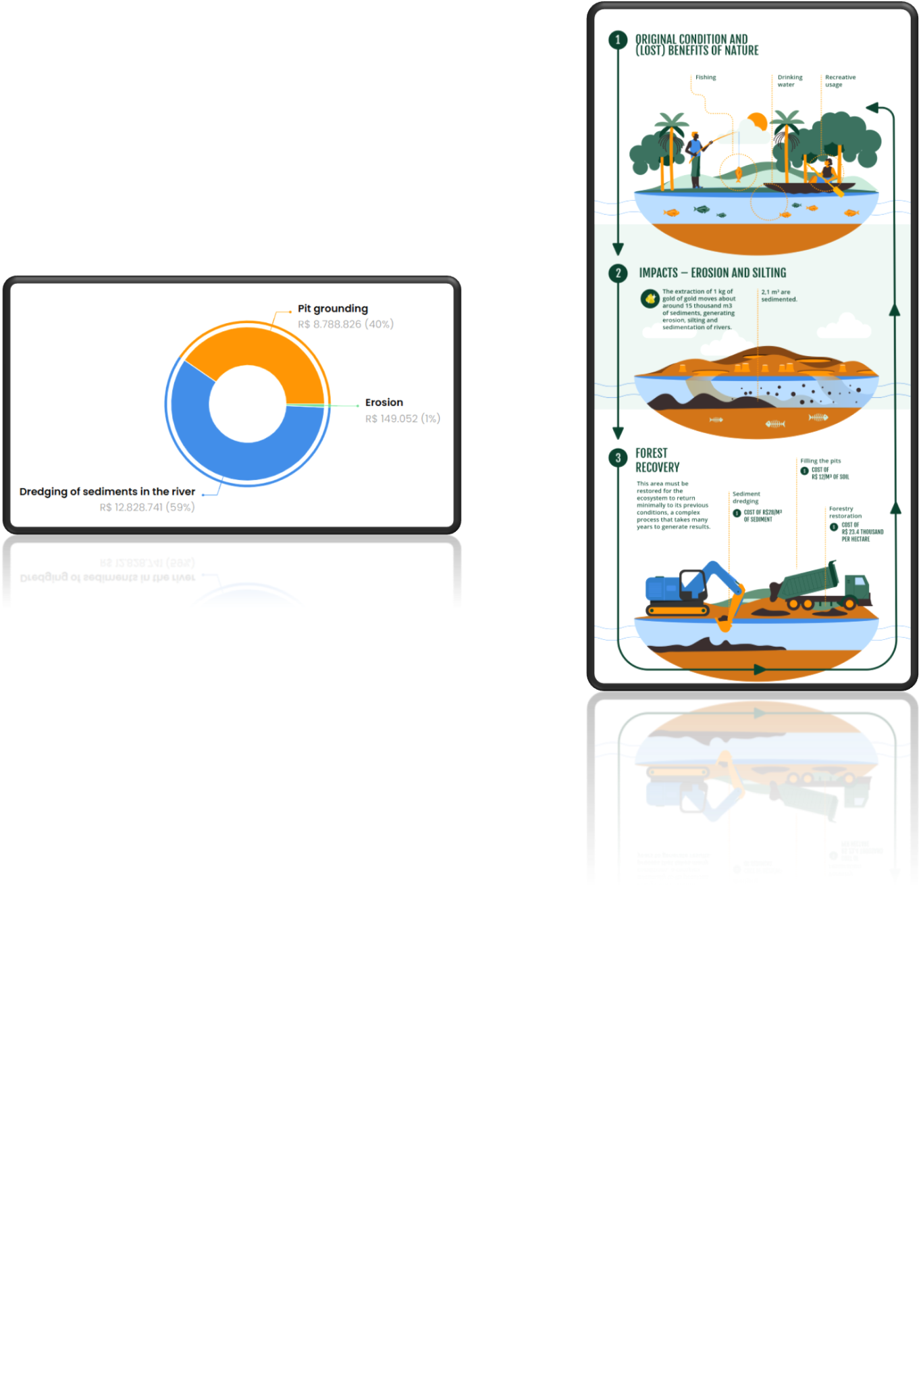
Impact: Erosion

Slide 12
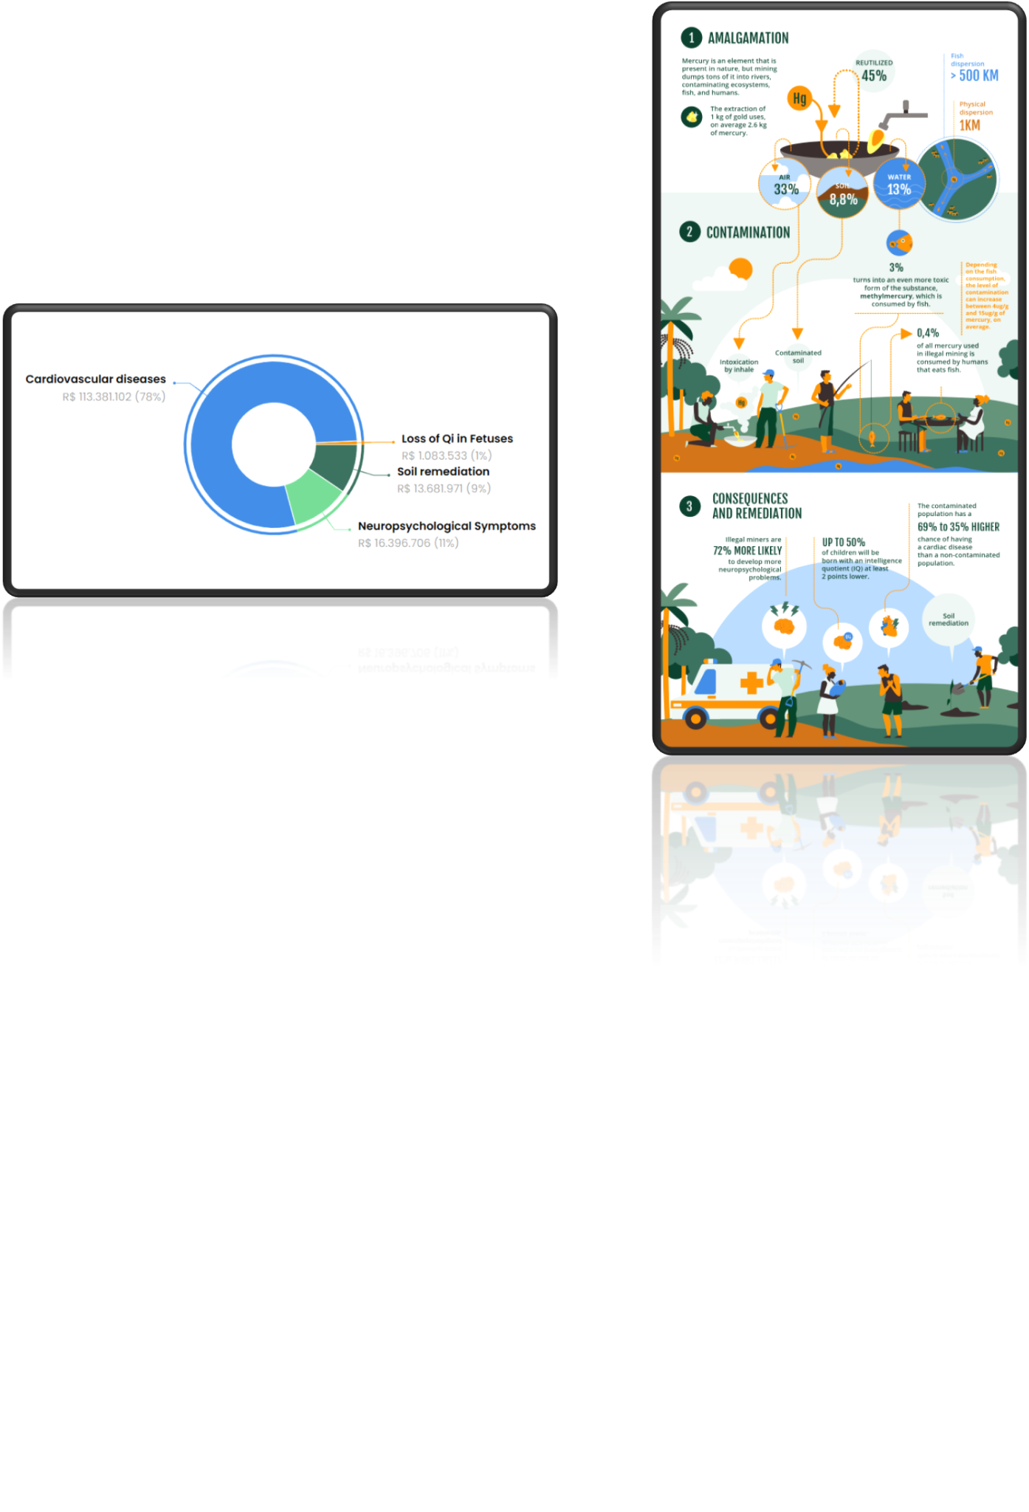
Impact: Mercury Contamination

Slide 13
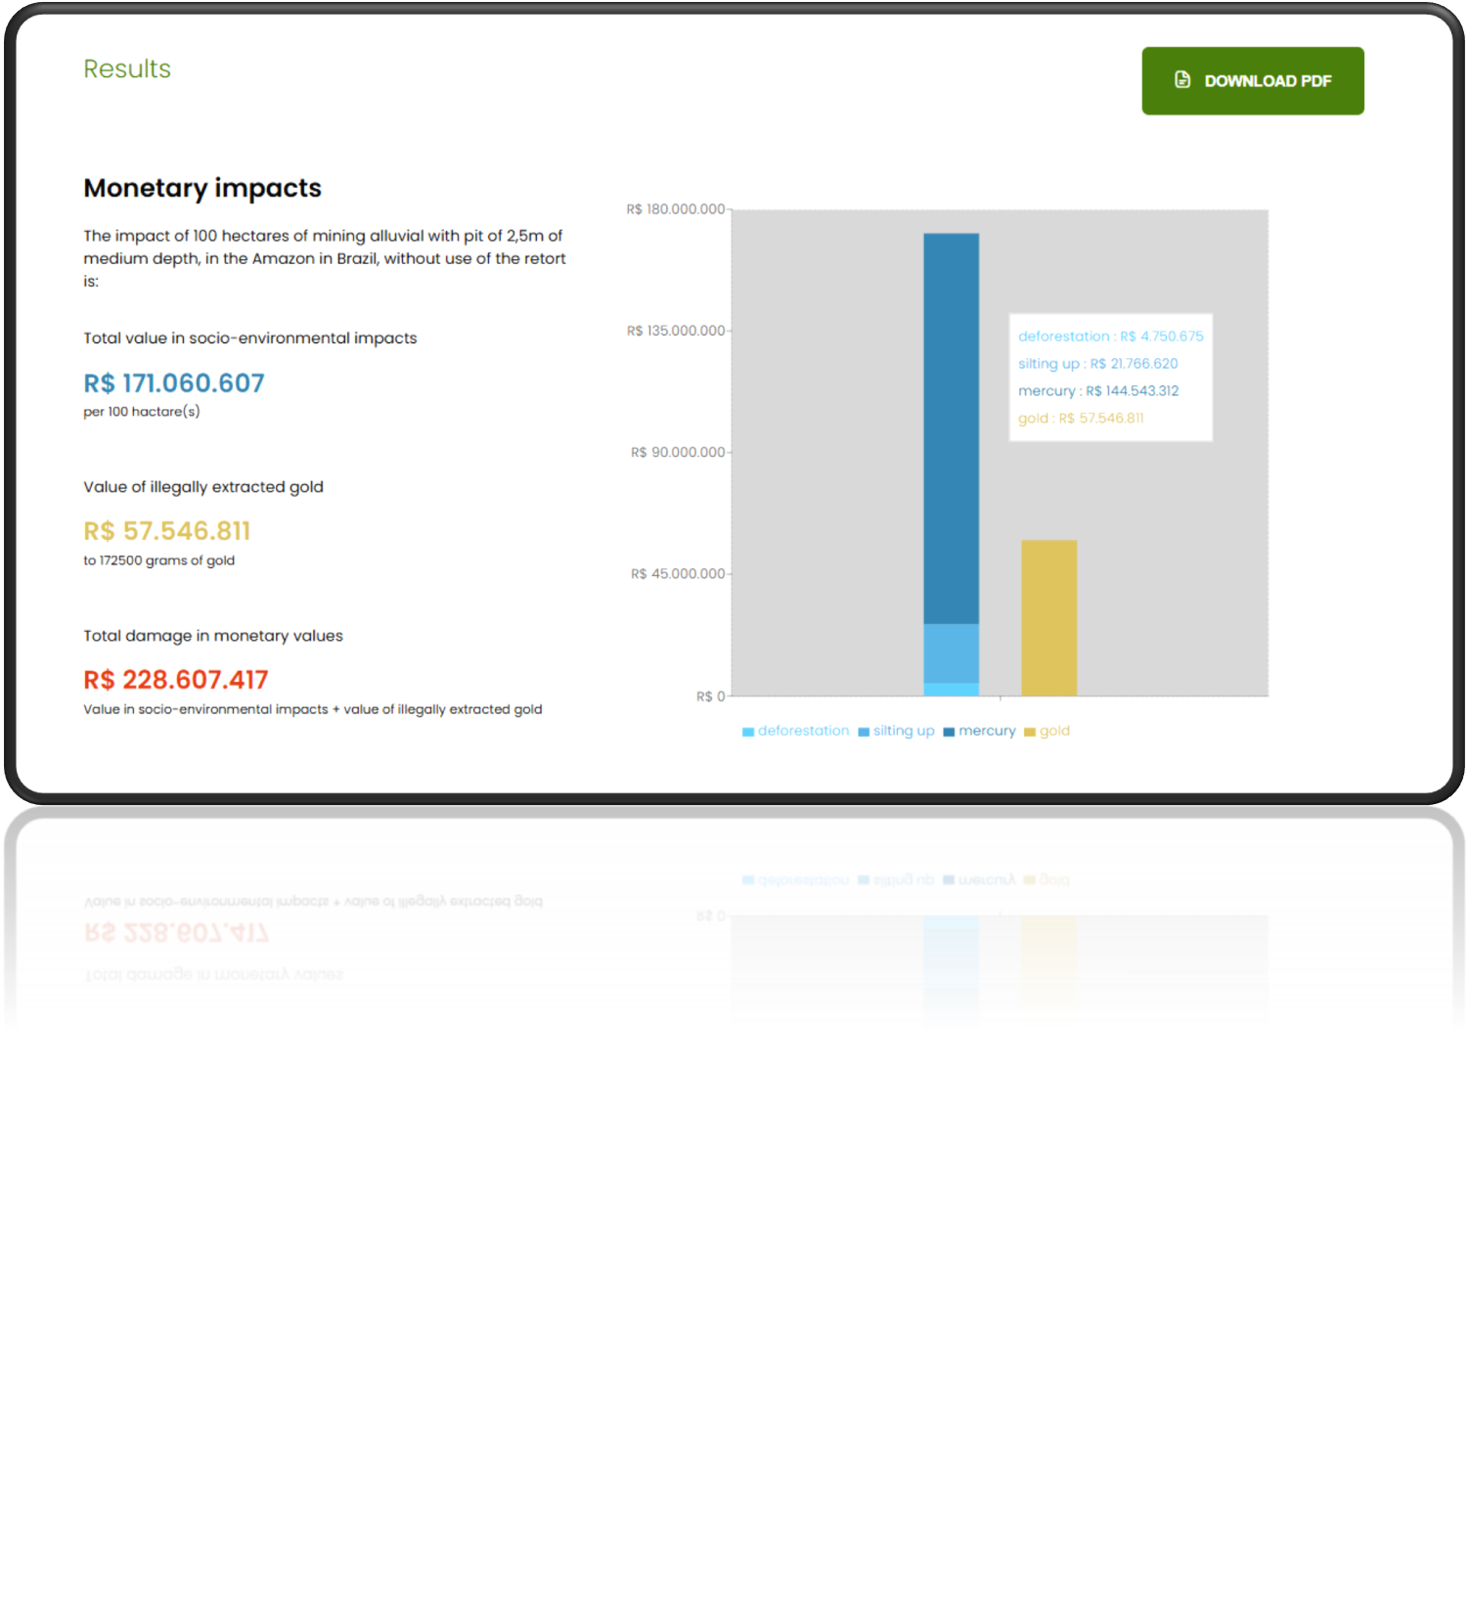

Slide 14
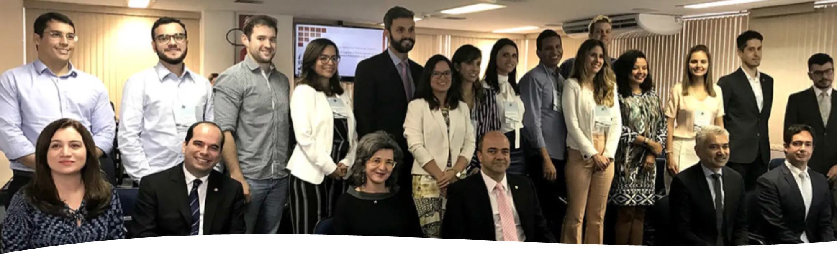
Policy Implications
•Brazilian Public Prosecutors : Adopted it as official methodology: Lawsuits worth more than US$ 9 billion
•Use case by the Federal Police and the Environmental Protection Agency at the Supreme Federal Court
•Other countries’ protection agencies to adopt the tool
•Perú, Colombia, Ecuador, Guyana, Suriname, Bolivia

Slide 15
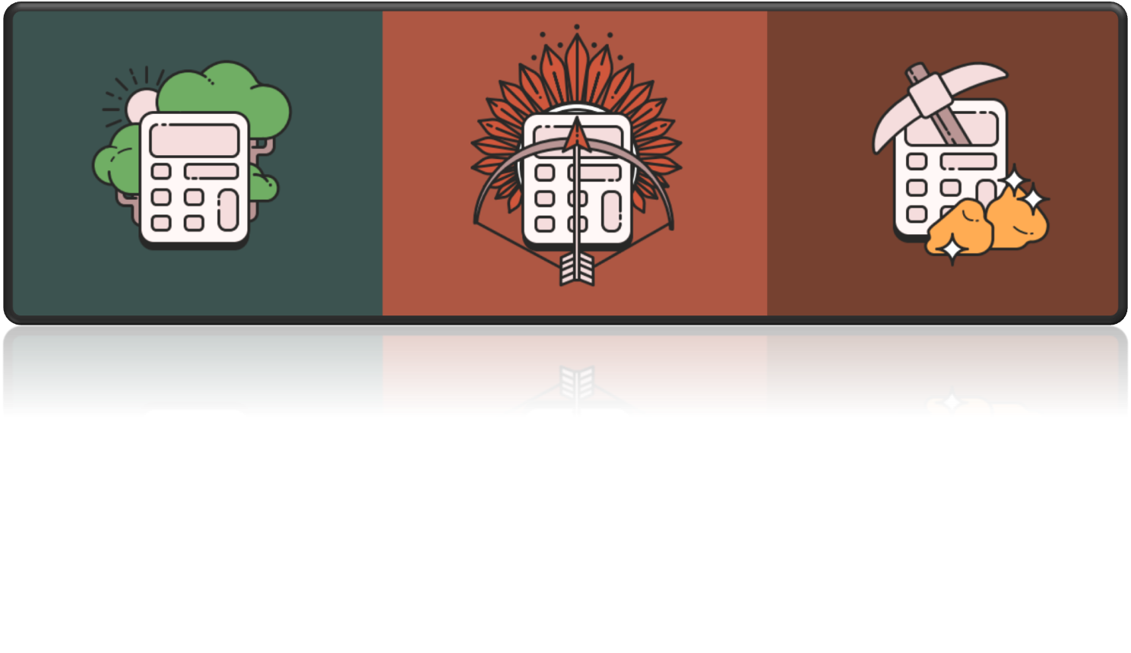
https://calculators.conservation-strategy.org/

Slide 16
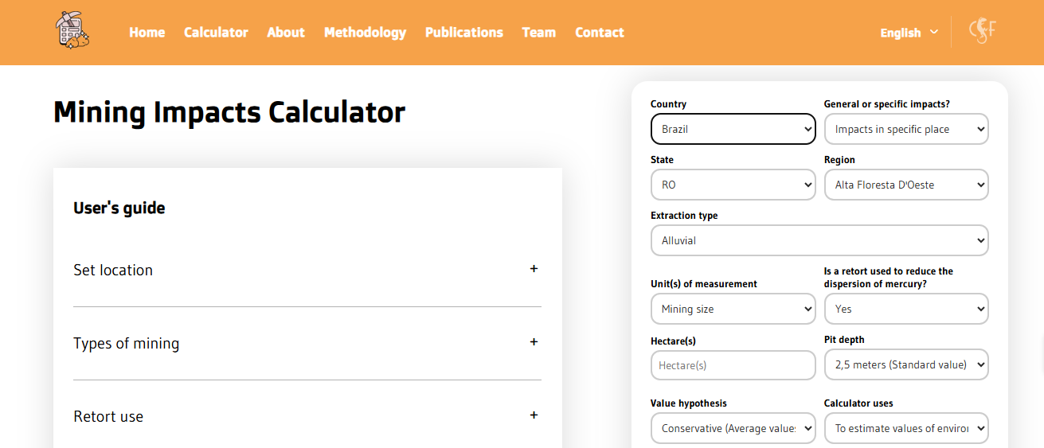
How does the Mining Impact Calculator (MIC) work?
https://miningcalculator.conservation-strategy.org/

Slide 17
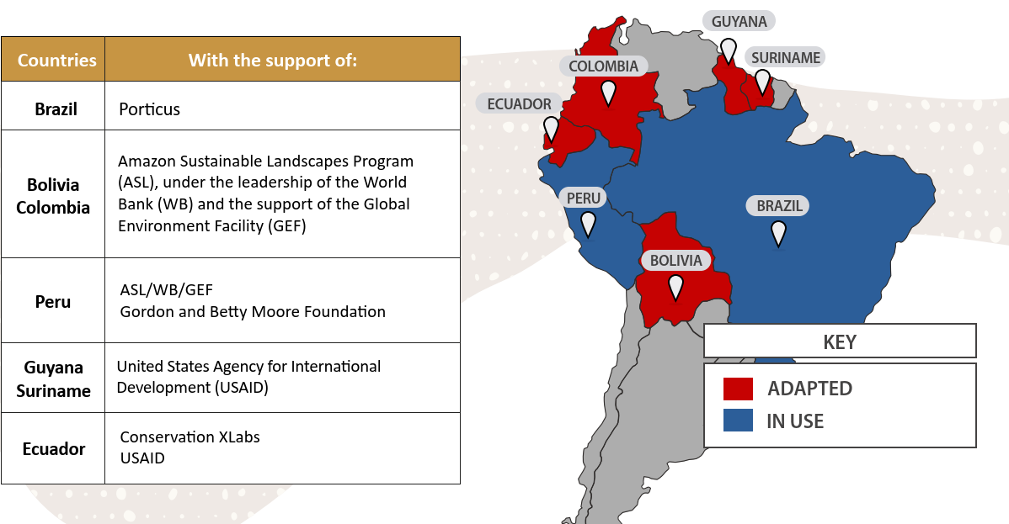
Adapting and adopting the Calculator across country contexts

Slide 18
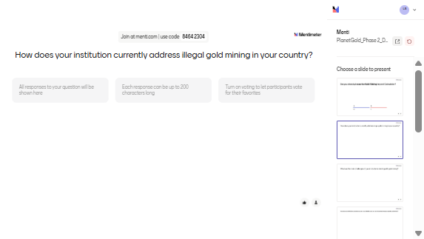
How does your institution currently address illegal gold mining?

Slide 19
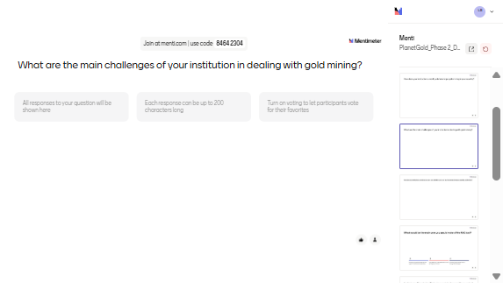
What are the main challenges of your institution in dealing with gold mining?

Slide 20
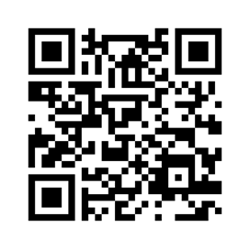

Exercise: Estimate values ​​of socio-environmental damages to calculate compensation
Scenario:
Imagine a community living in a protected area in Loreto, Putumayo, Peru, affected by an invasion of their land.
In one year of activity, the mining company illegally exploited 10 hectares of alluvial mining, with pits averaging 5 meters deep.
The miners did not use a retort in the gold amalgamation process.
Prosecutors want an estimate of this damage using maximum value assumptions, following the precautionary principle: in the case of uncertainties, it is better to overestimate than underestimate the damage.
Questions:
What is the estimated socio-environmental damage caused by these 10 hectares?
What is the value of the illegally extracted gold?
In addition to compensation to the community, prosecutors believe that, to discourage future crimes, a fine should be set at twice the value of the socio-environmental damage plus the value of the illegally extracted gold.
What would be the total value of the fine?

Slide 21
Overview of economic valuation and mining impacts for ASGM

Slide 22
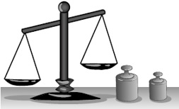
Why is it important to assign a value?
Information for decision makers
  What are the effects of ecosystem services on society?
Design Projects
  How does the project location minimize its externalities?
Design of Economic Incentives
  How much should the incentive level (PES) be to change a behavior?
Evaluate welfare redistribution
  What is the reasonable value of compensation or reparation?

Slide 23
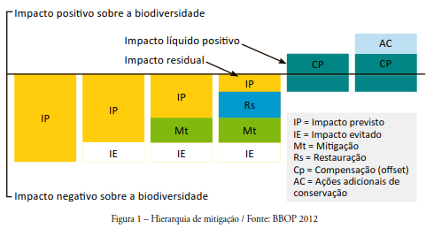
Planning perspective: Mitigation hierarchy
Positive impact on biodiversity
Net Positive Impact
Residual Impact
IP = Predicted Impact
IE = Impact avoided
Mt = Mitigation
Rs = Restoration
Cp = Compensation (offset)
AC = Additional conservation actions
Negative impact on biodiversity

Slide 24
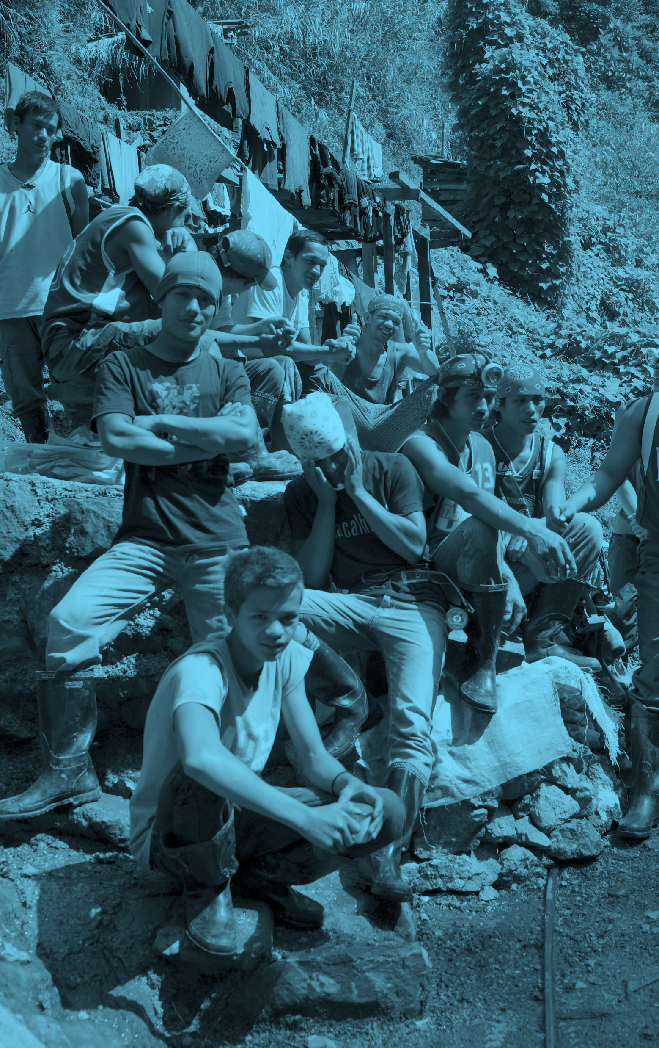

Economic Valuation: Warning
Economic valuation does not give anyone the right to violate the law.
  Compensation: Imperfect replacement
    Does not include moral damages
    A fine should be enough to prevent an illicit act
  “Prevention is better than heal” – Planning and participation as the best solution

Slide 25
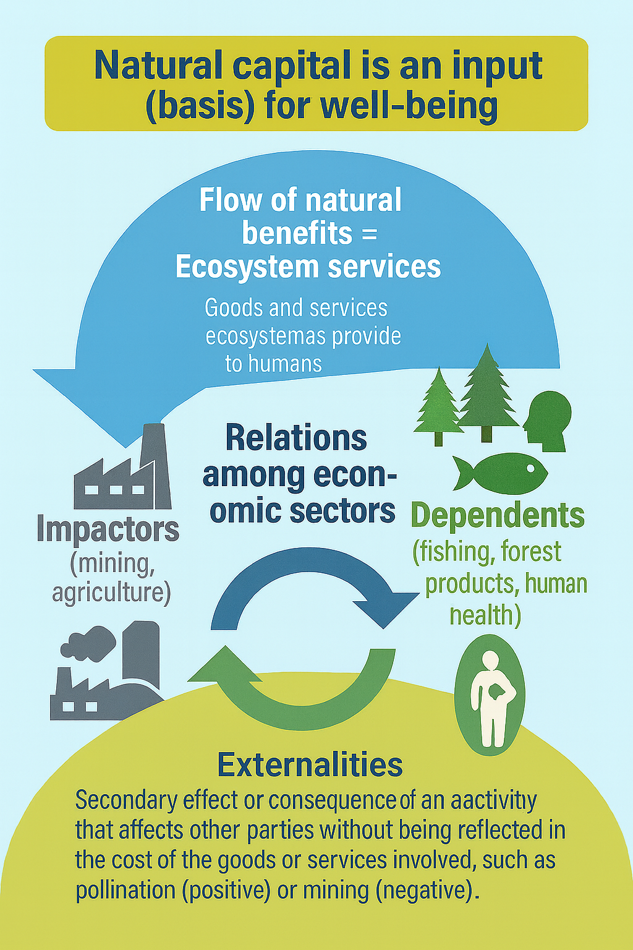
What do we evaluate?

Slide 26
Market System and Externalities
Prices can be indicators of desire and scarcity relationships, but...
Sometimes prices do not exist or are not “fair” due to issues of power asymmetries between agents or contexts
Indirect effects on others
  Costs not considered by decision maker
    Negative Externalities
    Positive Externalities
Production level is not efficient (higher or lower)
The (inefficient) price of a good does not consider all its social costs and benefits.
  Private (gold miner) x Social

Slide 27
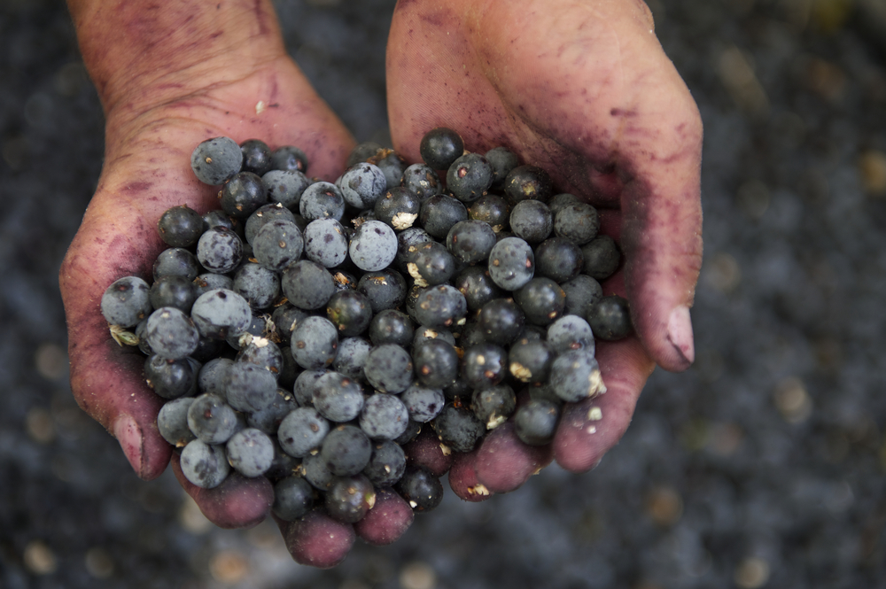
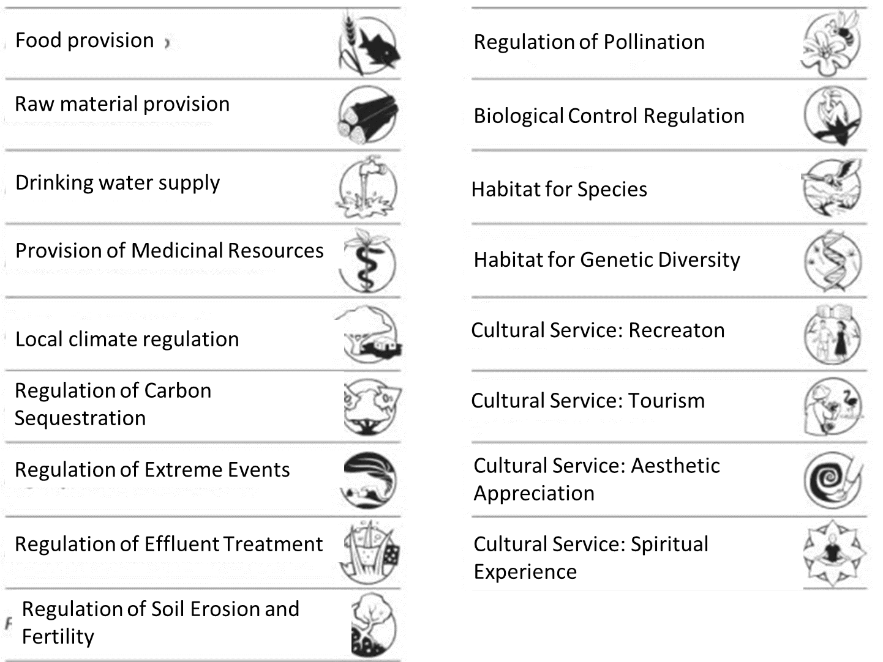
Environmental Services

Slide 28
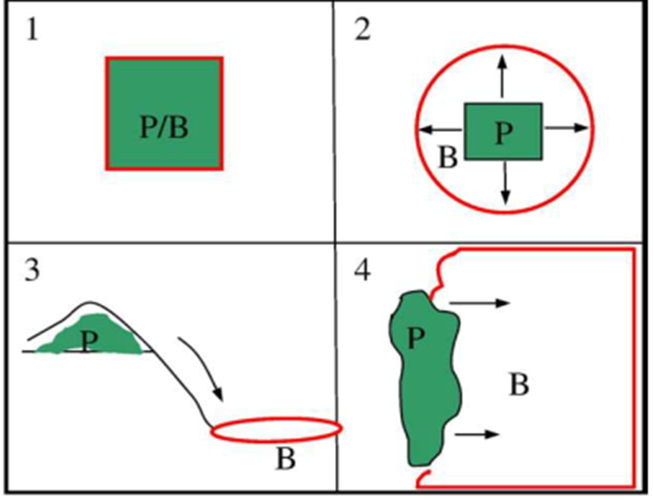
Ecosystem Services Dynamics

Slide 29
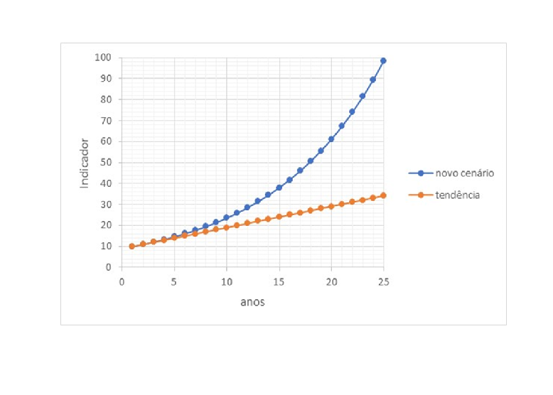
Valuation Hypothesis
Human perception of changes
  There is no absolute value of nature
  Weigh social preferences
Assessment of environmental changes
Comparison of Scenarios
With mining x Without mining
Mining with mercury x Mining without mercury

Slide 30
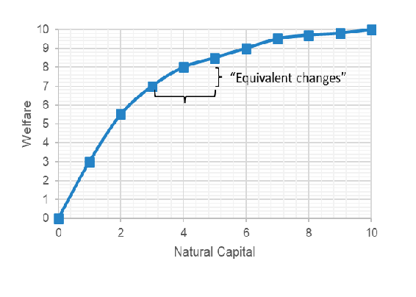
Valuation Stages: Biophysical vs Social Effects
Scenarios Comparison
1st Stage: Measure biophysical changes
  Deforestation (hectares)
  Erosion (m³)
  Mercury Contamination (sick people)
2nd Stage: Measure the social effects of these changes
  Deforestation ($)
  Erosion ($)
  Mercury Contamination ($)
Value depends on context

Slide 31
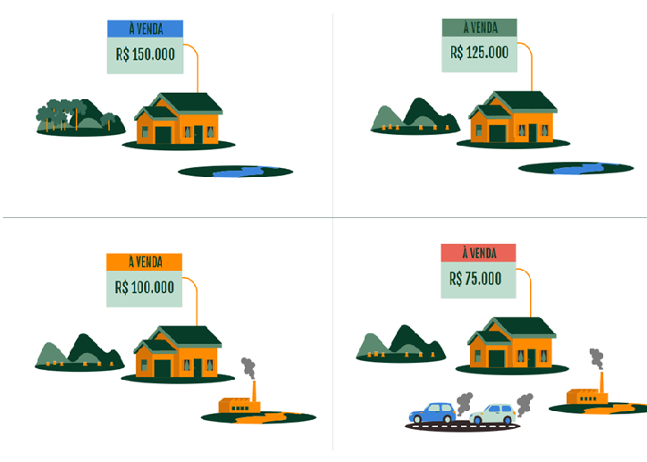
Valuation methods
Market prices (when they exist)
  Products sold in market
What we indirectly “reveal” in market purchases
  Interpretation of choices in markets (of subcomponents of real products)
What we declare important
  Surveys with simulations of plebiscites or auctions (hypothetical)
Benefit transfer
  Meta-analysis of the literature
If I cut down a tree in the middle of the Amazon rainforest, will it have the same value as a tree in a place with only one tree?

Slide 32





Types of assessment methods: Example of Change in Health
Valuation methods can be based on information about:
Market prices
Reduced income due to illness
What we indirectly “reveal” in transactions
Additional pay for risk of illness or death
What we declare important
  Willingness to pay: survey to avoid risk
Equivalent costs (which we assume are worth it)
Valuation Methods and Scenarios
Loss of Production due to absences (Salary)
Additional Salary for additional risk
Willingness to Pay for hypothetical drug
(that may be developed)
Treatment Cost

Slide 33
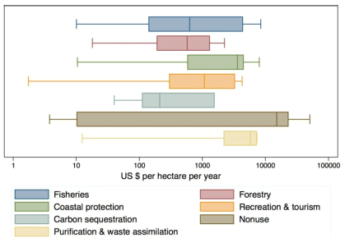
Benefit Transfer
Meta-analysis
Literature average values
Fixed by context variables
  GDP per capita; Population density; Species richness, etc.

Slide 34
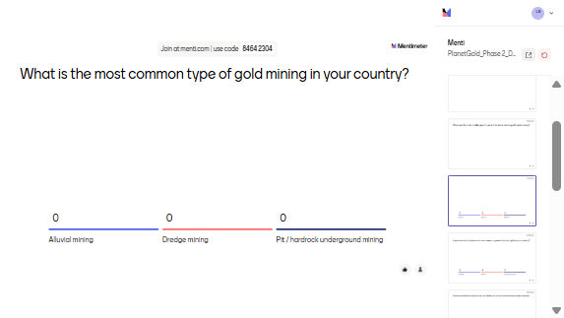
What is the most common type of gold mining in your country?

Slide 35
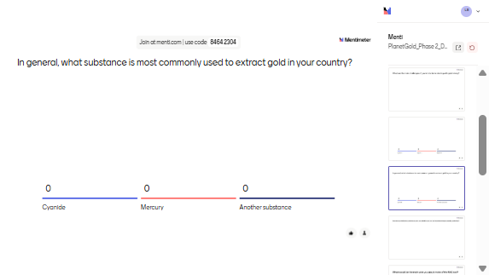
In general, what substance is most commonly used to extract gold in your country?

Slide 36
Methodology
An Overview

Slide 37
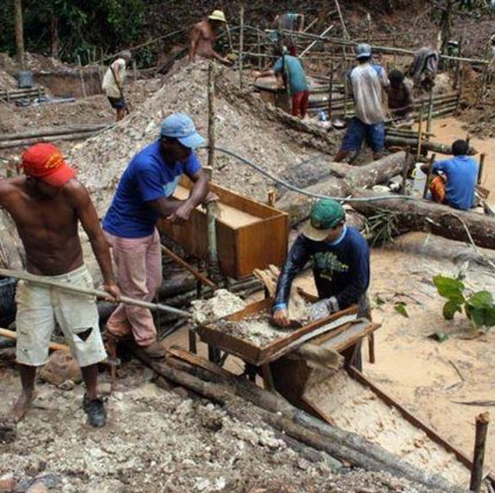
Methodology
Types of impact
    Deforestation
    Erosion and sedimentation
    Mercury contamination

Slide 38
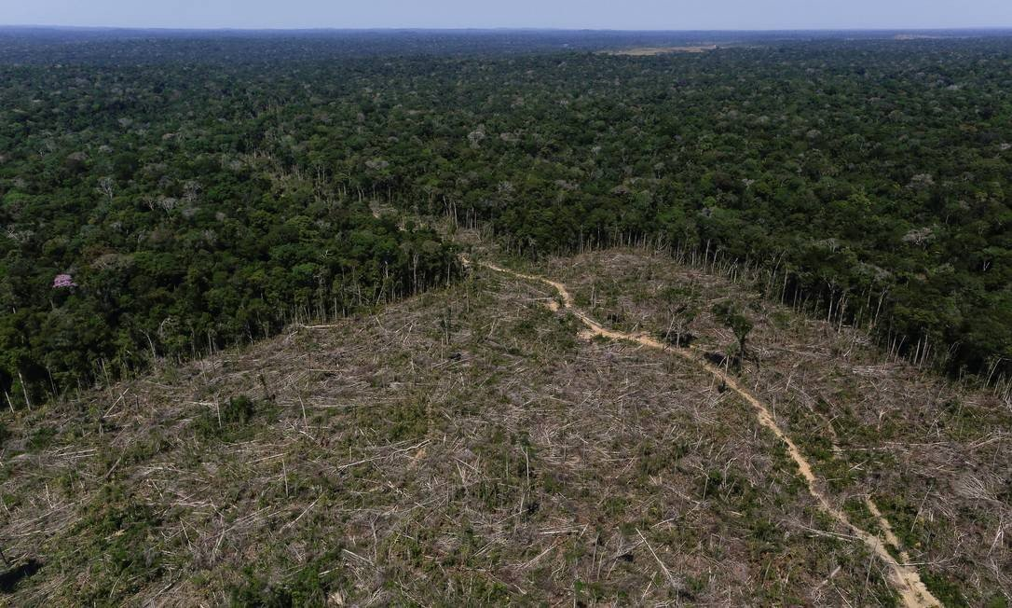
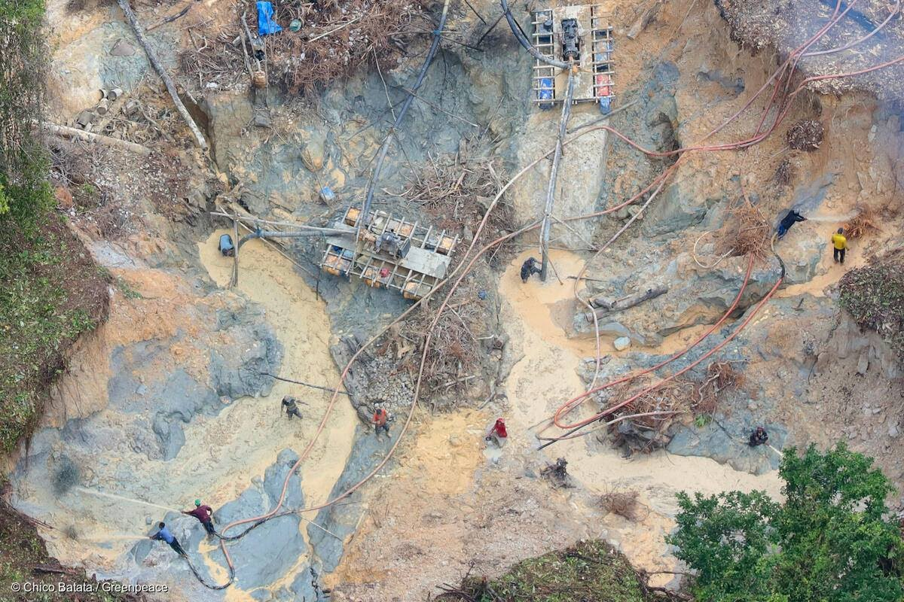
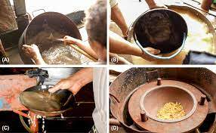
Impact Components
Deforestation
Erosion
Mercury contamination
Biophysical Impacts

Slide 39

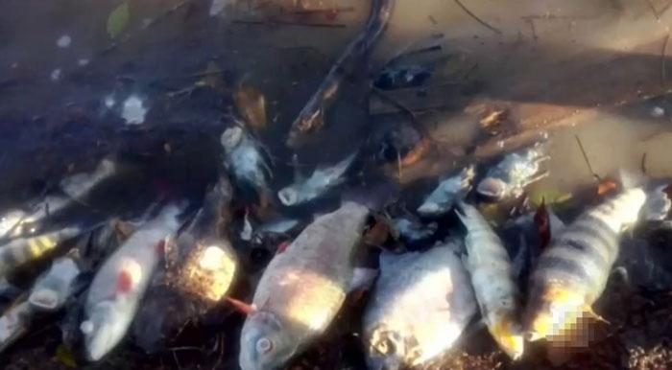
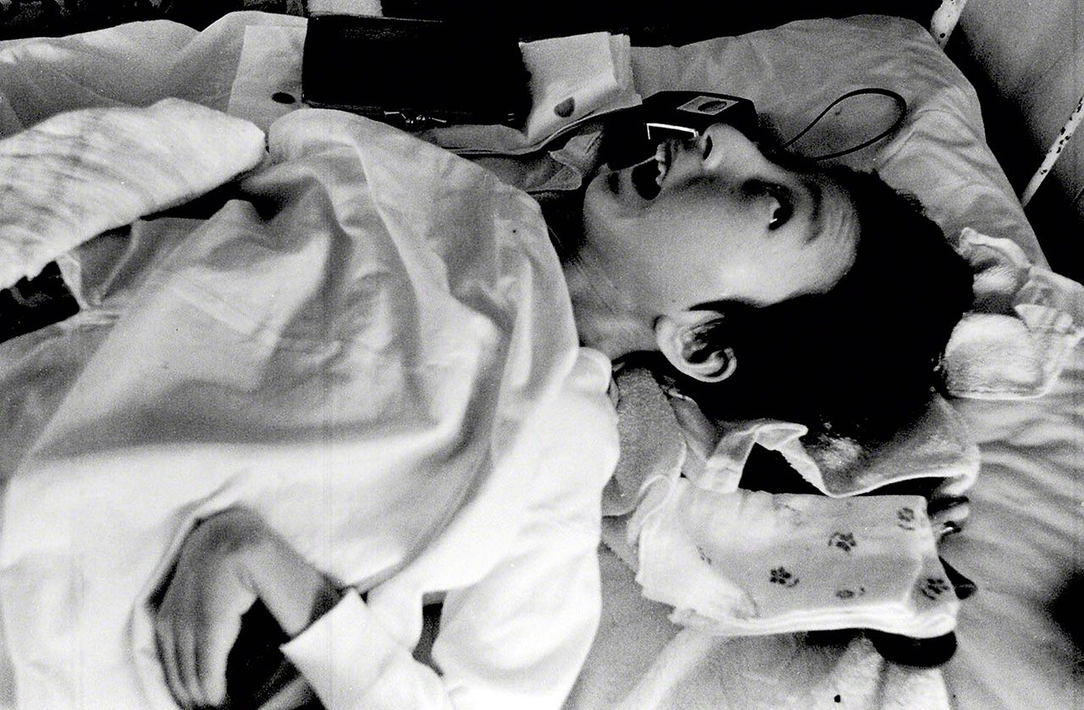
Impact Components
Deforestation
Erosion
Mercury Contamination
Biophysical Impacts
Social Consequences

Slide 40
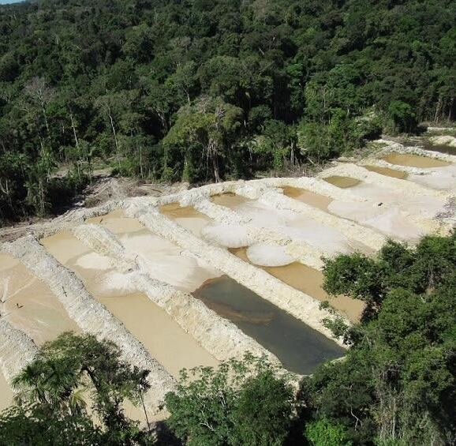
Methodology: Gold Extraction Productivity
Methodology: Productivity
Literature and interviews with miners.
Mining Area (ha)
Gold Production (kg)
Pit Depth
Mercury Use (kg)
Deforestation, soil loss
Mercury Contamination

Slide 41

Deforestation Assessment

Slide 42
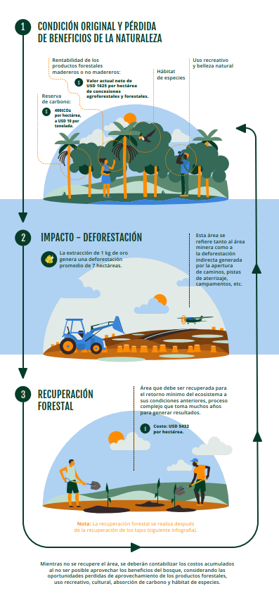
Methodology: Deforestation
Restoration Costs
    Adjusted by distance to urban centers
    80% of ES restored after 30 years
Opportunity Costs
    Meta-analysis (Siikamaki, 2015)
    Provisioning services: timber and non-timber forest products
    Climate regulation
    Others: species habitats and water-related services

Slide 43
Methodology: Deforestation
  Meta-analysis (value transfer function)
Ecosystem Service Values
Population Density
Per Capita Income
Species Richness

Slide 44
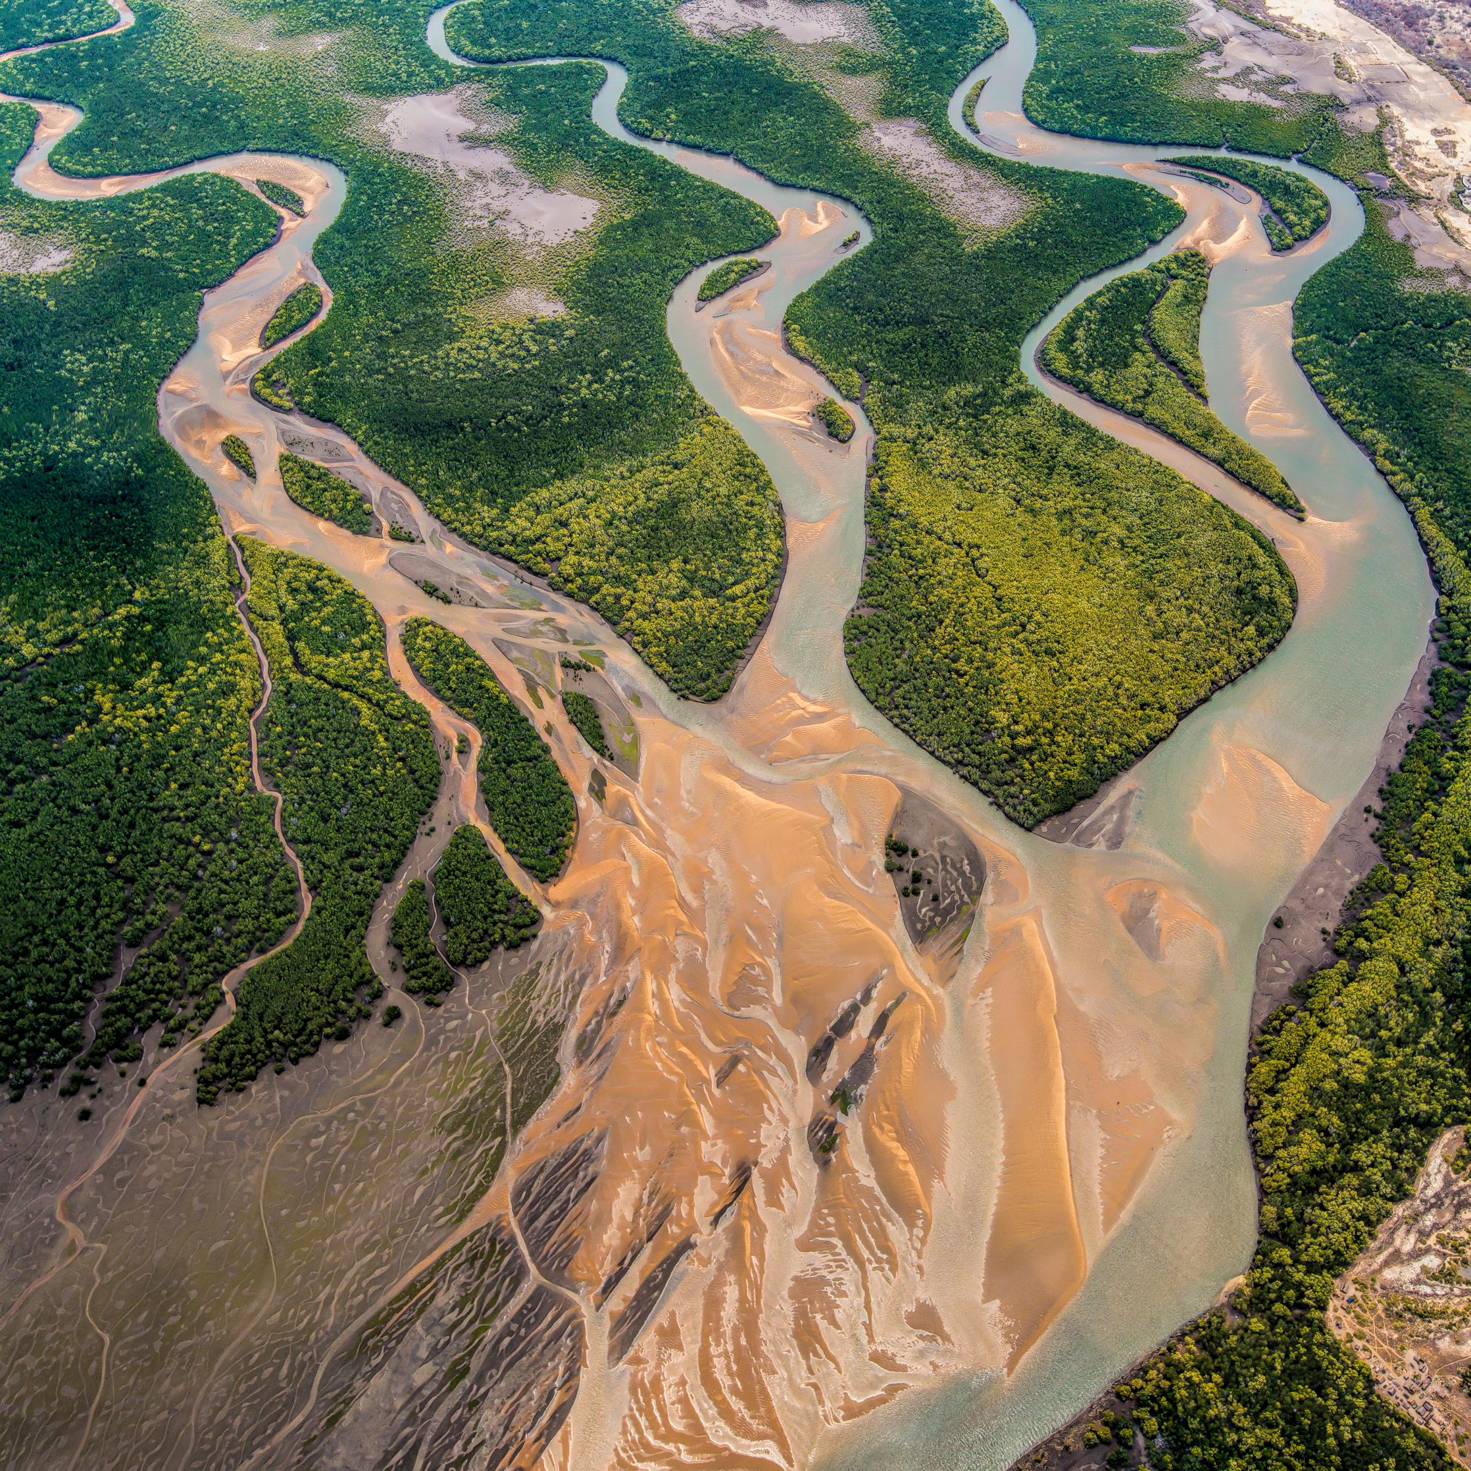
Erosion and Sedimentation Assessment

Slide 45
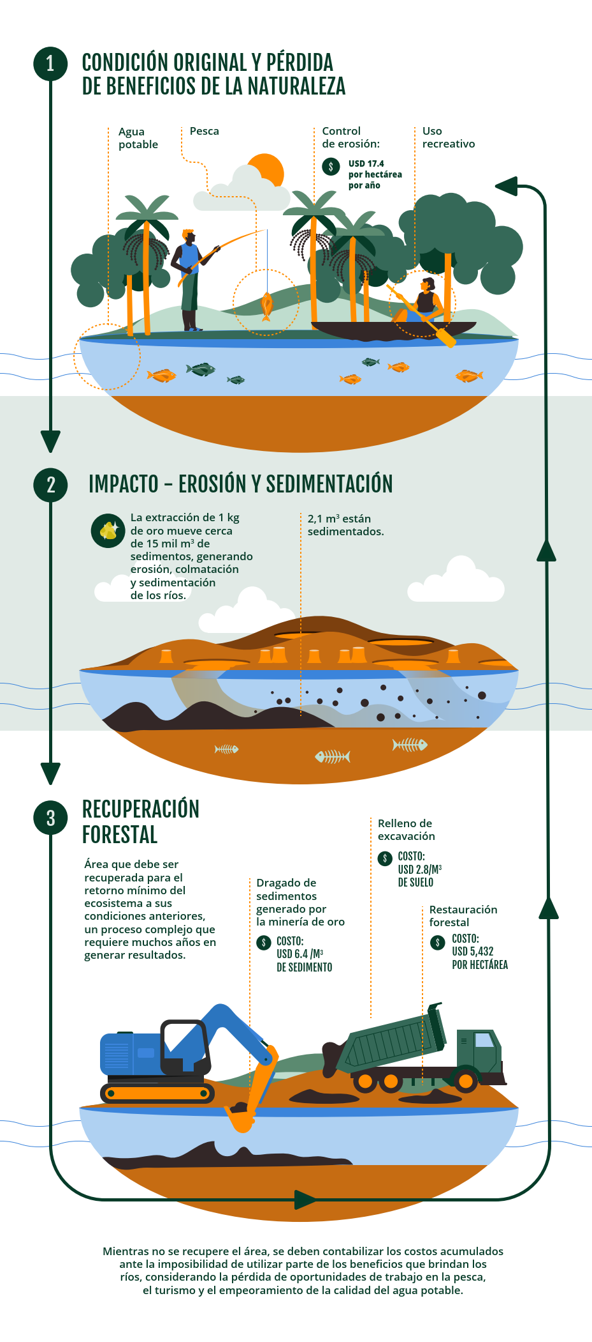
Erosion and Sedimentation Assessment
Impact | Enfoque | Specific impact
Erosion / Sedimentation | Opportunity cost | Ecosystem Services: Erosion Control
 | Restoration cost | Soil Stabilization
 |  | Sediments / Dredging / Channel Straightening

Slide 46
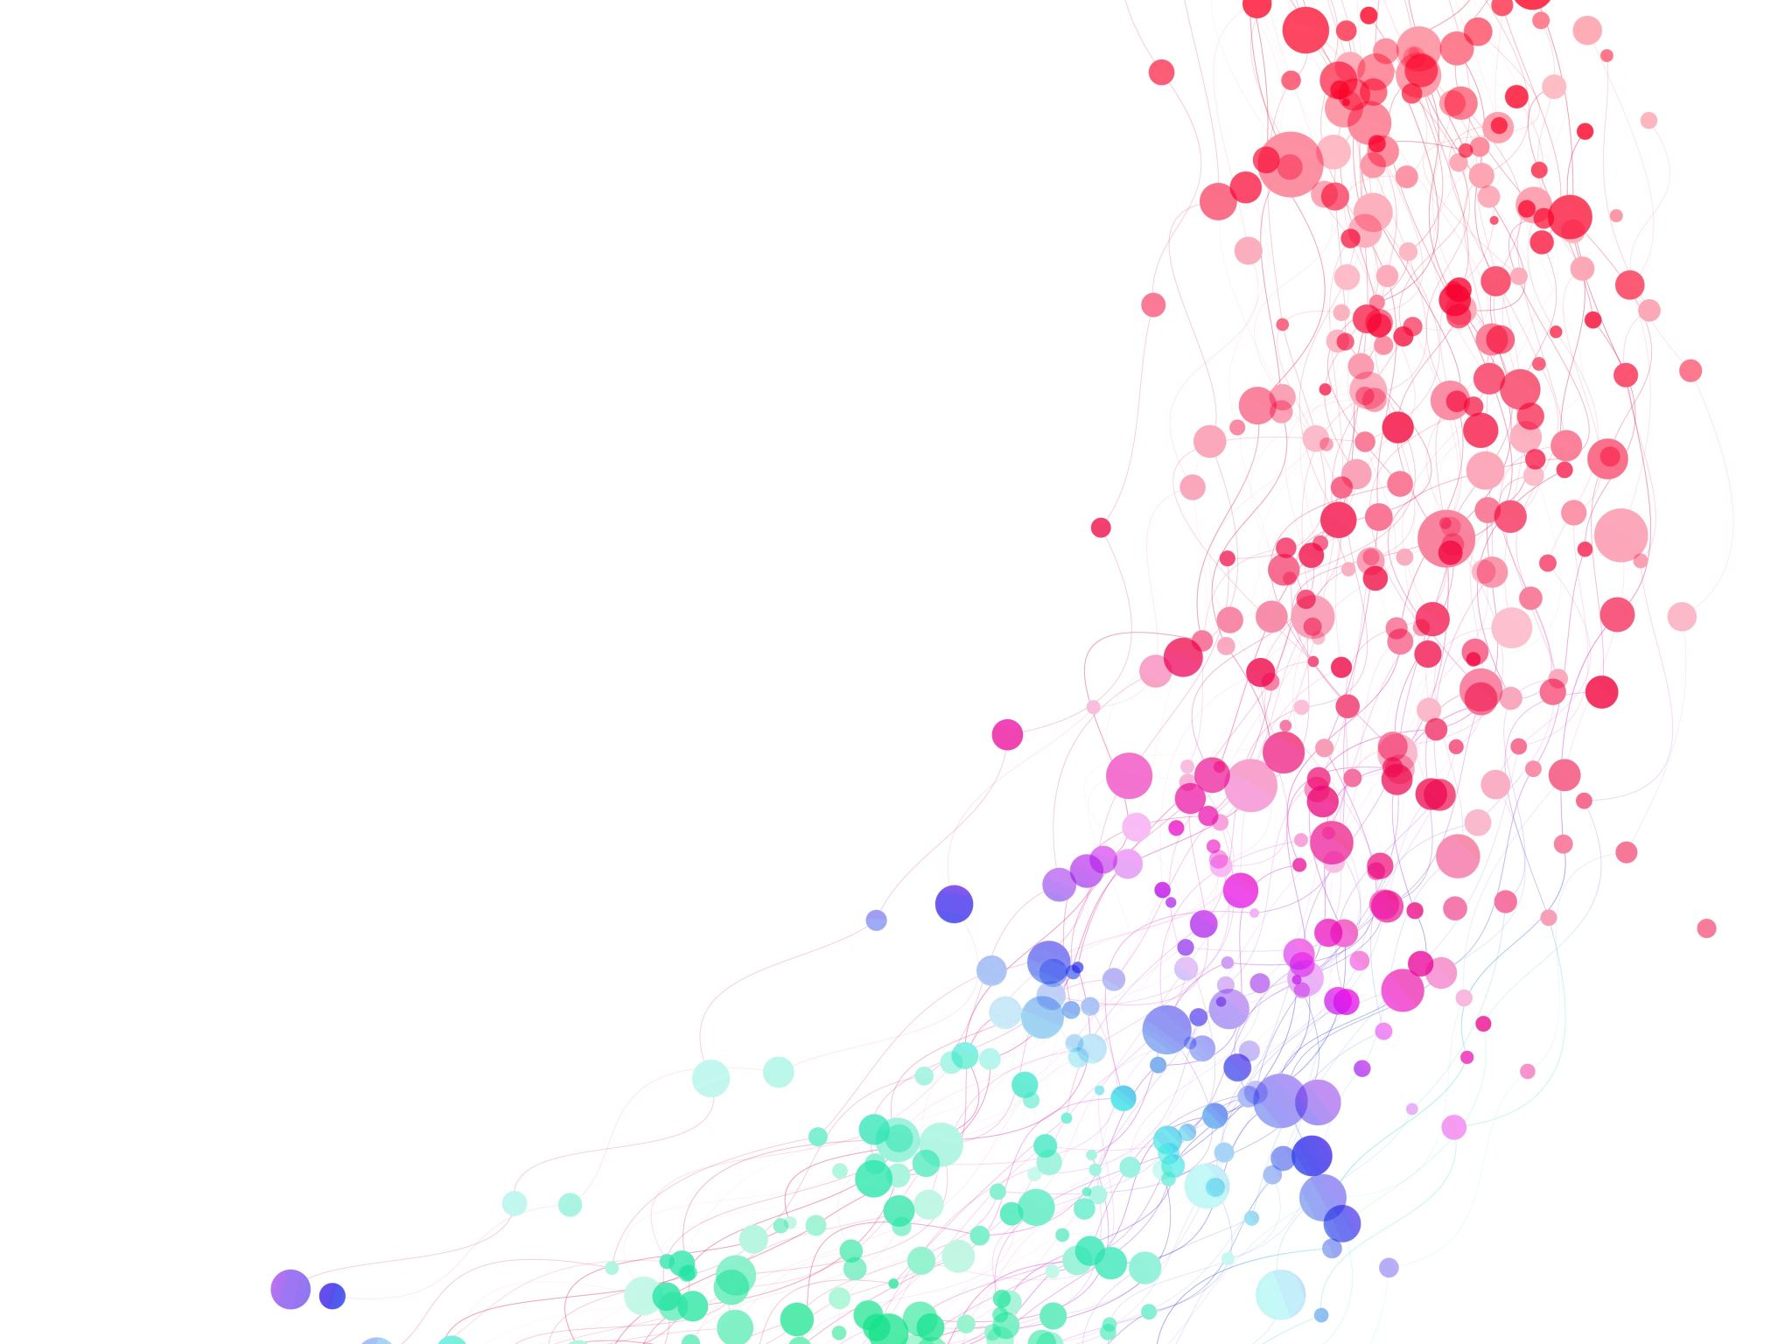
Assessment of the impacts of mercury

Slide 47
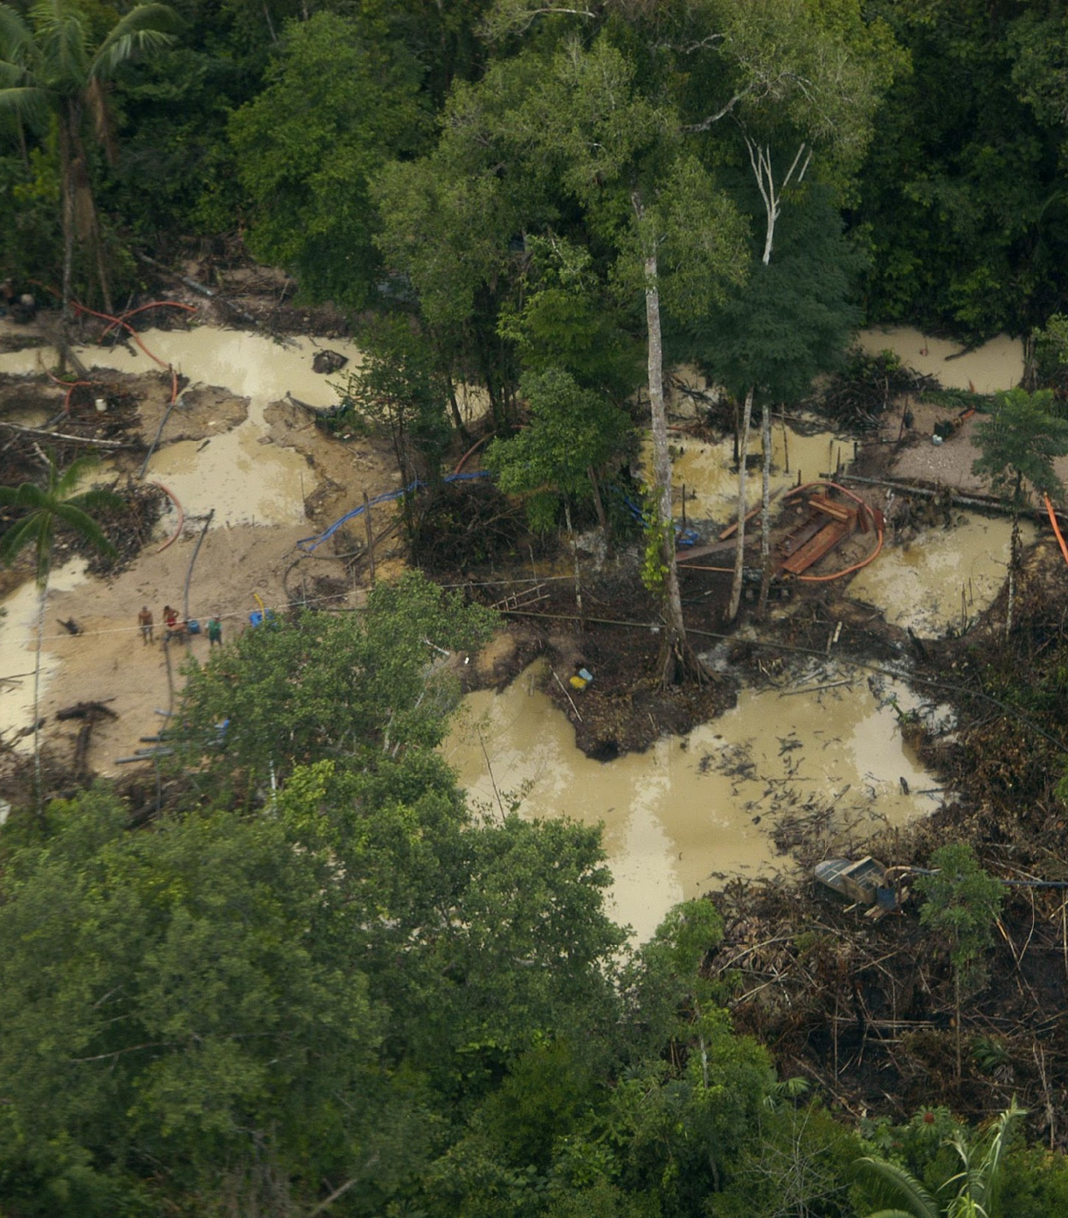
Methodology: Mercury contamination
Mercury is naturally present in the environment.
Deforestation also contributes to mercury dispersion.
How can we differentiate the sources?
How can responsibility be attributed for illegal artisanal gold mining?

Slide 48
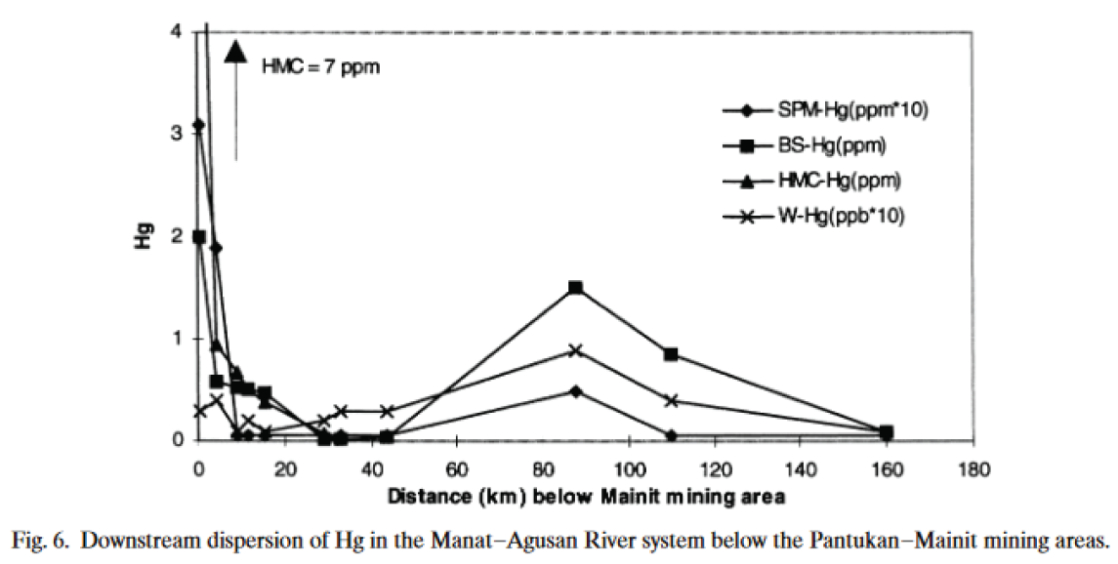
How can responsibility be attributed for illegal artisanal gold mining?
Ideal (but with no clear results)
Distance-decay function
The closer to the mining site, the higher the level of contamination.
Confounding factor: no statistical evidence
Fish can carry mercury up to 2,000 km.

Slide 49
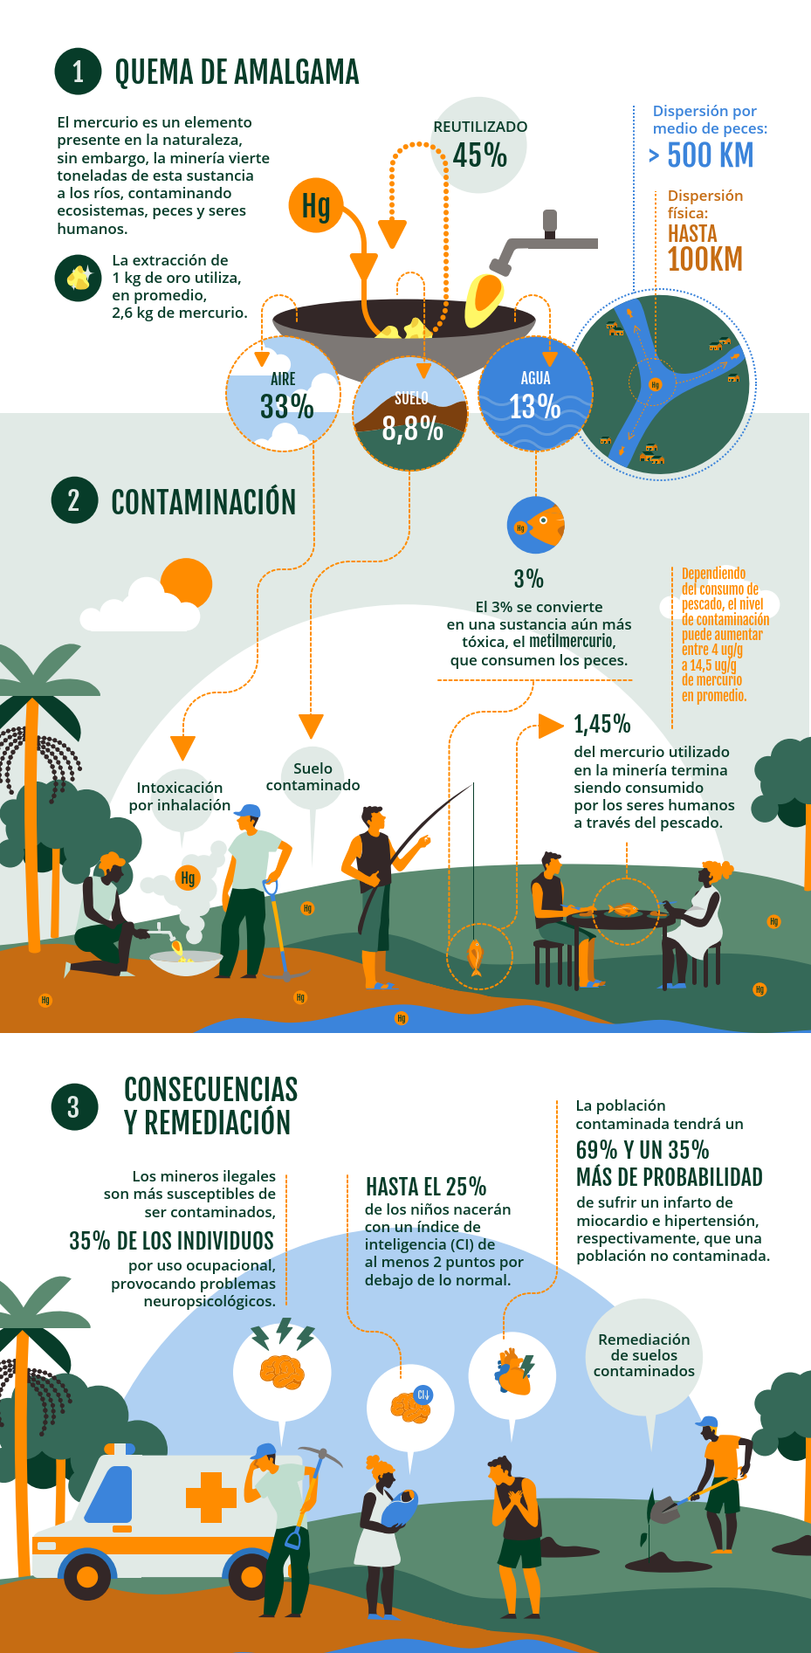
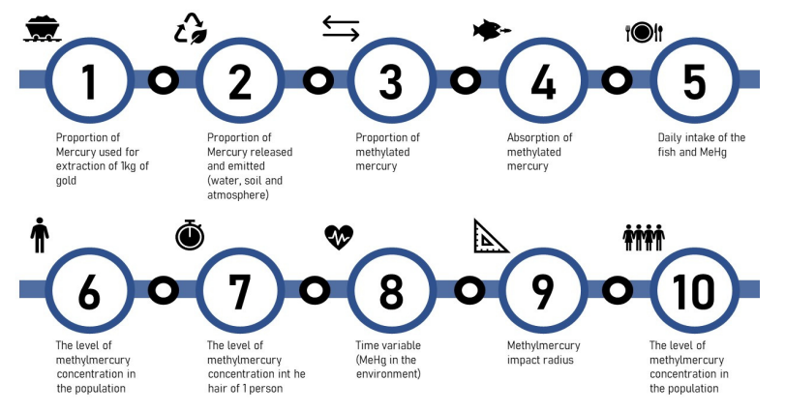
Methodology Mercury Release in the Water

Slide 50
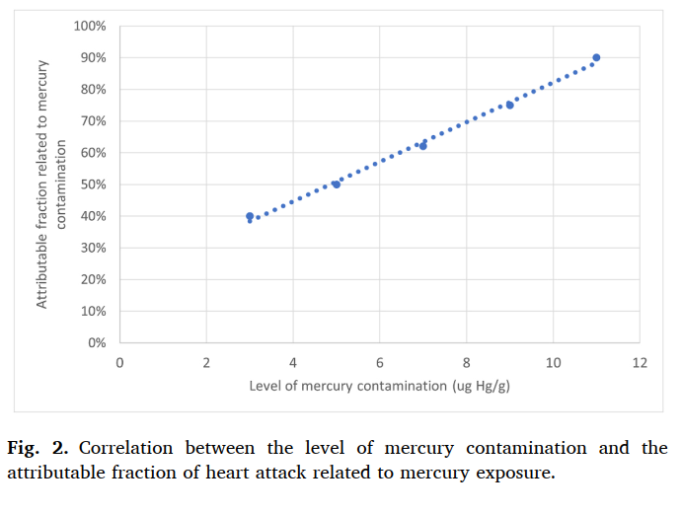
Mercury impacts
  Health Effects:
  Inhalation of airborne metallic mercury
    Neuropsychological problems in gold miners
  Health Effects: Ingestion of contaminated fish (methylmercury)
    IQ loss in fetuses
    Heart diseaseHypertension

Slide 51
Methodology: Mercury contamination
Value Transfer Function
# People Potentially Exposed
Health impacts
Population within a 100 km radius
Amount of Mercury
Average Fish Consumption
Average Body Weight of the Population
Severity of Health Impacts
Level of Fish Contamination

Slide 52
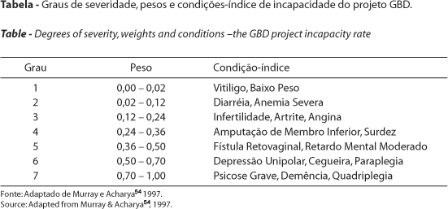
Methodology: Valuation of Health Effects
Equivalence Between DALY and VSL ($)
Disability-Adjusted Life Years (DALYs)
Value of a Statistical Life (VSL)

Slide 53
Exercise 2 Estimate investment values ​​to prevent impacts
Scenario
Currently, the government invests R$50 million annually to prevent barges from operating on the Madeira River in Humaitá, Amazonas. The environmental protection agency considers this insufficient and wants to demonstrate to the government that it would be worthwhile to increase investments to prevent socio-environmental damage.
Currently, there are still 40 dredges causing damage in the region. The environmental agency estimates that, with additional measures at an additional annual cost of R$80 million, the number of barges could be reduced from 40 to 10.
The dredges have an average power of 100 hp and do not use retorts.
For the calculations, use the "conservative value assumption" and a cumulative inflation rate of 10% since 2022.
Questions:
What is the annual socio-environmental damage caused by 40 dredges? (Ignore the value of gold)
What is the annual socio-environmental damage caused by 10 dredges?
What would be the reduction in socio-environmental impact of the most effective control action requested by IBAMA?
Is it socially efficient to increase annual government investments in prevention?
calculators.conservation-strategy.org

Slide 54
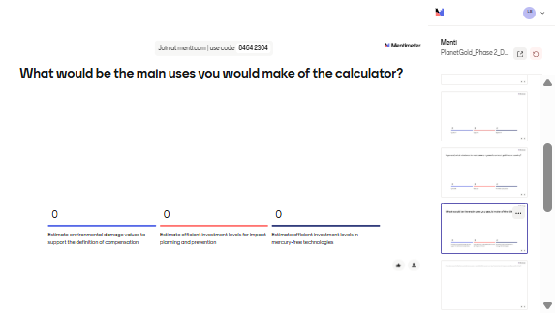
What would be the main uses you would make of the MIC tool?

Slide 55
Mini break
5 minutes

Slide 56
Case Study Presentation

Slide 57
Considerations for Building a Case Study
  1. Identify the input variables required for the tool based on the specifics of the case study.
    Extraction type (alluvial / dredge boats / underground hard rock mining)
    Units of measurement
      Amount of gold (gr)
      Mining size (ha)
      Number of ferries in 1 year
      Years of mining exploration
      Units of measurement
    Use of retort
    Pit depth (alluvial and underground gard rock mining)
    Motor power (dredge boats mining)

Slide 58
Considerations for Building a Case Study
  2. Review the internal variables of the tool that may need to be adapted to the national context.
  Gold productivity (grams of gold per ton of ore)
  Carbon Stock per Hectare (tCO2/ha)
  Value of Timber and Non-Timber Products per Hectare
  GDP per capita, population density, species richness by region (GBIF)
  Cost of Forest Restoration (US$/ha)
  Channel Straightening and River Dredging Cost (US$/m³)

Slide 59
Considerations for Building a Case Study
  2. Review the internal variables of the tool that may need to be adapted to the national context.
  Mercury-to-Gold Ratio per Gram of Gold Extracted
  Proportion of Mercury Released into Water and Sediments, and Emitted into the Atmosphere (%)
  Methylation Rate (%)
  Average Body Weight (kg/person) and Fish Consumption Level (kg per capita)
  Level of Mercury Contamination in Fish (ug Hg/g peixe)
  Life Expectancy (Men) / Life Expectancy (General Population)
  Mercury Concentration in Soil (gr Hg/ tons of soil

Slide 60
Federal Prosecution Service (MPF) vs. Financial Institutions (DTVMs) - Brokerage and Securities Distribution Institutions
Focus of the Action
Not directed at individual miners, but at financial intermediaries (DTVMs) in the supply chain
Operated in Itaituba, Jacareacanga, and Novo Progresso, main hotspots of illegal mining
Institutions could face fines of R$ 10.6 billion for social and environmental damages (using the MIC)
Strategic Legal Action
In 2021, the Federal Prosecution Service (MPF) filed lawsuits to suspend the operations of three financial institutions (FD’Gold, Carol, OM)
Accused of introducing 4.3 tons of illegal gold into national and international markets (2019–2020)

Slide 61
Federal Prosecution Service (MPF) vs. Financial Institutions (DTVMs) - Brokerage and Securities Distribution Institutions
Methodology and Evidence
Based on satellite imagery, public mineral data (CFEM, ANM), and field studies
Collaboration with the Federal University of Minas Gerais (UFMG)
Found that 58.4% of the gold in Pará had false origins or came from intact forest areas without valid mining titles
Socio-environmental Impact
Gold laundering facilitates the expansion of illegal mining in Indigenous Lands (Munduruku, Sai-Cinza)
Fuels organized crime, violence, and human rights violations
The MPF demands the “suffocation of the market” for illegal gold to break the supply chain

Slide 62
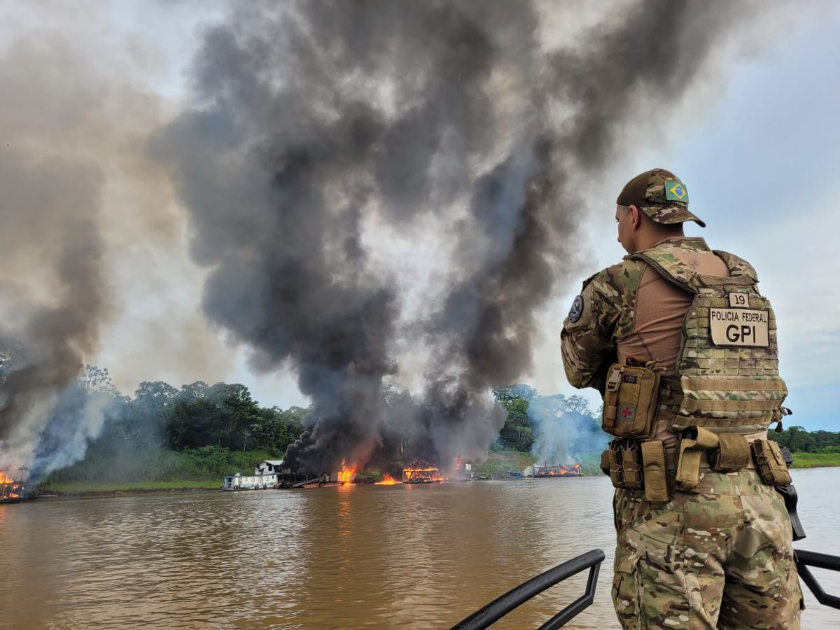
Case study
Tri-Border Area between Brazil, Peru, and Colombia

Slide 63
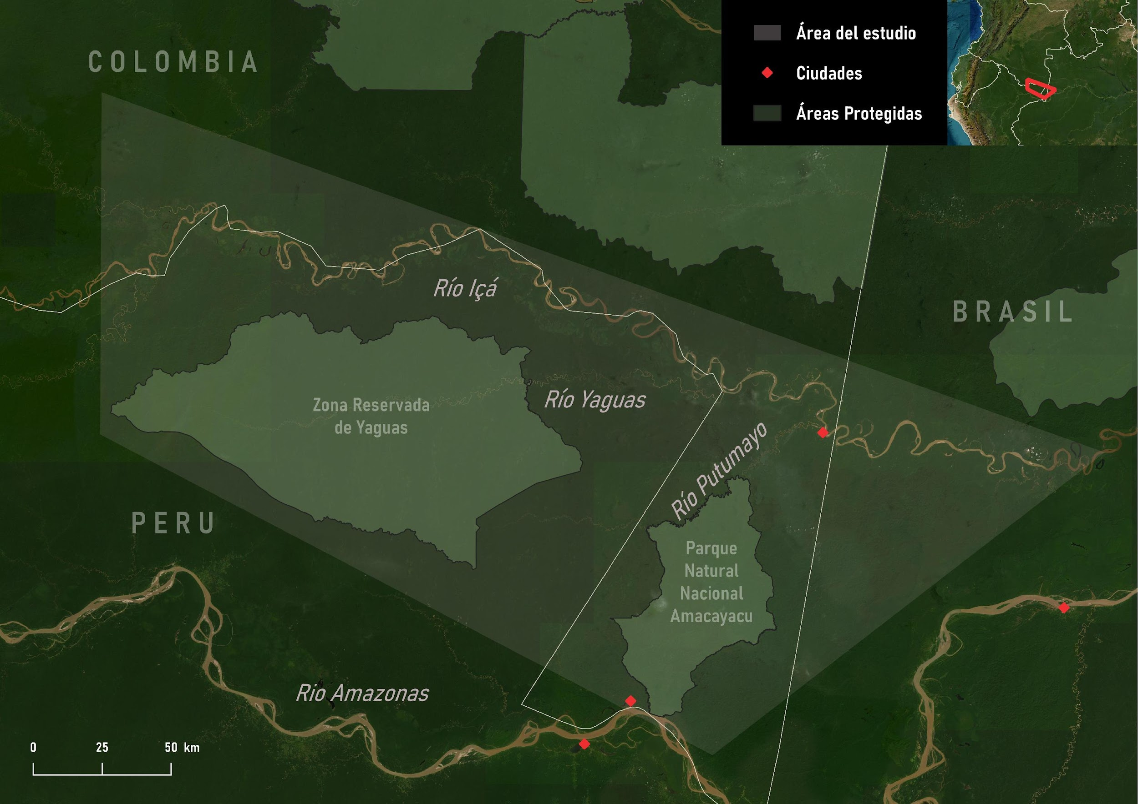
Study Area
Tri-border area between Brazil (Santo Antônio do Içá and Tabatinga), Peru (Loreto), and Colombia (Amazonas)
Around four Indigenous ethnic groups inhabit the region
Extensive mining activity using dredges, near Amacayacu National Natural Park (PNN Amacayacu)

Slide 64

Expansion of Illegal Mining Activities
A more homogeneous distribution of illegal mining sites was observed across the three territories.
To account for the two observed patterns, it was decided to conduct two separate analyses: one for 2021 and another for 2022.

Slide 65

Scenario 1
(2021)
The impacts were calculated in 2021;
2 dredging points in Peru, 4 in Colombia, and 15 in Brazil: a total of 21 dredges.

Slide 66


Results
Scenario 1
Non-monetary impacts
Number of ferries | 21
Total gold amount (30 ferries in 1 year) | 252
Gold production (kg) | 108
Removed Sediments (t) | 4.192.559
Mercury Released into Rivers(kg) | 5
Monetary impacts (USD)
River Sedimentation | 1.364.480
Risk of Cardiovascular Diseases | 17.654.997
Neuropsychological Symptoms | 1.532.400
Gold value | 6.106.284
Total | 26.658.164

Slide 67

Scenario 2
(2022)
The impacts were calculated in 2022;
10 dredge points in Colombia and 51 in Brazil: 61 dredges in total

Slide 68
Results
Scenario 2
Impactos no monetários
Número de balsas | 61
Total de extracción de oro (30 balsas operando por 1 año) | 360
Producción de oro (kg) | 327
Sedimentos retirados (t) | 12.718.829
Mercurio vertido em ríos (kg) | 16
Impactos monetários (USD)
Sedimentación de ríos | 2.262.148
Riesgo de enfermidades cardiovasculares | 58.386.887
Síntomas neuropsicológicos | 4.561.829
Oro | 18.572.293
Costo total | 83.783.158

Slide 69
Case study - conclusion
  The Illegal Gold Mining Impact Calculator is intended to serve as a basis for judging cases related to this issue.
  Total economic damages for each case study ranged from 57 to 135 million USD
  The loss of societal well-being caused by the impacts of illegal mining activities is one of the key reasons why this tool is so important.
  It is also worth highlighting the calculator’s potential if automatically integrated into a dredge detection system, such as the one used by the Brazilian Federal Police. This would allow for rapid assessment of mining impacts, supporting the work of enforcement authorities and generating real-time results.

Slide 70

How does your institution currently measure or calculate the social and environmental damages caused by illegal gold mining?

Slide 71
Context and current limitations of the tool
- Designed for the Amazon region at this stage.
Focused on the three most common types of artisanal mining in the Amazon.
Currently estimates only health impacts related to mercury exposure → Other substances such as cyanide are not yet included in the economic valuation.
Moral damages are not considered.
Estimates of the impacts of social conflicts are not included.
Atmospheric mercury emissions and their effects on the general population are not yet quantified.

Slide 72

What would need to be adapted for this approach to be relevant locally?
Input variables (e.g., mercury use, population exposure, gold yields)
Institutional alignment and capacity to use the tool
Communication and framing to fit national policy priorities

Slide 73

Case Study Q&A /Discussion
Lessons learned from the case study and how they can inform future implementation efforts.

Slide 74
Who would like to volunteer to bring maps for our next session?
- Additional context (e.g., photos)
- Information on which institutions are involved in regulating/organizing gold mining in your country
- Any available maps, as well as an estimate of the scale (hectares, number of dredges/rafts, etc.)
- What are the dilemmas faced in the region?

Slide 75
Thank you.

