Slide 1









Évaluation économique de l'impact de l'exploitation aurifère illégale
7 Octobrre 2025
Évaluation des impacts de l'exploitation artisanale de l'or
Jour 1
Supported by:
Led by:
In partnership with:

Slide 2

Bienvenue à la série de webinaires de la Phase 2 – Souvenez-vous de la Phase 1
Phase 1 : 10 et 14 juin 2024
  Expliquer le fonctionnement du Calculateur d’Impacts Miniers (MIC)
  Décrire les différents types d’impacts mesurés
  Présenter des exercices pour explorer différents contextes d’utilisation du MIC
Phase 2 : Approfondissements sur l’exploitation minière artisanale et à petite échelle de l’or (EMAPE)
  Renforcer la compréhension des participants sur les impacts environnementaux et sociaux de l’exploitation aurifère
  Améliorer l’utilisabilité du Calculateur d’Impacts Miniers (MIC), y compris l’exploration d’adaptations potentielles pour différents contextes des pays PlanetGOLD
  Identifier les principaux défis liés à l’adoption et à l’application du MIC à travers des exercices pratiques et des discussions interactives

Slide 3
Bienvenue à la série de webinaires de la Phase 2 – Présentations
Faisons connaissance !
Merci de partager dans le chat ou d’ouvrir votre micro :
Votre nom
Votre pays
Votre rôle ou poste
Et un point que vous souhaitez partager (par exemple : votre intérêt pour le sujet, vos attentes pour la session, ou un lien avec l’EMAPE)

Slide 4
Bienvenue à la série de webinaires de la phase 2 – Règles
Bien que nous ayons quelques présentations, cette session est conçue pour être interactive et engageante.
Nous utiliserons une variété d’approches, notamment :
  Des dynamiques de groupe pour encourager la participation et l’échange
  Des exercices pratiques pour explorer les concepts clés et les outils
  Des discussions ouvertes pour partager des expériences et réfléchir ensemble
  Mentimeter pour recueillir vos impressions et contributions en temps réel

Slide 5
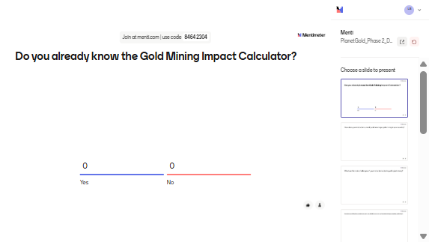
Do you already know the Gold Mining Impact Calculator?

Slide 6
Mining Impact Calculator
An overview

Slide 7
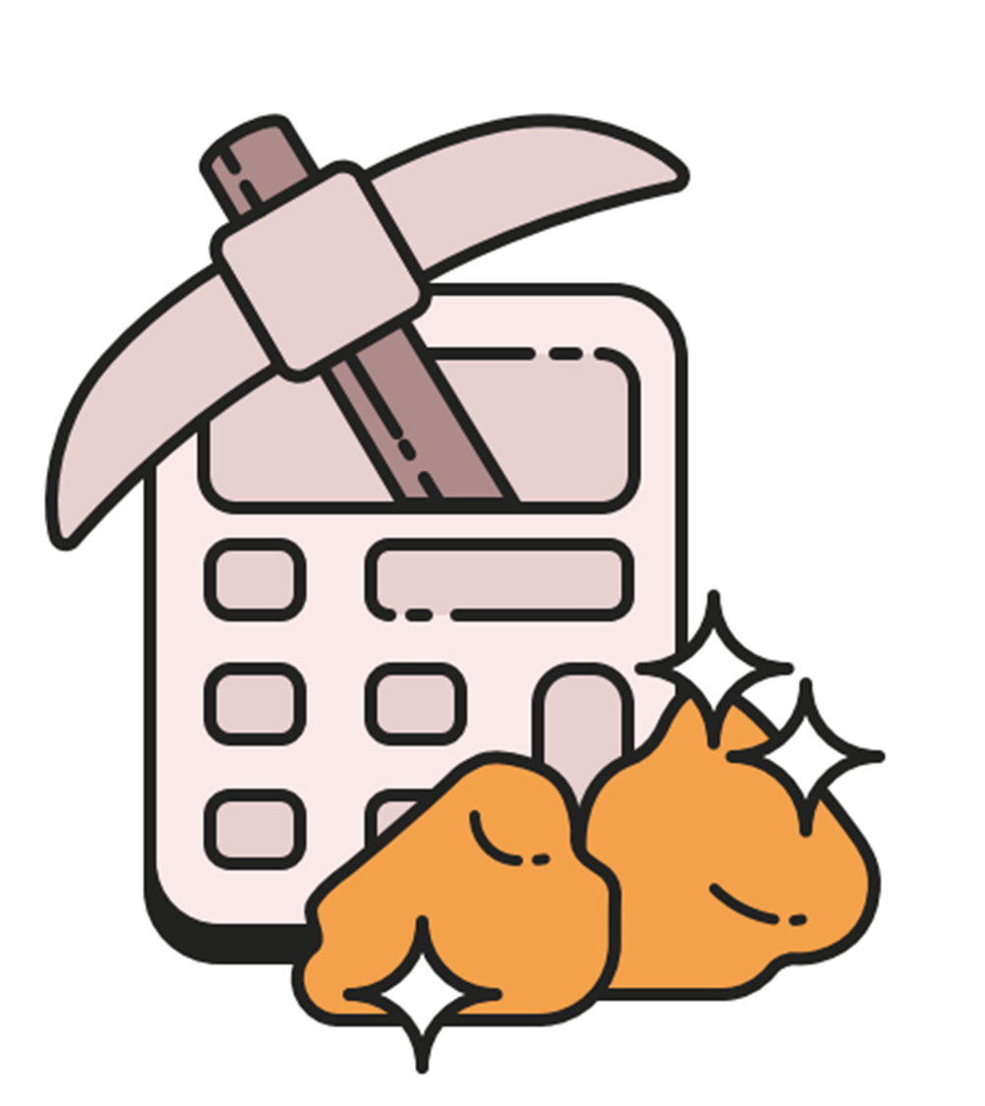
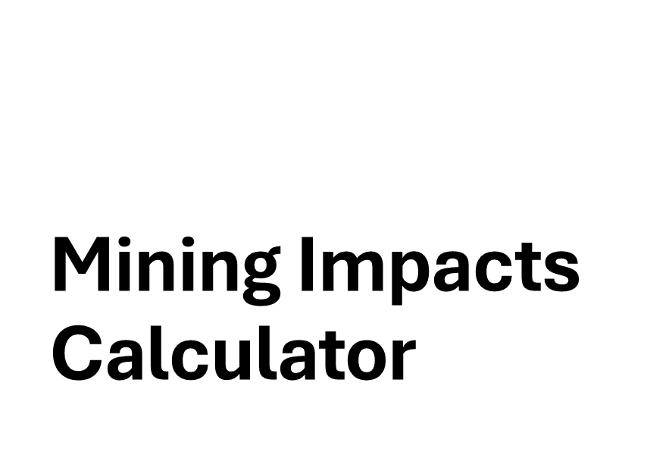

Slide 8
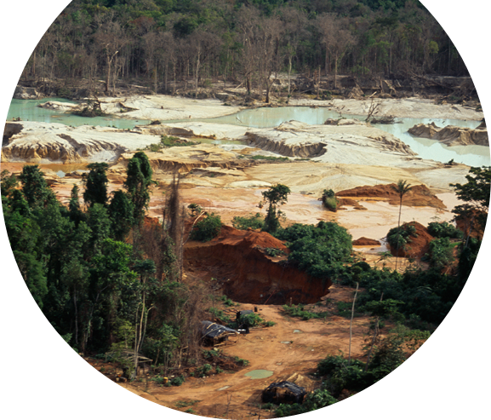
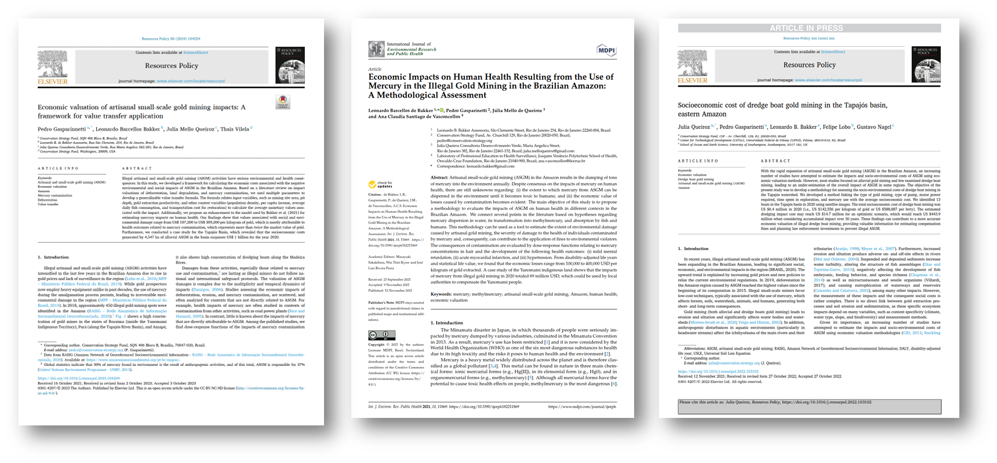
Calculateur des impacts miniers
Lancé au Brésil en 2021
  Partenariat avec le Ministère Public Fédéral (MPF)
Soutien au gouvernement pour calculer
  Les amendes environnementales
  Les bénéfices d’une meilleure protection
Premier outil pour évaluer les impacts du mercure + l’érosion + la déforestation
Méthodologie publiée dans trois revues académiques

Slide 9
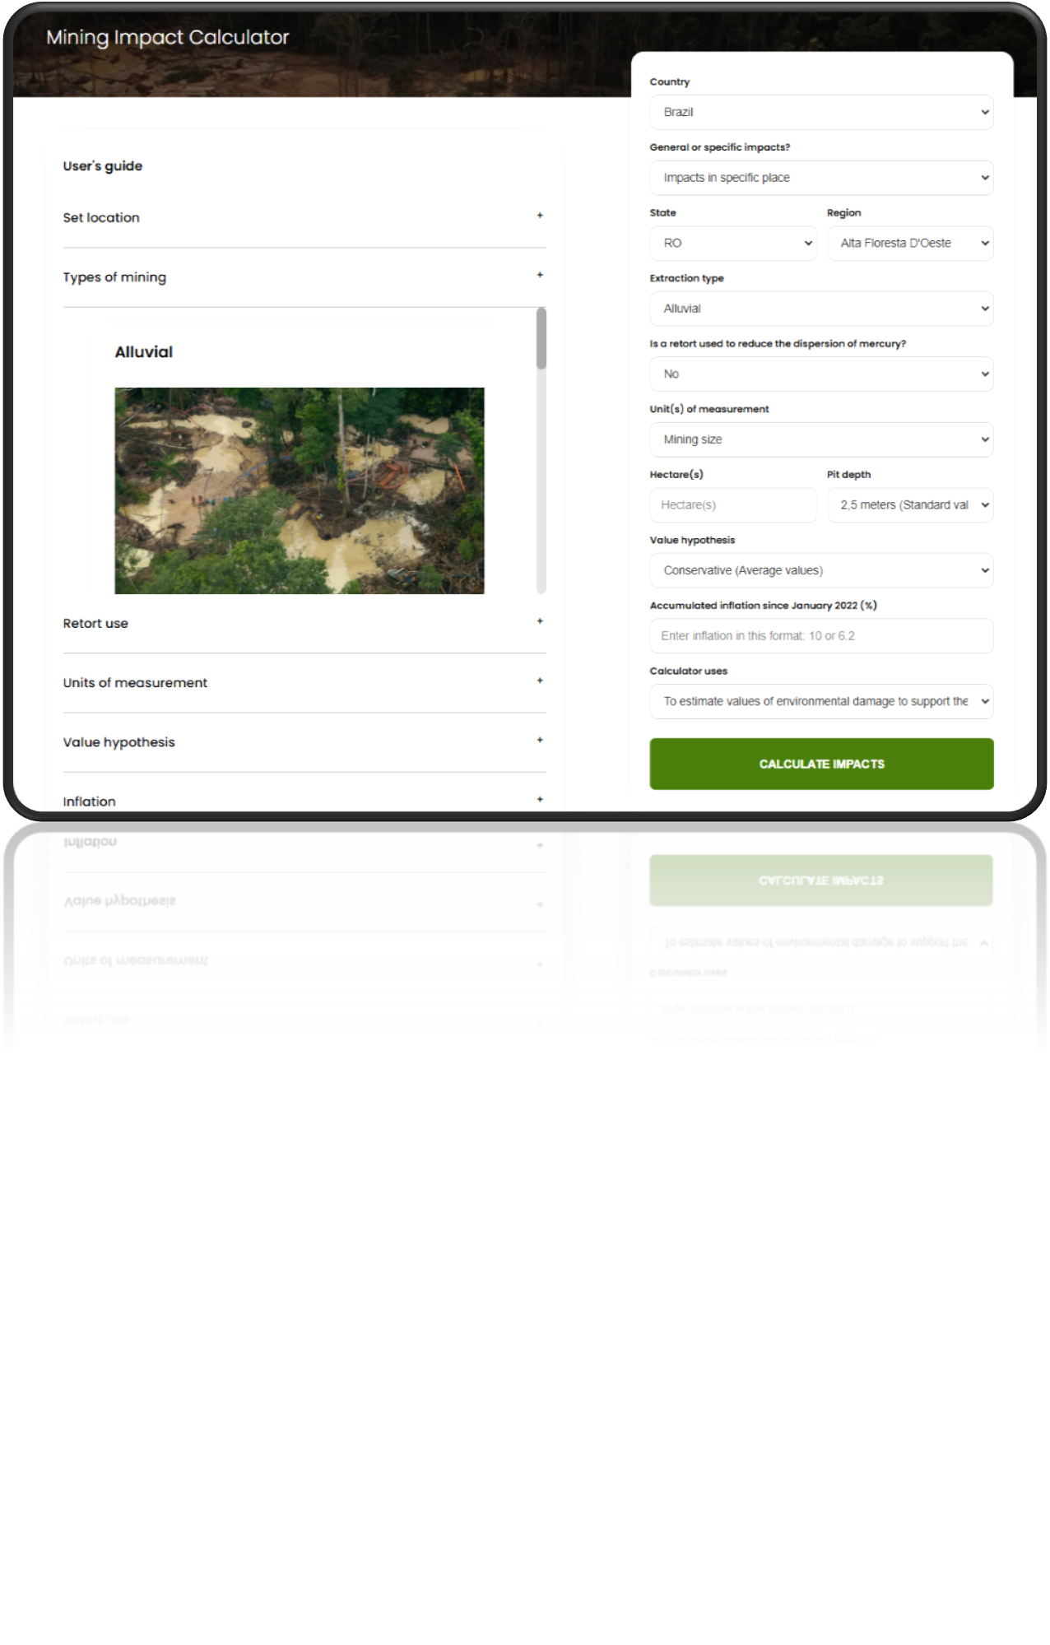

Slide 10
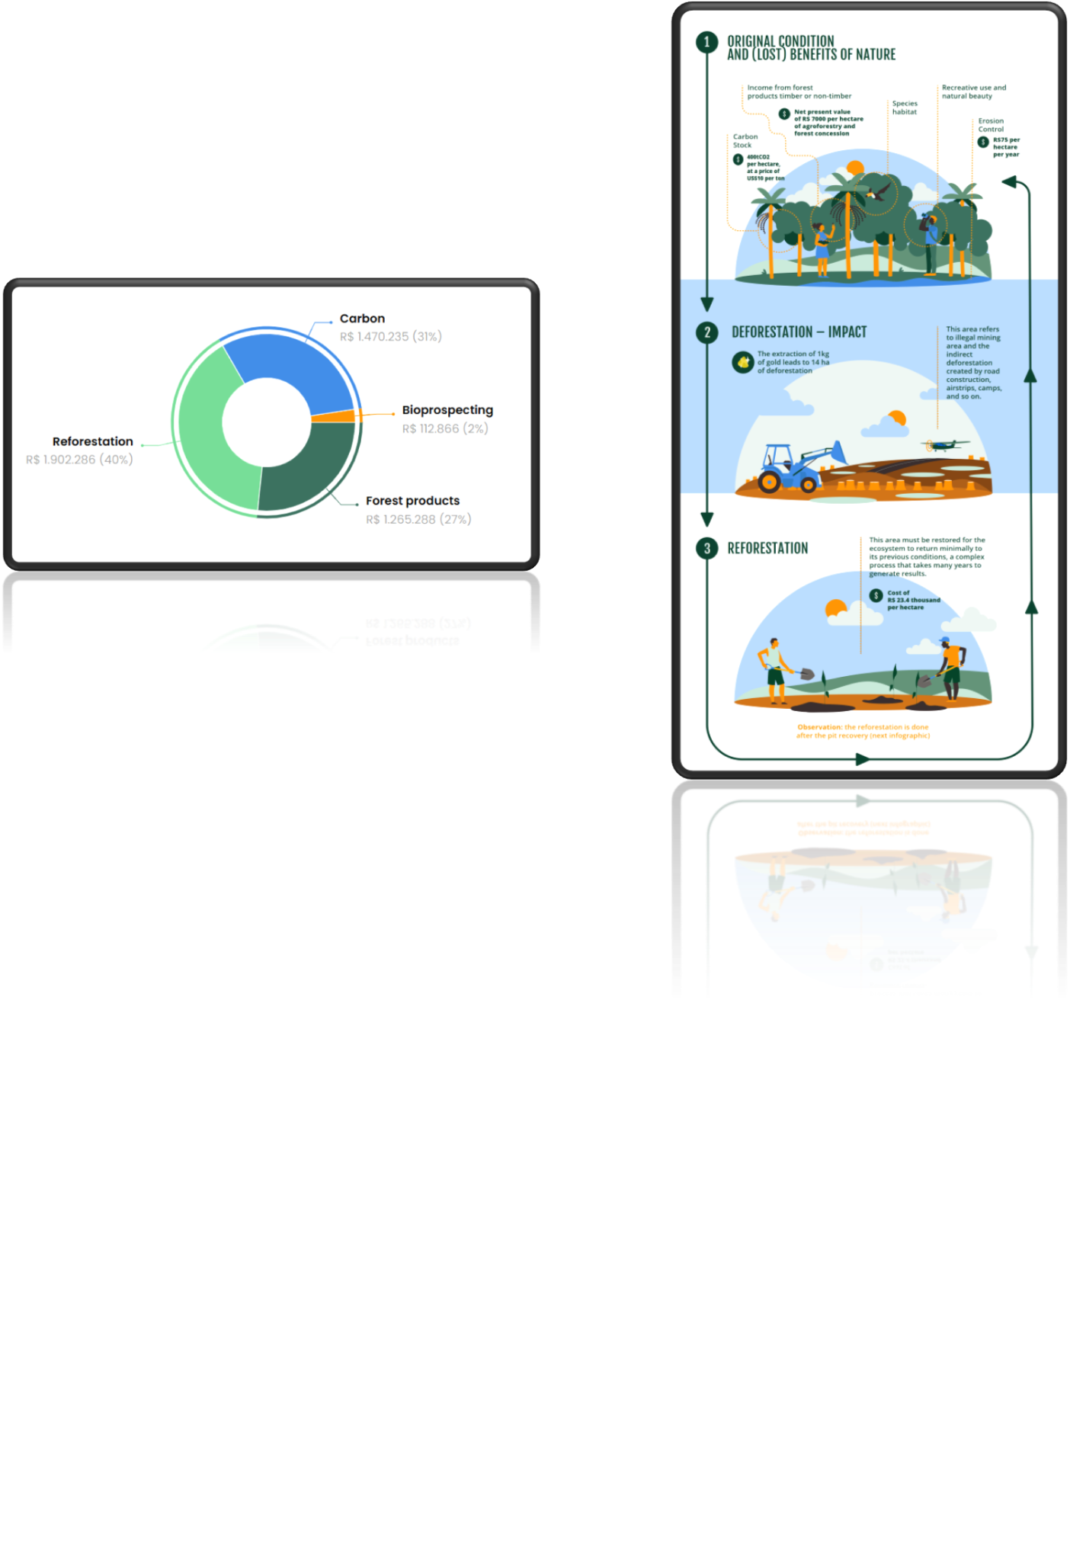
Impact : Déforestation

Slide 11
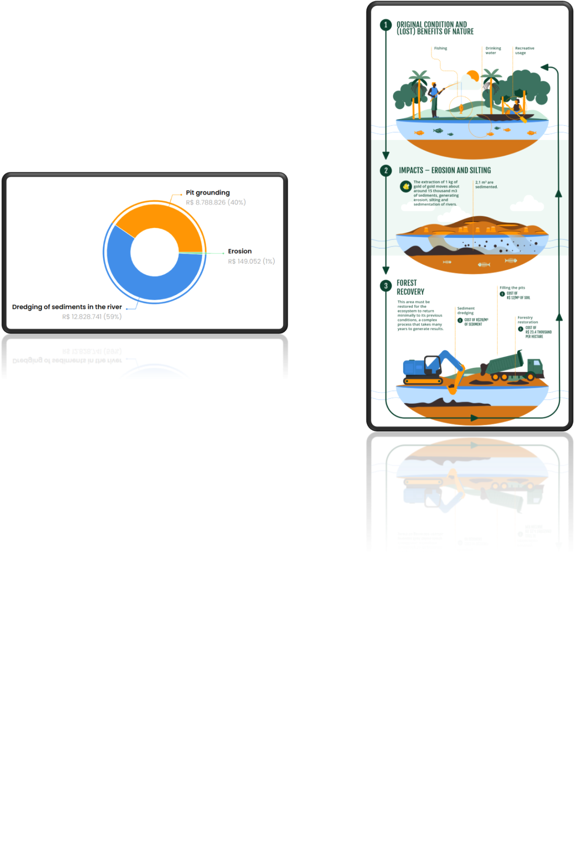
Impact : Érosion

Slide 12
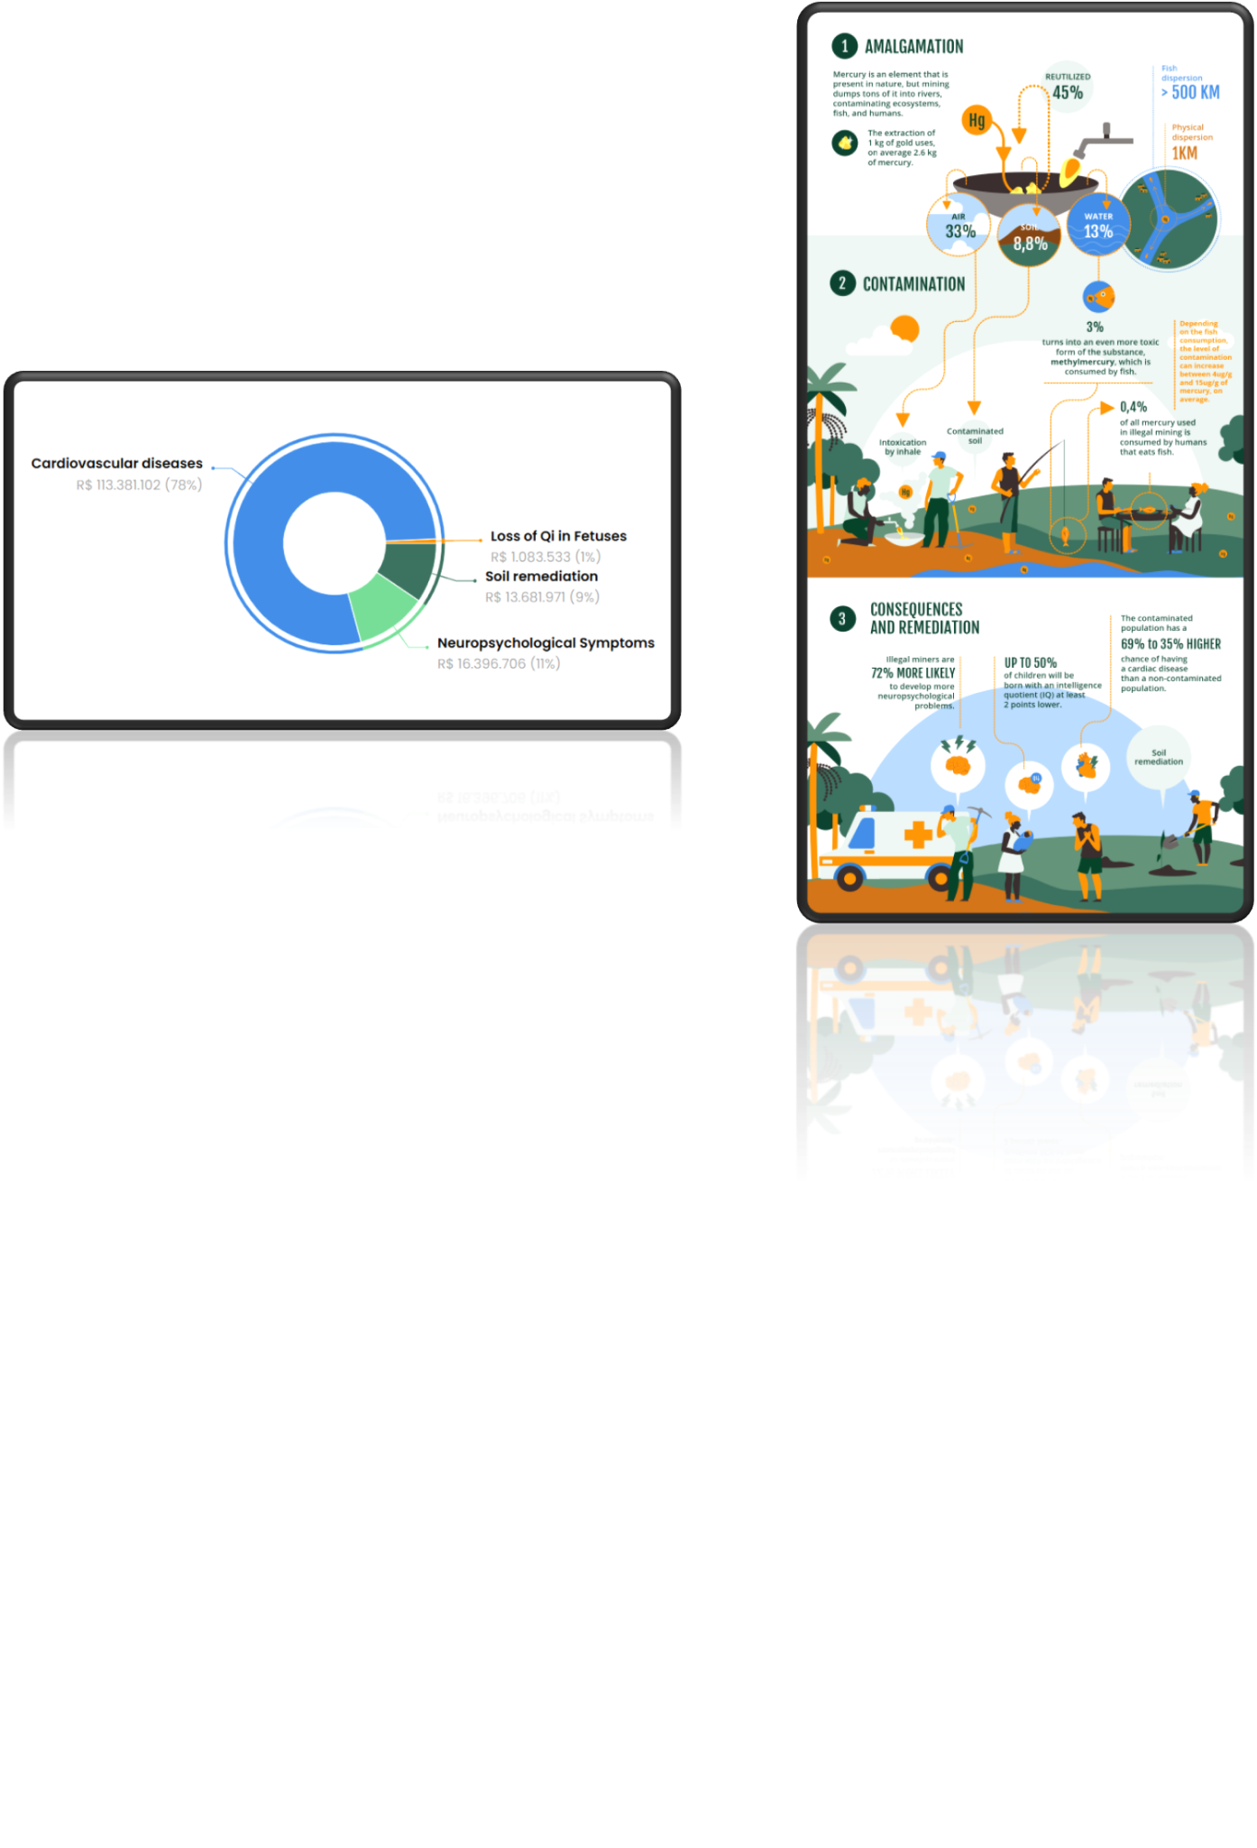
Impact : Contamination au mercure

Slide 13
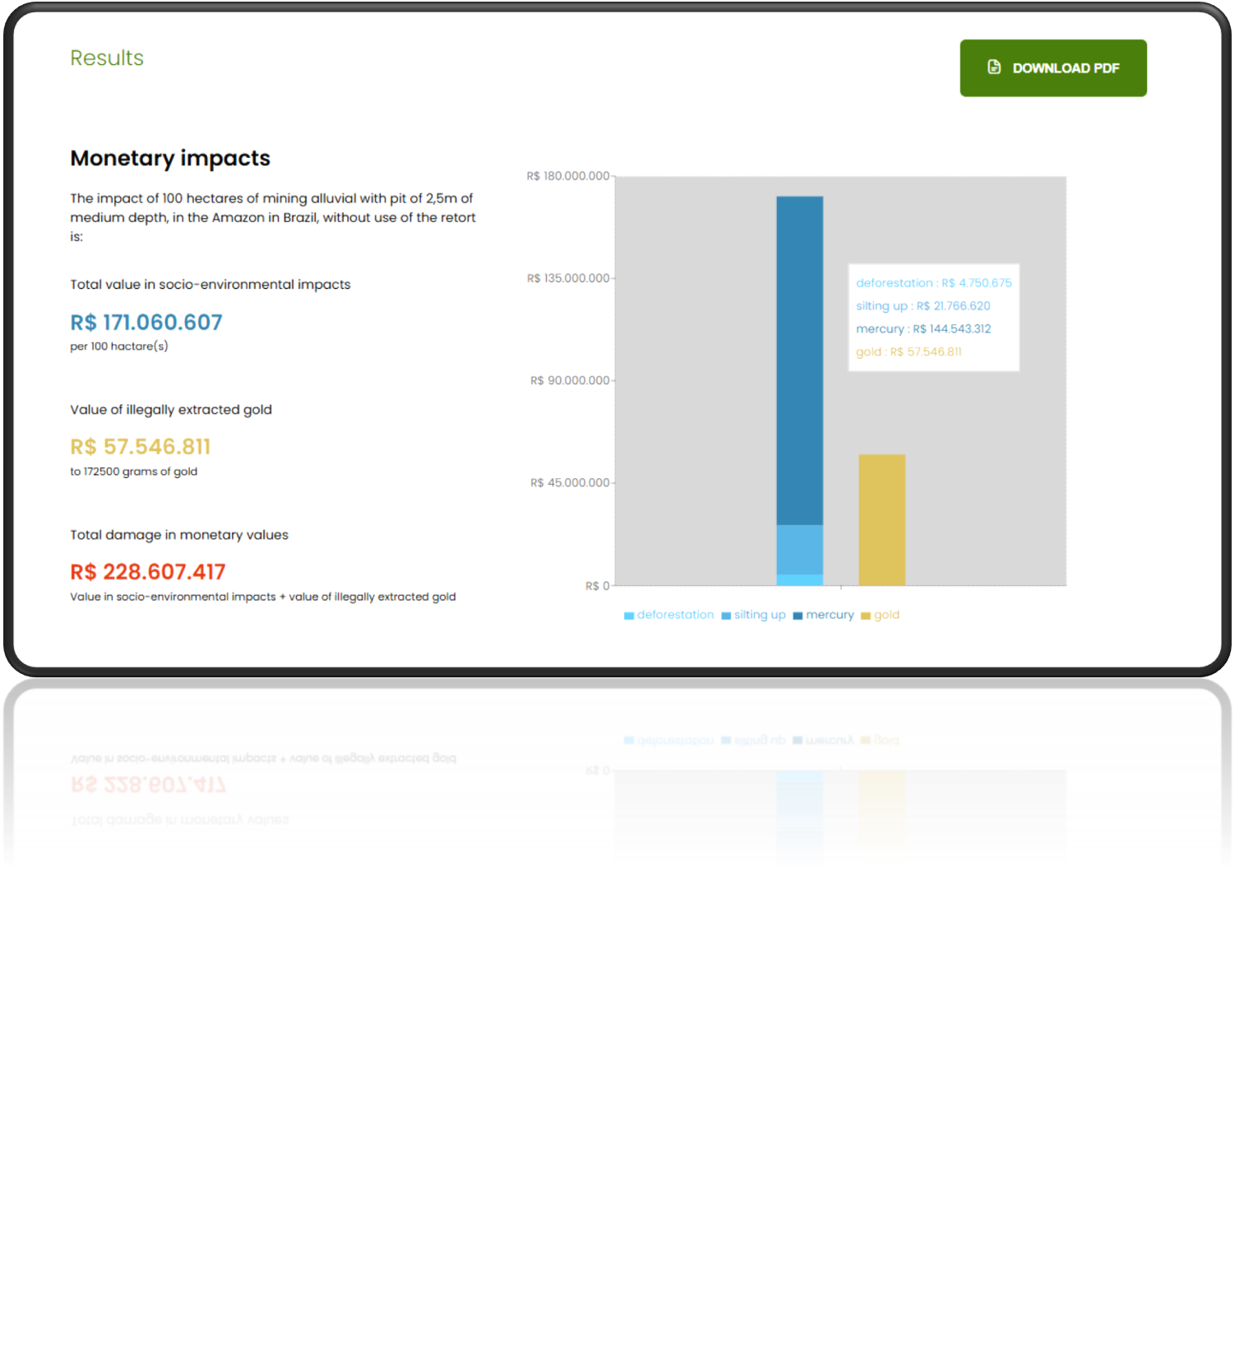

Slide 14
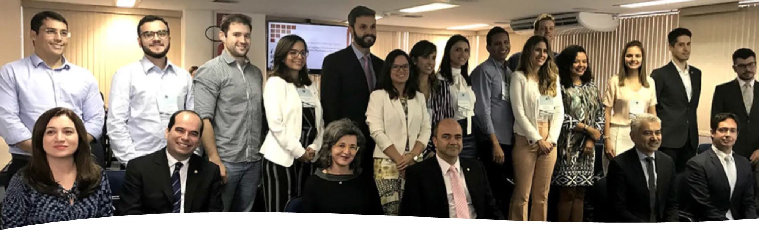
Implications politiques
• Les procureurs publics brésiliens : ont adopté la méthodologie comme référence officielle – des poursuites judiciaires d’une valeur de plus de 9 milliards USD
• Cas d’usage par la Police Fédérale et l’Agence de Protection de l’Environnement devant la Cour suprême fédérale
• Les agences de protection d’autres pays envisagent d’adopter l’outil :
- Pérou, Colombie, Équateur, Guyana, Suriname, Bolivie

Slide 15
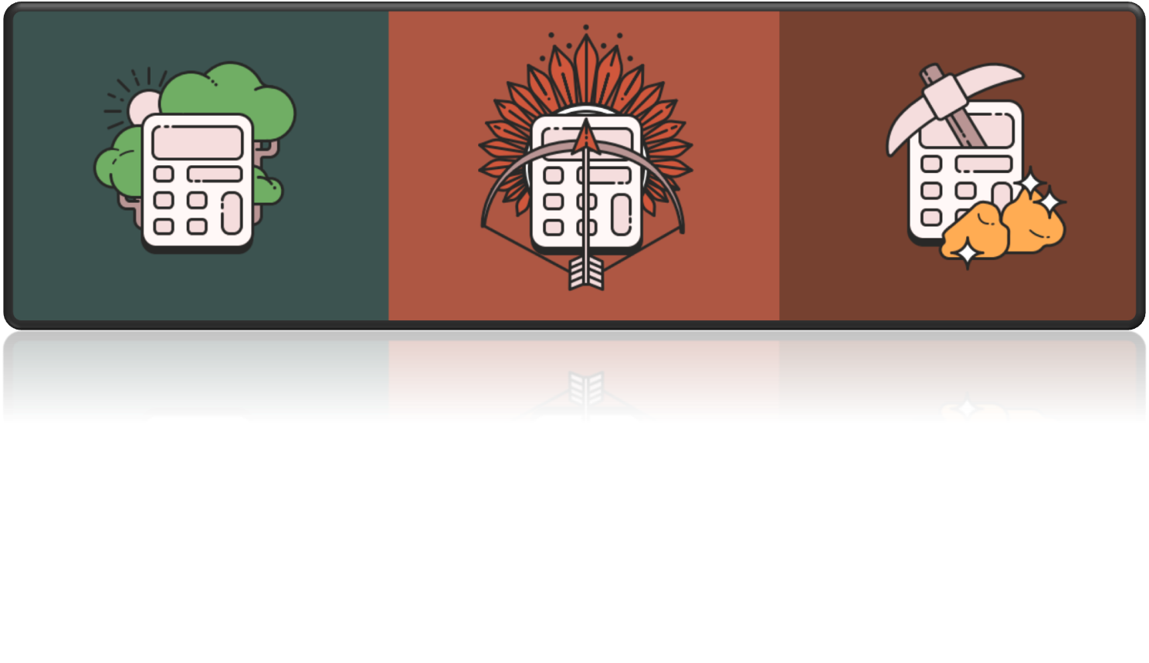
https://calculators.conservation-strategy.org/

Slide 16
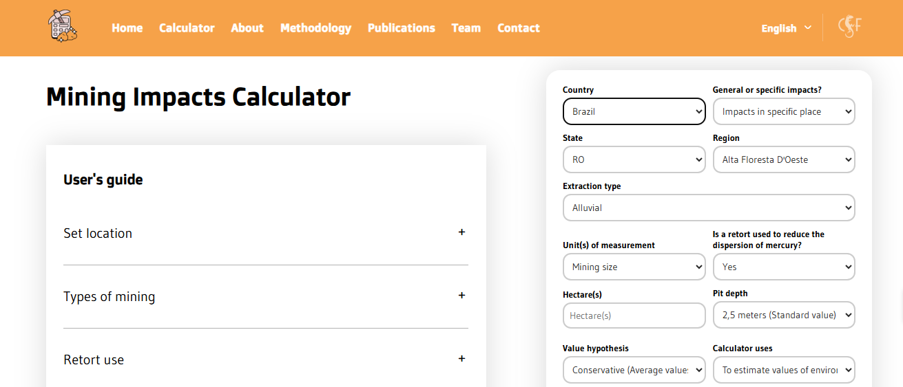
Comment fonctionne le Calculateur des Impacts Miniers (MIC) ?
https://miningcalculator.conservation-strategy.org/

Slide 17
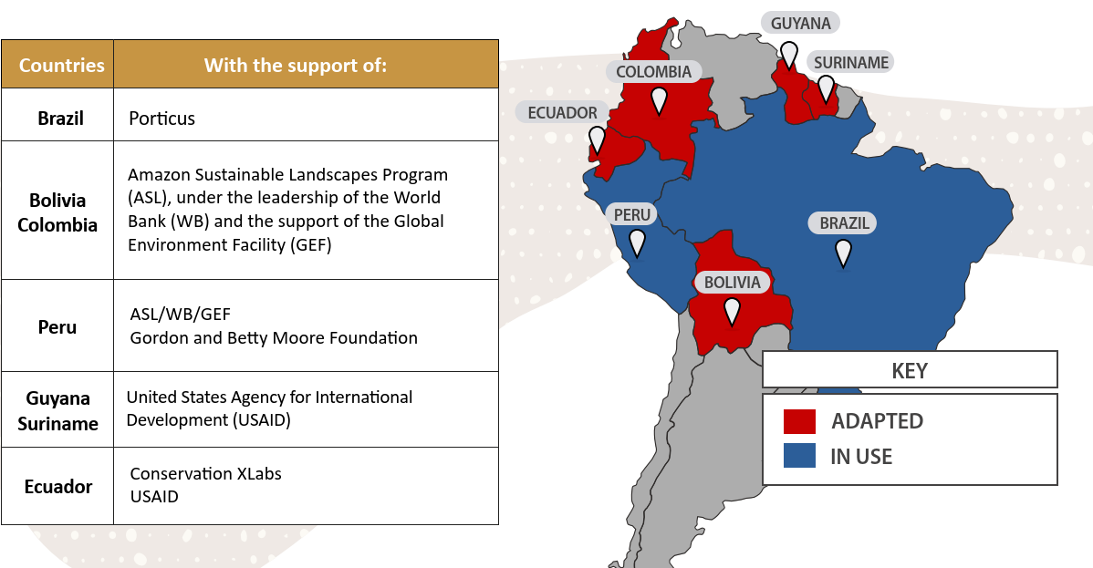
Adapter et adopter le Calculateur dans différents contextes nationaux

Slide 18
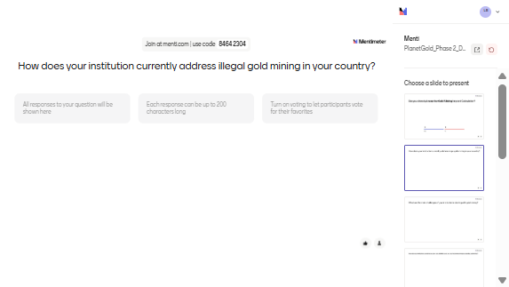
Comment votre institution traite-t-elle actuellement l’exploitation illégale de l’or ?

Slide 19
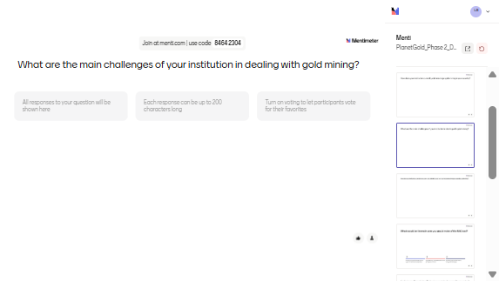
Quels sont les principaux défis de votre institution dans la gestion de l’exploitation aurifère ?

Slide 20
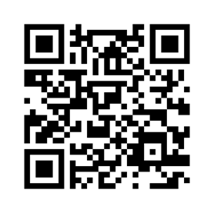

Exercice : Estimer les valeurs des dommages socio-environnementaux pour calculer l’indemnisation
Scénario :
Imaginez une communauté vivant dans une zone protégée à Loreto, Putumayo, au Pérou, touchée par une invasion de ses terres.
En un an d’activité, l’entreprise minière a exploité illégalement 10 hectares de mines alluviales, avec des fosses d’une profondeur moyenne de 5 mètres.
Les mineurs n’ont pas utilisé de rétorte dans le processus d’amalgamation de l’or.
Les procureurs souhaitent obtenir une estimation des dommages en utilisant des hypothèses de valeur maximale, conformément au principe de précaution : en cas d’incertitude, il vaut mieux surestimer que sous-estimer les dommages.
Questions :
Quel est le préjudice socio-environnemental estimé causé par ces 10 hectares ?
Quelle est la valeur de l’or extrait illégalement ?
En plus de l’indemnisation de la communauté, les procureurs estiment que, pour dissuader les crimes futurs, une amende devrait être fixée à deux fois la valeur du préjudice socio-environnemental, plus la valeur de l’or extrait illégalement.
Quelle serait la valeur totale de l’amende ?

Slide 21
Overview of economic valuation and mining impacts for ASGM

Slide 22
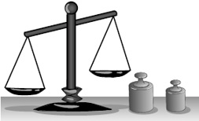
Why is it important to assign a value?
Informations pour les décideurs
  Quels sont les effets des services écosystémiques sur la société ?
Conception de projets
  Comment l’emplacement du projet permet-il de minimiser ses externalités ?
Conception d’incitations économiques
  Quel devrait être le niveau d’incitation (PSE) pour modifier un comportement ?
Évaluation de la redistribution du bien-être
  Quelle est la valeur raisonnable de la compensation ou de la réparation ?

Slide 23
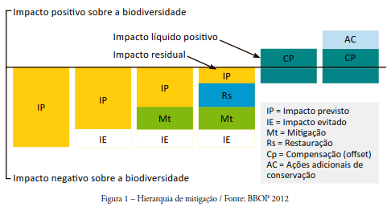
Perspective de planification : hiérarchie de la mitigation
Positive impact on biodiversity
Net Positive Impact
Residual Impact
IP = Predicted Impact
IE = Impact avoided
Mt = Mitigation
Rs = Restoration
Cp = Compensation (offset)
AC = Additional conservation actions
Negative impact on biodiversity

Slide 24
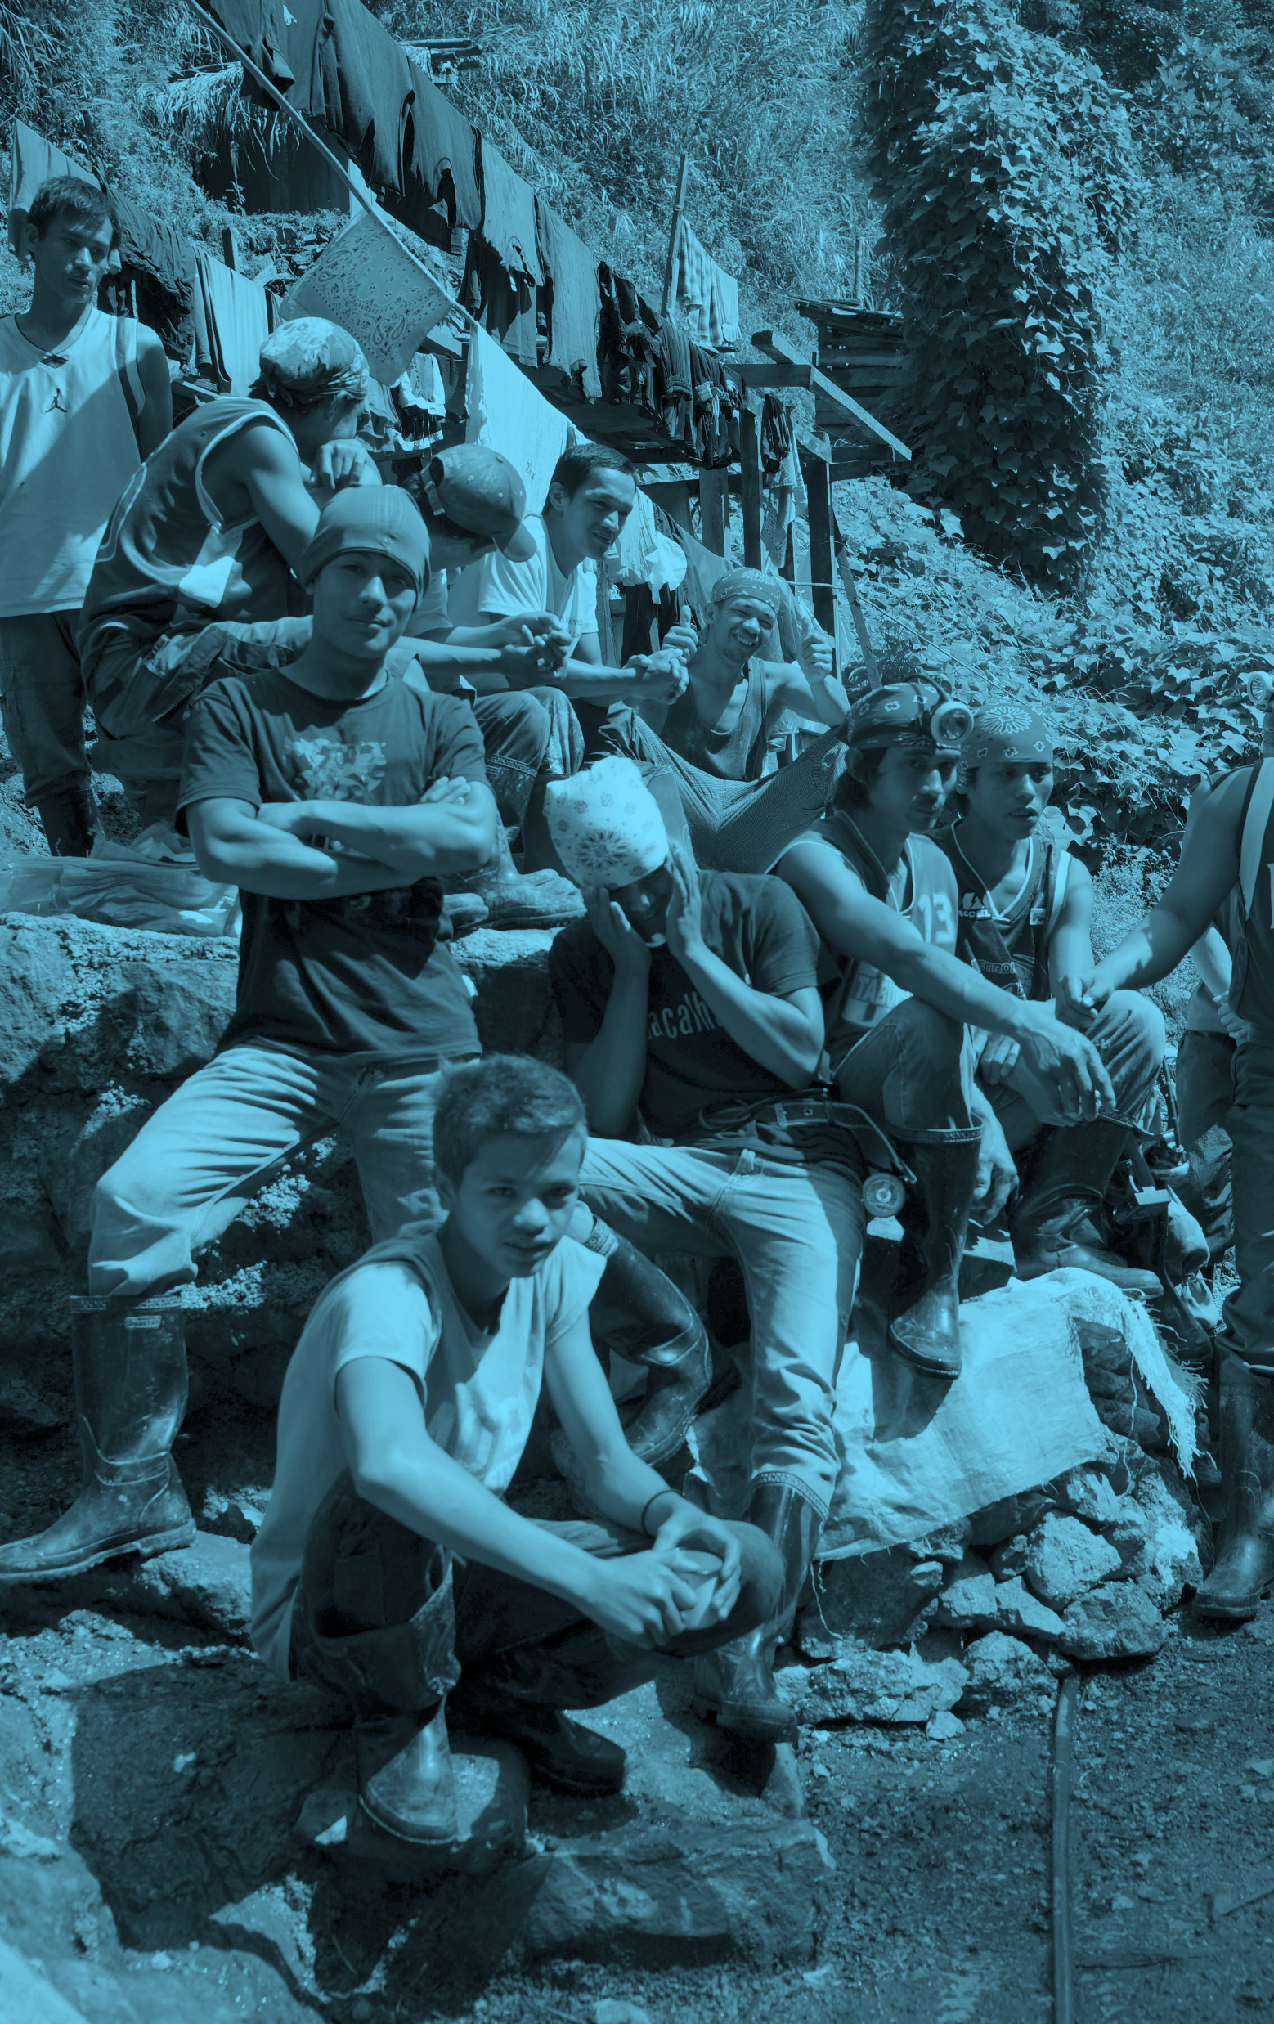

Economic Valuation: Warning
L’évaluation économique ne donne à personne le droit de violer la loi.
Compensation : remplacement imparfait
  Ne comprend pas les dommages moraux
  Une amende doit être suffisante pour prévenir un acte illicite
« Mieux vaut prévenir que guérir » – La planification et la participation comme meilleure solution

Slide 25
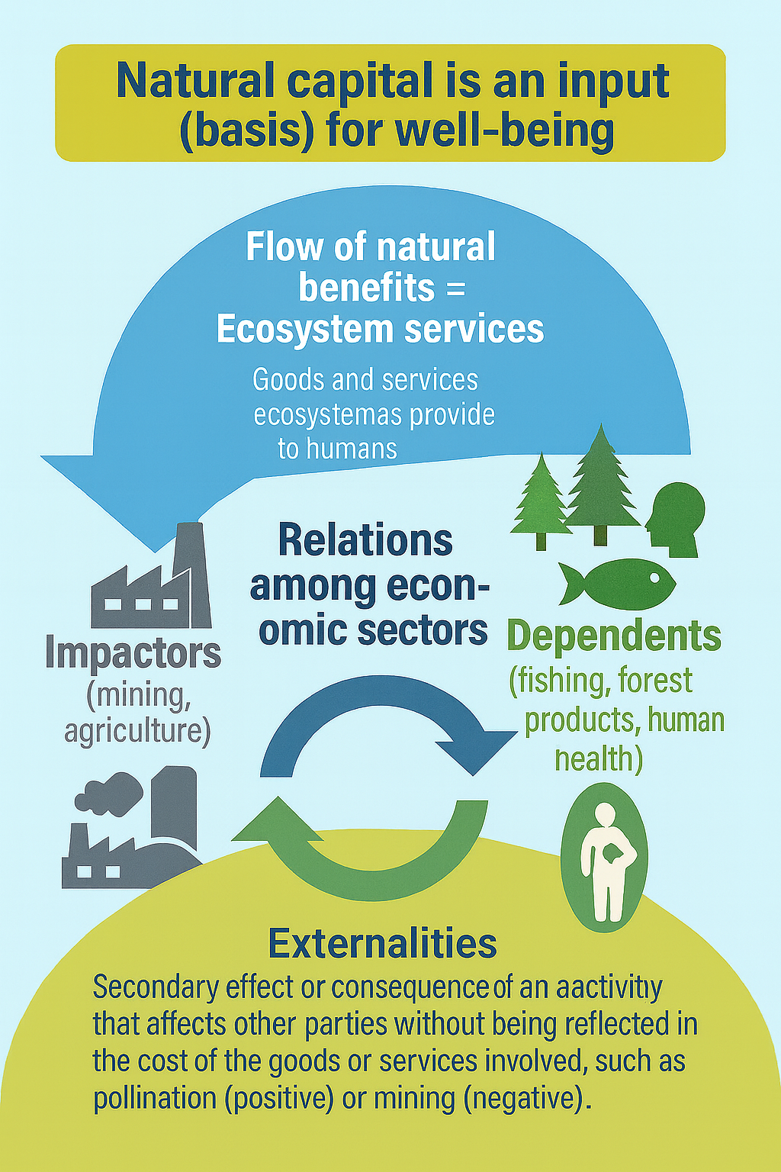
Que devons-nous évaluer ?

Slide 26
Market System and Externalities
Prices can be indicators of desire and scarcity relationships, but...
Sometimes prices do not exist or are not “fair” due to issues of power asymmetries between agents or contexts
Indirect effects on others
  Costs not considered by decision maker
    Negative Externalities
    Positive Externalities
Production level is not efficient (higher or lower)
The (inefficient) price of a good does not consider all its social costs and benefits.
  Private (gold miner) x Social

Slide 27
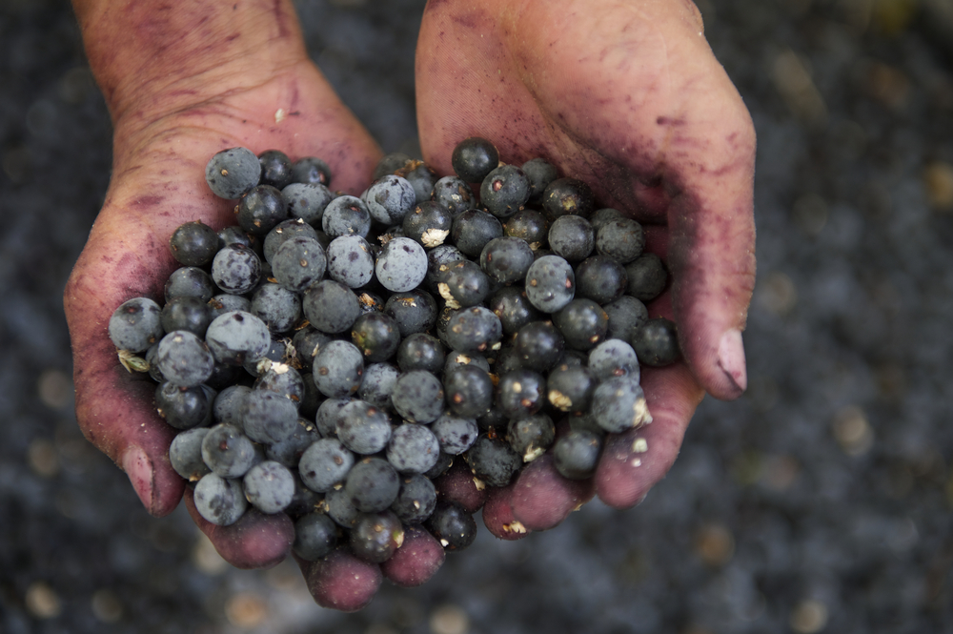
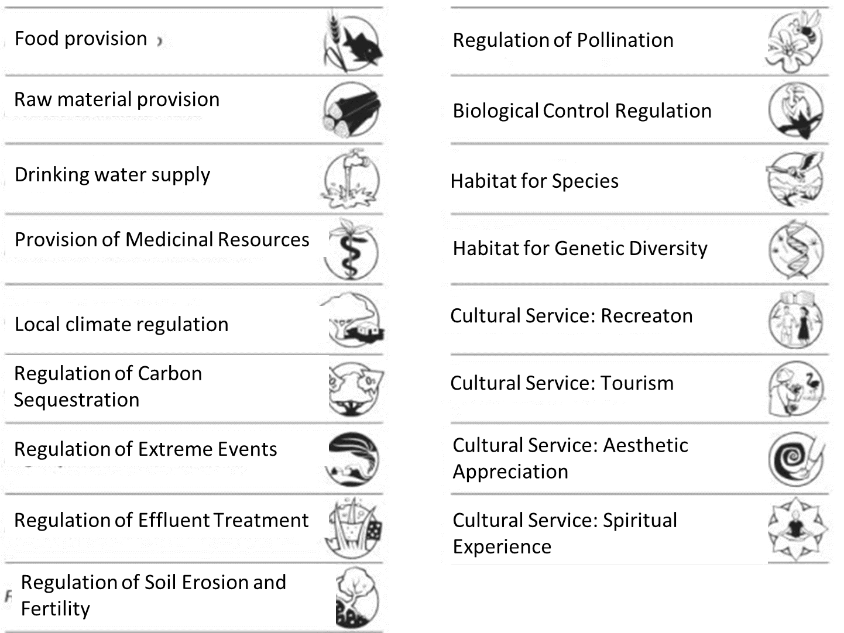
Services environnementaux

Slide 28
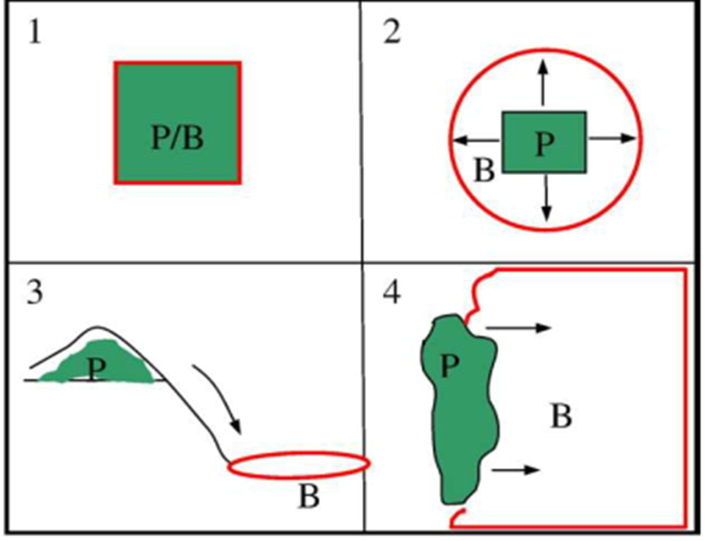
Dynamiques des services écosystémiques

Slide 29
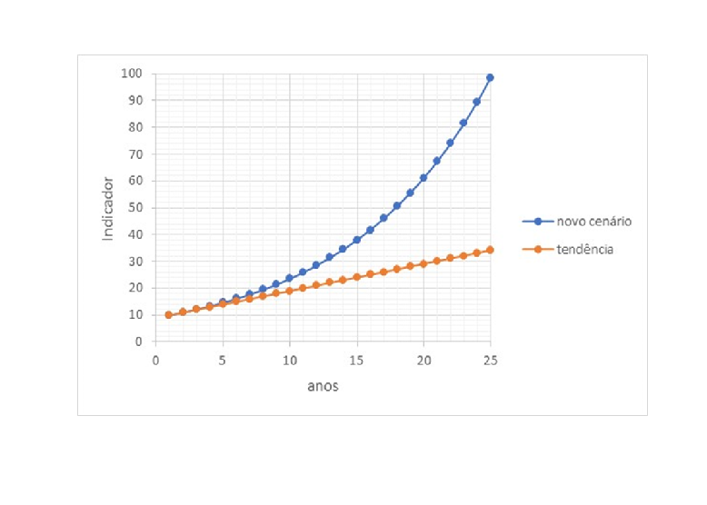
Hypothèse de valorisation
Perception humaine des changements
Il n’existe pas de valeur absolue de la nature
Évaluer les préférences sociales
Évaluation des changements environnementaux
Comparaison des scénarios
Avec exploitation minière / Sans exploitation minière
Exploitation minière avec mercure / Exploitation minière sans mercure

Slide 30
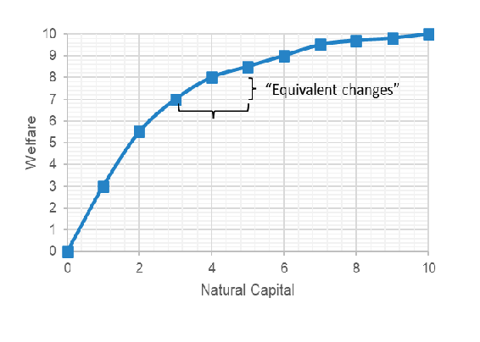
Étapes de valorisation : effets biophysiques vs effets sociaux
Comparaison des scénarios
1ère étape : Mesurer les changements biophysiques
Déforestation (hectares)
Érosion (m³)
Contamination au mercure (personnes malades)
2ème étape : Mesurer les effets sociaux de ces changements
Déforestation (€)
Érosion (€)
Contamination au mercure (€)
Value depends on context

Slide 31
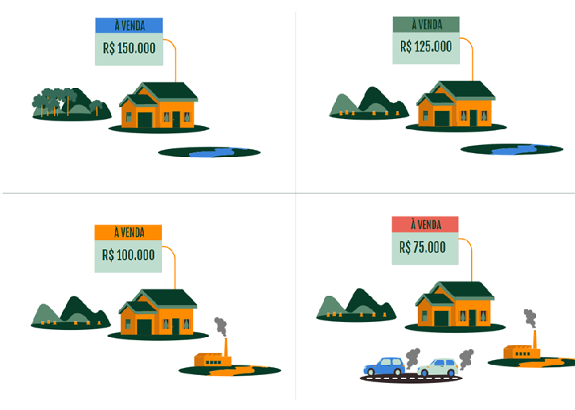
Valuation methods
Market prices (when they exist)
  Products sold in market
What we indirectly “reveal” in market purchases
  Interpretation of choices in markets (of subcomponents of real products)
What we declare important
  Surveys with simulations of plebiscites or auctions (hypothetical)
Benefit transfer
  Meta-analysis of the literature
If I cut down a tree in the middle of the Amazon rainforest, will it have the same value as a tree in a place with only one tree?

Slide 32





Types of assessment methods: Example of Change in Health
Valuation methods can be based on information about:
Market prices
Reduced income due to illness
What we indirectly “reveal” in transactions
Additional pay for risk of illness or death
What we declare important
  Willingness to pay: survey to avoid risk
Equivalent costs (which we assume are worth it)
Valuation Methods and Scenarios
Loss of Production due to absences (Salary)
Additional Salary for additional risk
Willingness to Pay for hypothetical drug
(that may be developed)
Treatment Cost

Slide 33
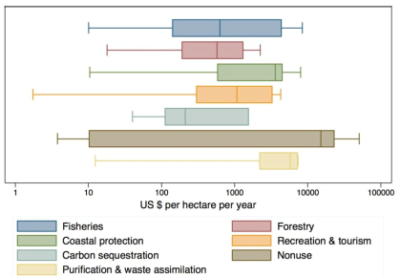
Benefit Transfer
Meta-analysis
Literature average values
Fixed by context variables
  GDP per capita; Population density; Species richness, etc.

Slide 34
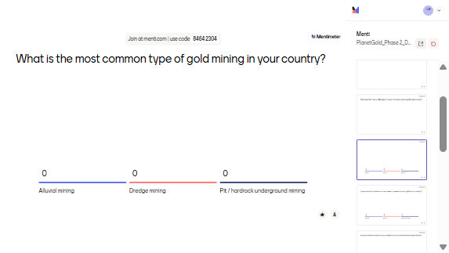
What is the most common type of gold mining in your country?

Slide 35
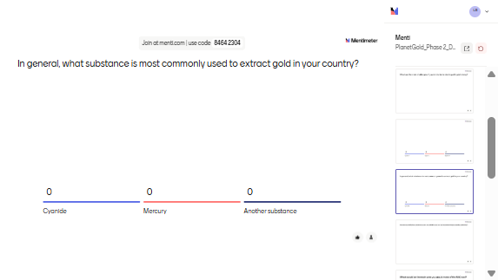
In general, what substance is most commonly used to extract gold in your country?

Slide 36
Methodology
An Overview

Slide 37
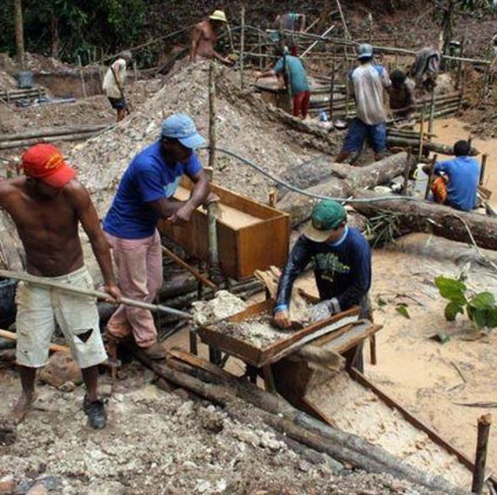
Methodology
Types of impact
    Deforestation
    Erosion and sedimentation
    Mercury contamination

Slide 38
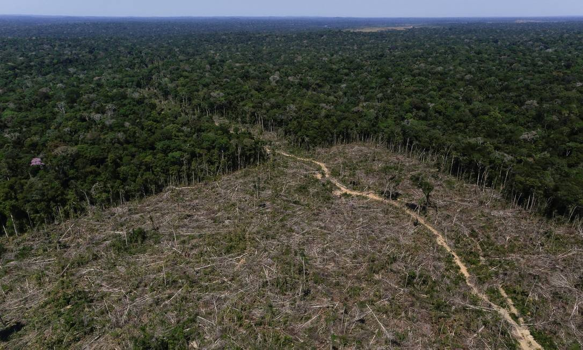
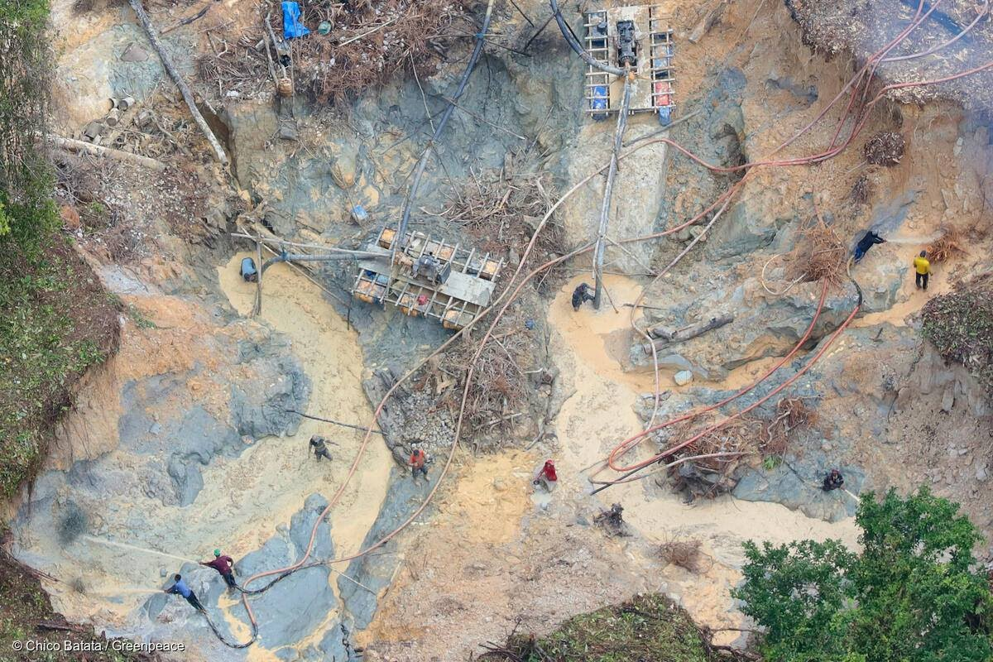
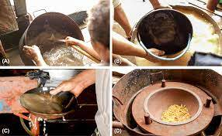
Impact Components
Deforestation
Erosion
Mercury contamination
Biophysical Impacts

Slide 39

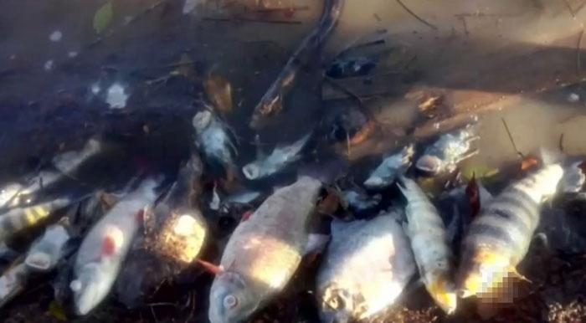
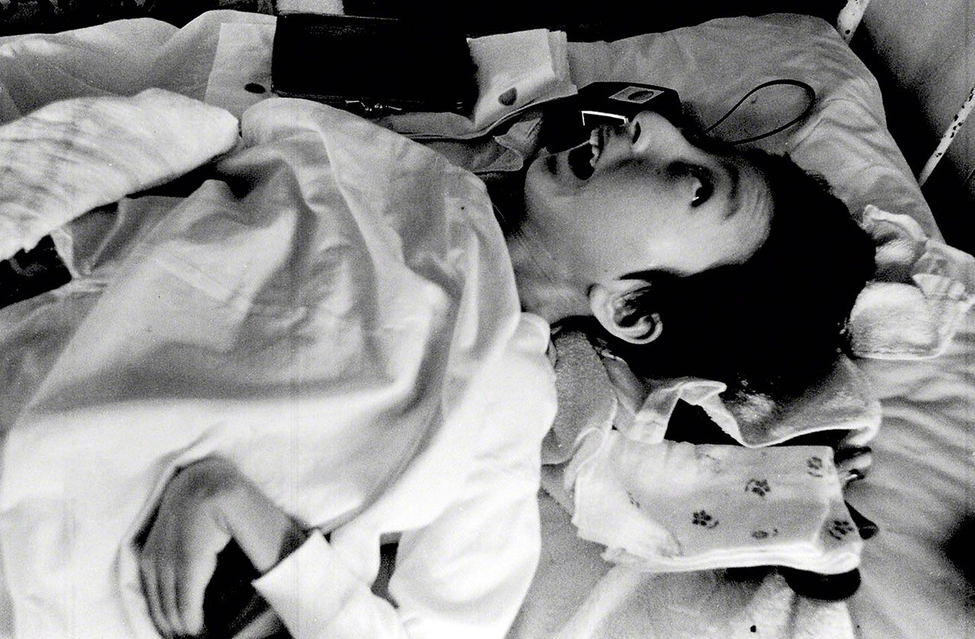
Impact Components
Deforestation
Erosion
Mercury Contamination
Biophysical Impacts
Social Consequences

Slide 40
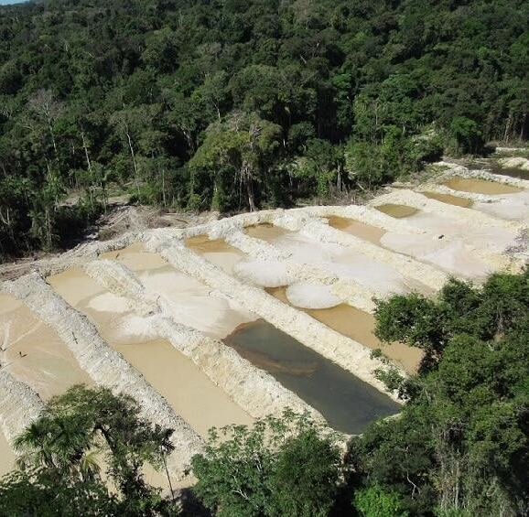
Methodology: Gold Extraction Productivity
Methodology: Productivity
Literature and interviews with miners.
Mining Area (ha)
Gold Production (kg)
Pit Depth
Mercury Use (kg)
Deforestation, soil loss
Mercury Contamination

Slide 41

Deforestation Assessment

Slide 42
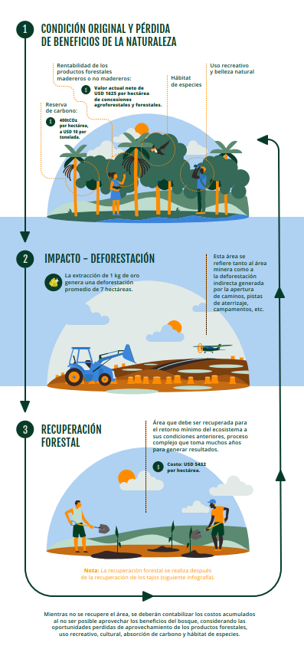
Methodology: Deforestation
Restoration Costs
    Adjusted by distance to urban centers
    80% of ES restored after 30 years
Opportunity Costs
    Meta-analysis (Siikamaki, 2015)
    Provisioning services: timber and non-timber forest products
    Climate regulation
    Others: species habitats and water-related services

Slide 43
Methodology: Deforestation
  Meta-analysis (value transfer function)
Ecosystem Service Values
Population Density
Per Capita Income
Species Richness

Slide 44
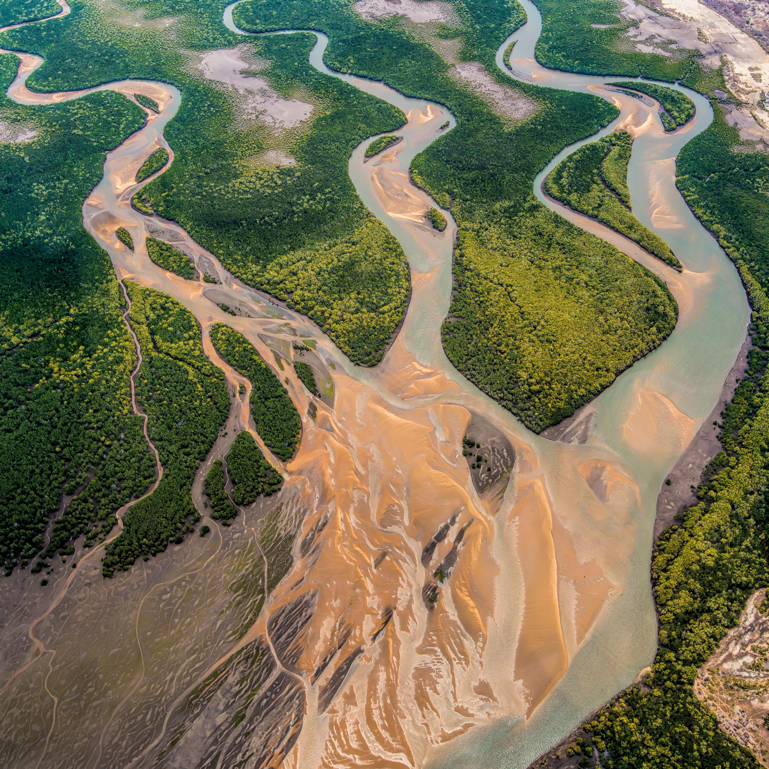
Erosion and Sedimentation Assessment

Slide 45
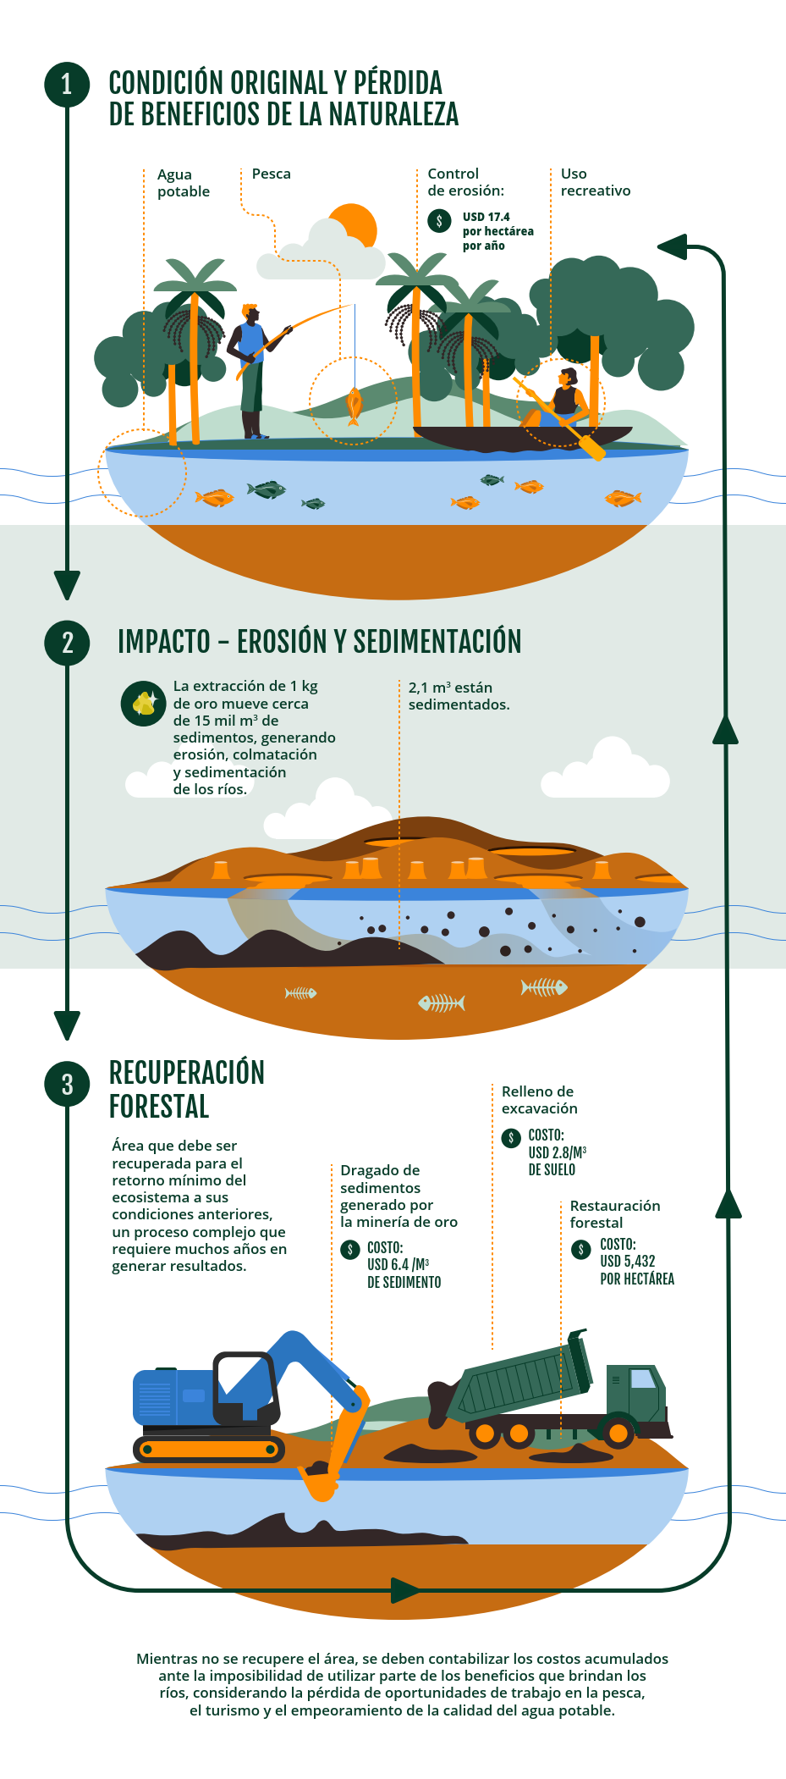
Erosion and Sedimentation Assessment
Impact | Enfoque | Specific impact
Erosion / Sedimentation | Opportunity cost | Ecosystem Services: Erosion Control
 | Restoration cost | Soil Stabilization
 |  | Sediments / Dredging / Channel Straightening

Slide 46
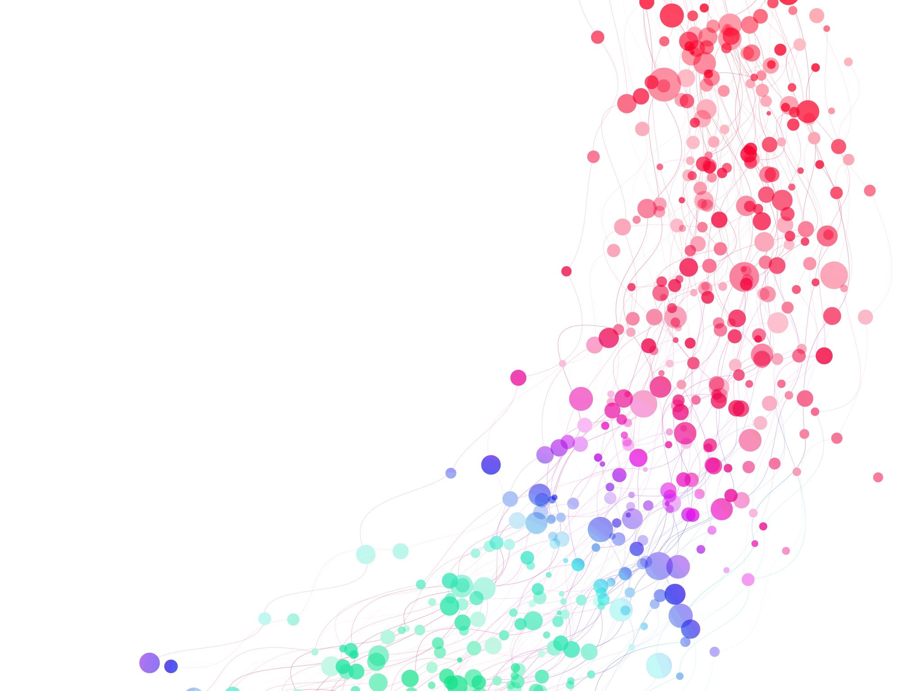
Assessment of the impacts of mercury

Slide 47
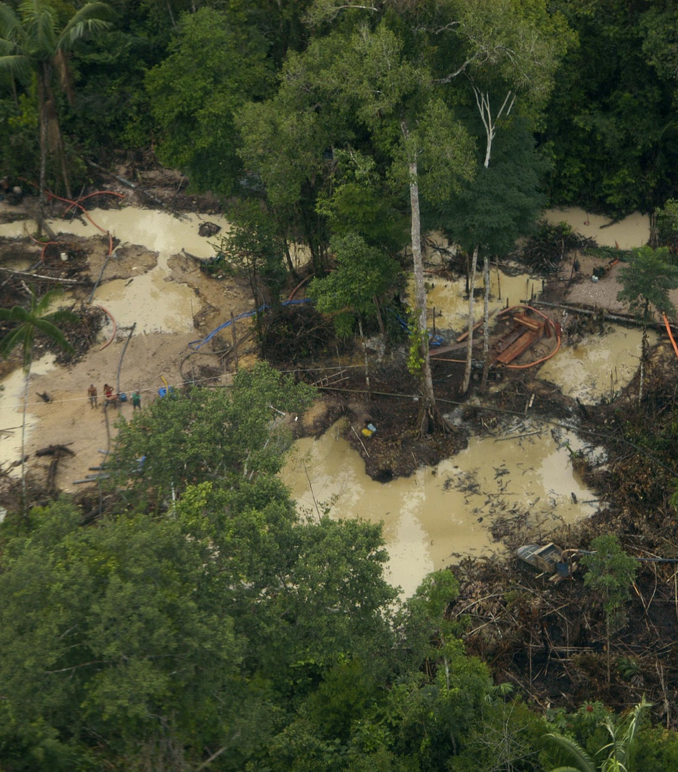
Methodology: Mercury contamination
Mercury is naturally present in the environment.
Deforestation also contributes to mercury dispersion.
How can we differentiate the sources?
How can responsibility be attributed for illegal artisanal gold mining?

Slide 48
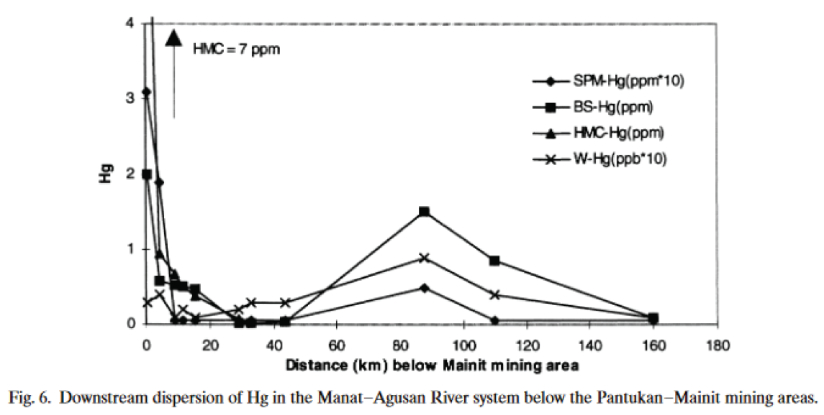
How can responsibility be attributed for illegal artisanal gold mining?
Ideal (but with no clear results)
Distance-decay function
The closer to the mining site, the higher the level of contamination.
Confounding factor: no statistical evidence
Fish can carry mercury up to 2,000 km.

Slide 49
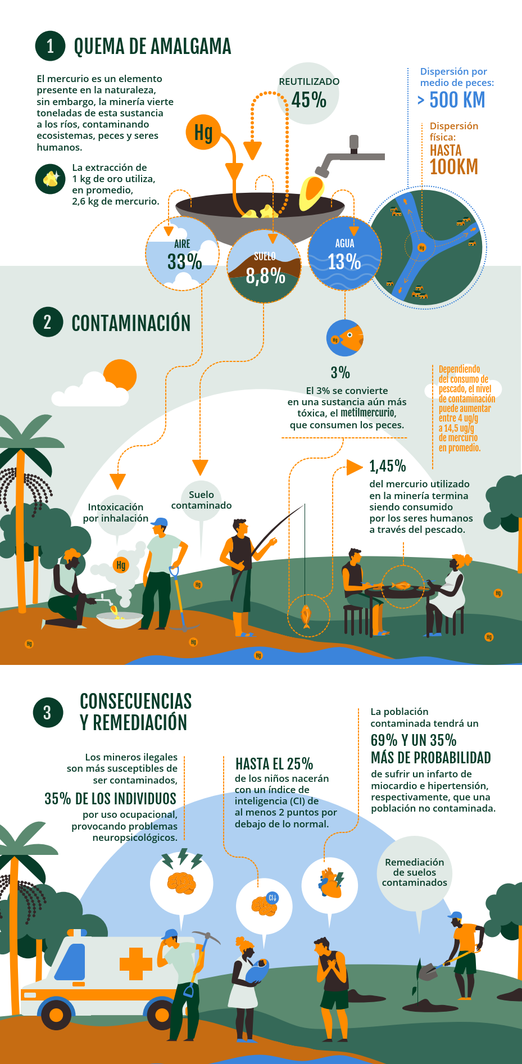
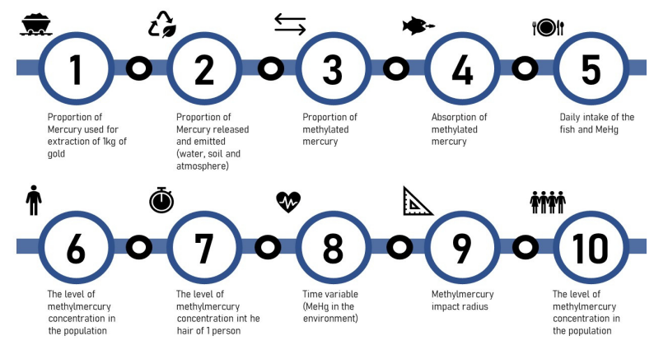
Methodology Mercury Release in the Water

Slide 50
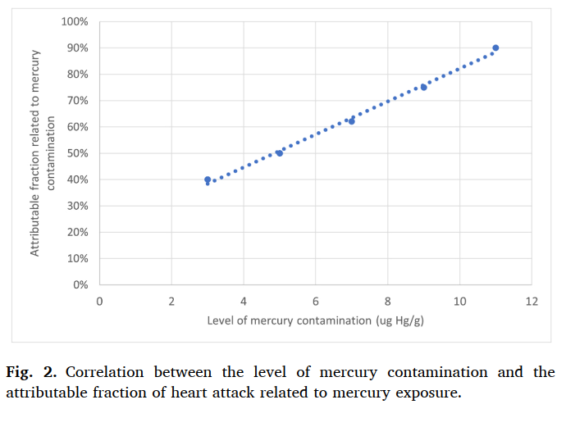
Mercury impacts
  Health Effects:
  Inhalation of airborne metallic mercury
    Neuropsychological problems in gold miners
  Health Effects: Ingestion of contaminated fish (methylmercury)
    IQ loss in fetuses
    Heart diseaseHypertension

Slide 51
Methodology: Mercury contamination
Value Transfer Function
# People Potentially Exposed
Health impacts
Population within a 100 km radius
Amount of Mercury
Average Fish Consumption
Average Body Weight of the Population
Severity of Health Impacts
Level of Fish Contamination

Slide 52
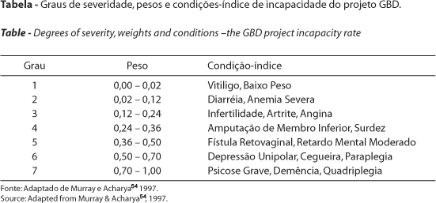
Methodology: Valuation of Health Effects
Equivalence Between DALY and VSL ($)
Disability-Adjusted Life Years (DALYs)
Value of a Statistical Life (VSL)

Slide 53
Exercise 2 Estimate investment values ​​to prevent impacts
Scenario
Currently, the government invests R$50 million annually to prevent barges from operating on the Madeira River in Humaitá, Amazonas. The environmental protection agency considers this insufficient and wants to demonstrate to the government that it would be worthwhile to increase investments to prevent socio-environmental damage.
Currently, there are still 40 dredges causing damage in the region. The environmental agency estimates that, with additional measures at an additional annual cost of R$80 million, the number of barges could be reduced from 40 to 10.
The dredges have an average power of 100 hp and do not use retorts.
For the calculations, use the "conservative value assumption" and a cumulative inflation rate of 10% since 2022.
Questions:
What is the annual socio-environmental damage caused by 40 dredges? (Ignore the value of gold)
What is the annual socio-environmental damage caused by 10 dredges?
What would be the reduction in socio-environmental impact of the most effective control action requested by IBAMA?
Is it socially efficient to increase annual government investments in prevention?
calculators.conservation-strategy.org

Slide 54
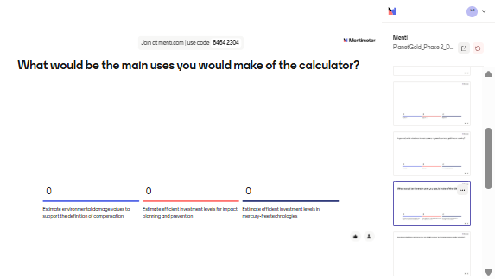
What would be the main uses you would make of the MIC tool?

Slide 55
Mini break
5 minutes

Slide 56
Case Study Presentation

Slide 57
Considerations for Building a Case Study
  1. Identify the input variables required for the tool based on the specifics of the case study.
    Extraction type (alluvial / dredge boats / underground hard rock mining)
    Units of measurement
      Amount of gold (gr)
      Mining size (ha)
      Number of ferries in 1 year
      Years of mining exploration
      Units of measurement
    Use of retort
    Pit depth (alluvial and underground gard rock mining)
    Motor power (dredge boats mining)

Slide 58
Considerations for Building a Case Study
  2. Review the internal variables of the tool that may need to be adapted to the national context.
  Gold productivity (grams of gold per ton of ore)
  Carbon Stock per Hectare (tCO2/ha)
  Value of Timber and Non-Timber Products per Hectare
  GDP per capita, population density, species richness by region (GBIF)
  Cost of Forest Restoration (US$/ha)
  Channel Straightening and River Dredging Cost (US$/m³)

Slide 59
Considerations for Building a Case Study
  2. Review the internal variables of the tool that may need to be adapted to the national context.
  Mercury-to-Gold Ratio per Gram of Gold Extracted
  Proportion of Mercury Released into Water and Sediments, and Emitted into the Atmosphere (%)
  Methylation Rate (%)
  Average Body Weight (kg/person) and Fish Consumption Level (kg per capita)
  Level of Mercury Contamination in Fish (ug Hg/g peixe)
  Life Expectancy (Men) / Life Expectancy (General Population)
  Mercury Concentration in Soil (gr Hg/ tons of soil

Slide 60
Federal Prosecution Service (MPF) vs. Financial Institutions (DTVMs) - Brokerage and Securities Distribution Institutions
Focus of the Action
Not directed at individual miners, but at financial intermediaries (DTVMs) in the supply chain
Operated in Itaituba, Jacareacanga, and Novo Progresso, main hotspots of illegal mining
Institutions could face fines of R$ 10.6 billion for social and environmental damages (using the MIC)
Strategic Legal Action
In 2021, the Federal Prosecution Service (MPF) filed lawsuits to suspend the operations of three financial institutions (FD’Gold, Carol, OM)
Accused of introducing 4.3 tons of illegal gold into national and international markets (2019–2020)

Slide 61
Federal Prosecution Service (MPF) vs. Financial Institutions (DTVMs) - Brokerage and Securities Distribution Institutions
Methodology and Evidence
Based on satellite imagery, public mineral data (CFEM, ANM), and field studies
Collaboration with the Federal University of Minas Gerais (UFMG)
Found that 58.4% of the gold in Pará had false origins or came from intact forest areas without valid mining titles
Socio-environmental Impact
Gold laundering facilitates the expansion of illegal mining in Indigenous Lands (Munduruku, Sai-Cinza)
Fuels organized crime, violence, and human rights violations
The MPF demands the “suffocation of the market” for illegal gold to break the supply chain

Slide 62
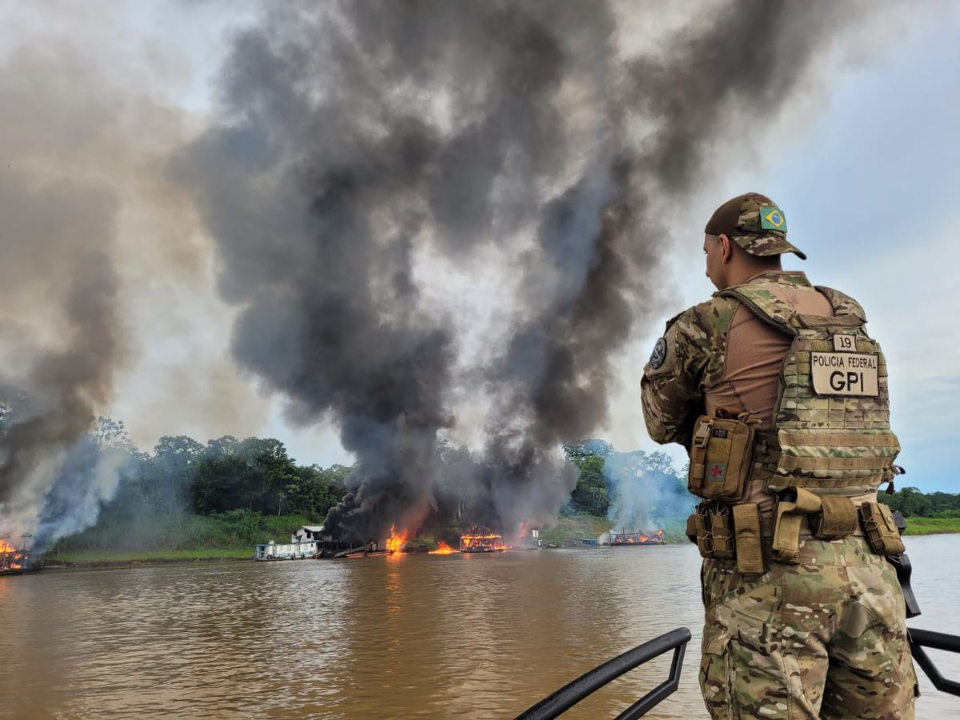
Case study
Tri-Border Area between Brazil, Peru, and Colombia

Slide 63
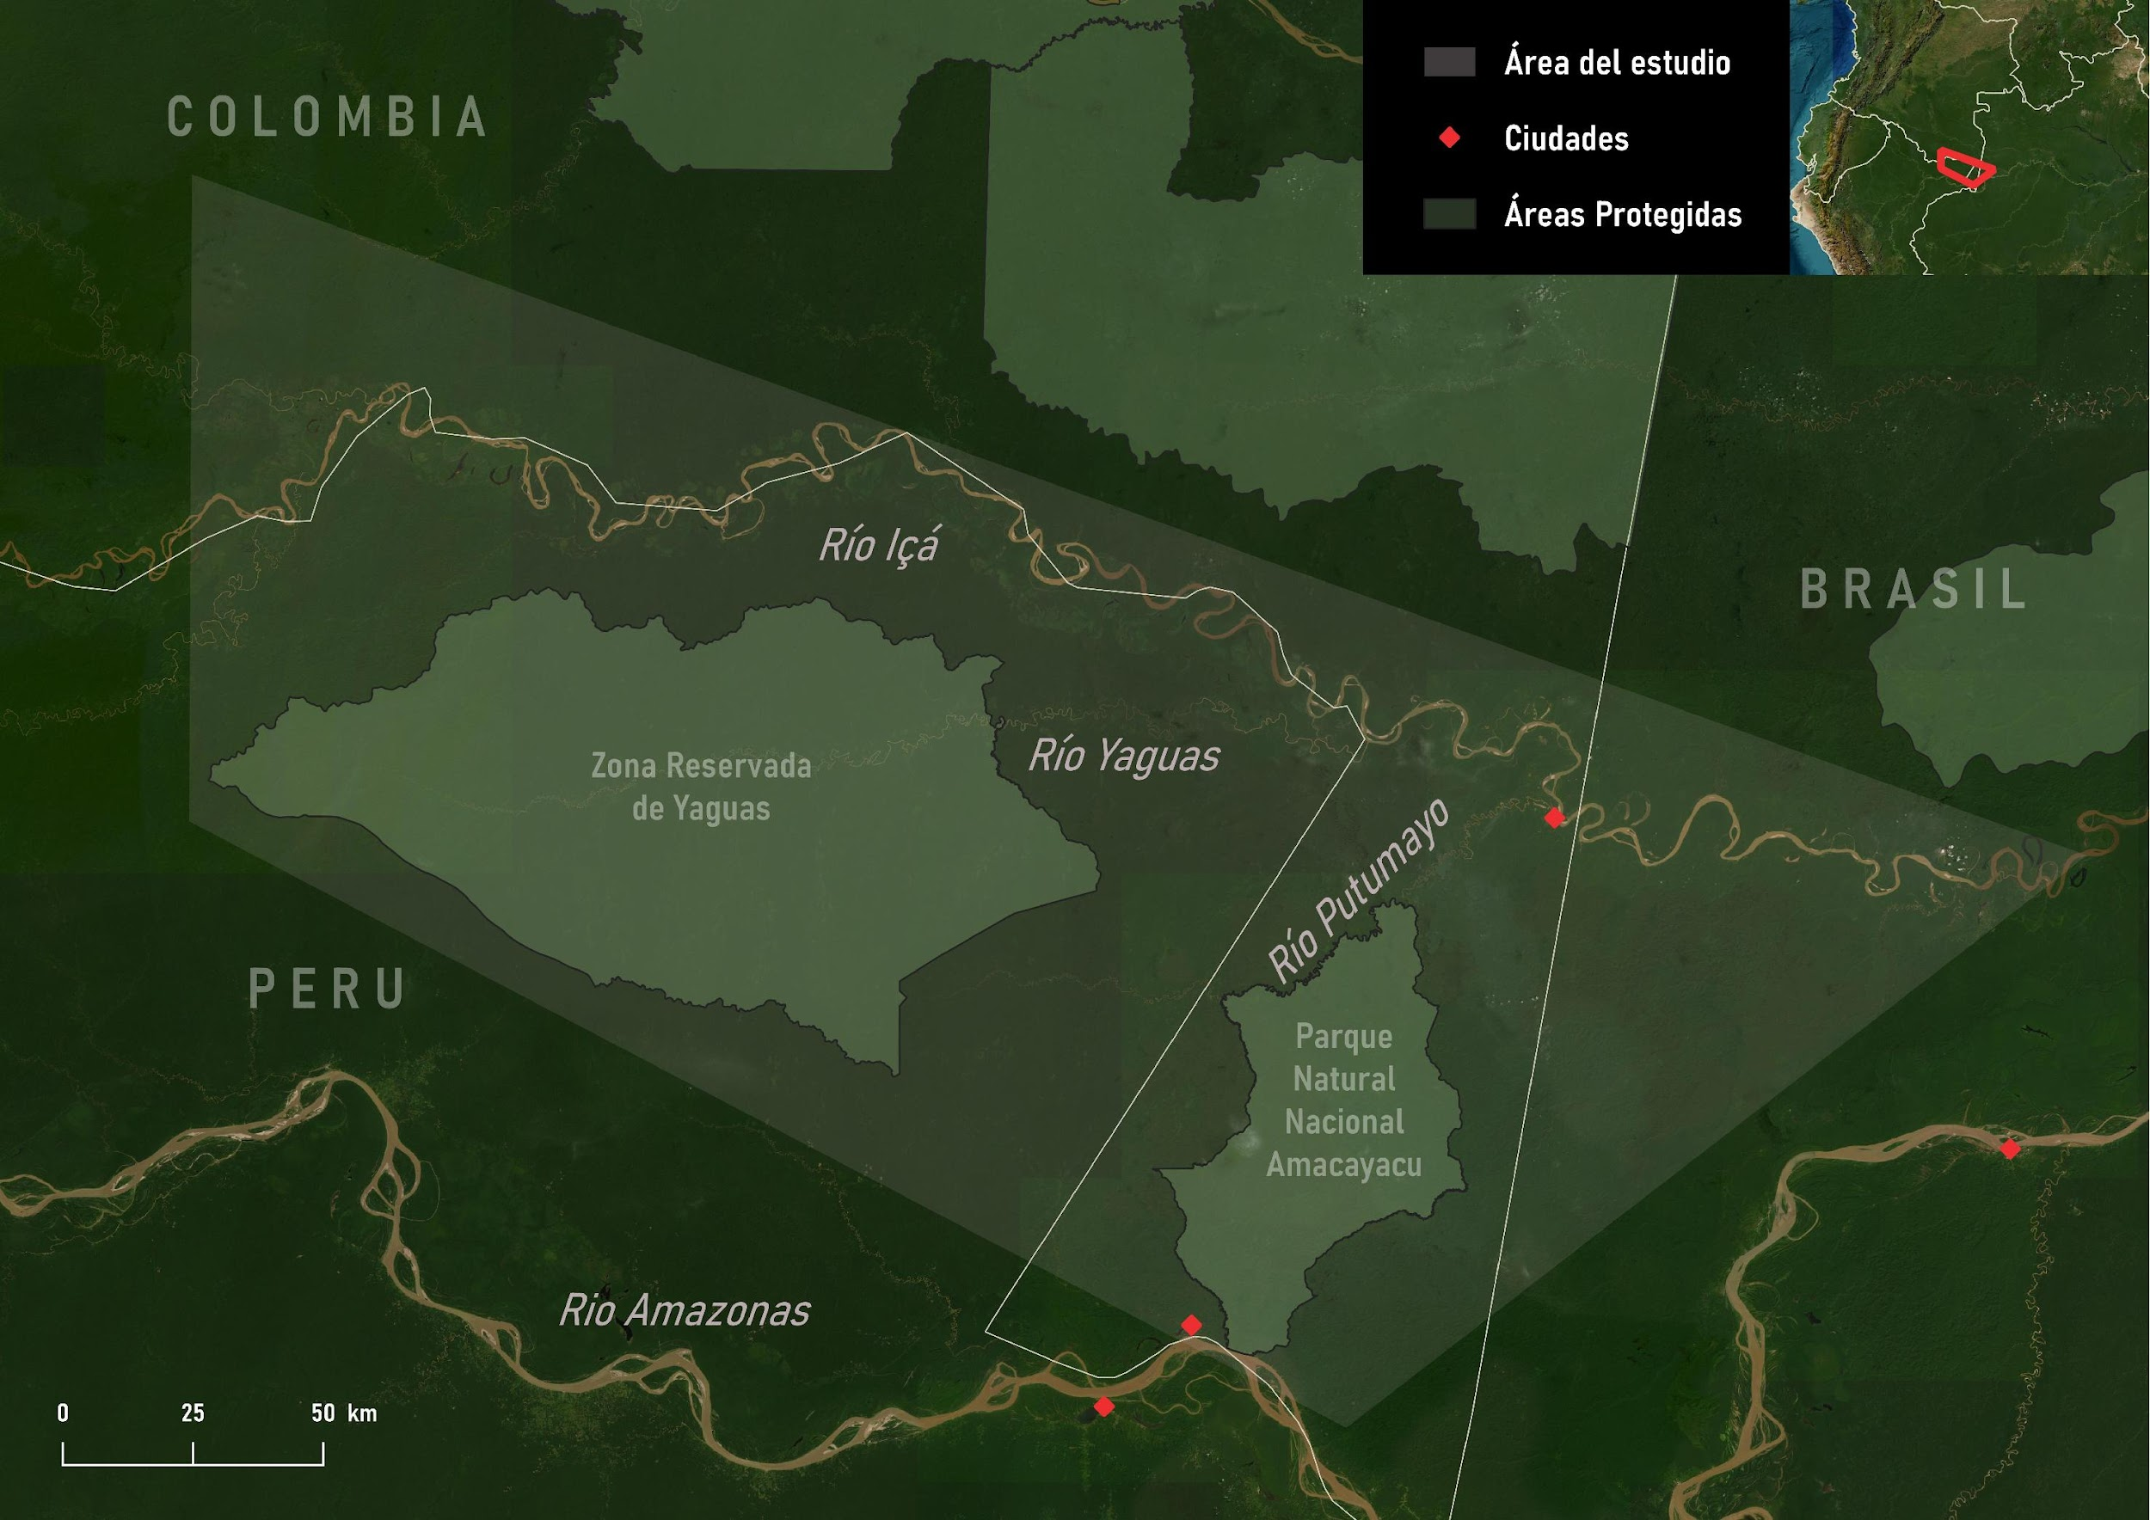
Study Area
Tri-border area between Brazil (Santo Antônio do Içá and Tabatinga), Peru (Loreto), and Colombia (Amazonas)
Around four Indigenous ethnic groups inhabit the region
Extensive mining activity using dredges, near Amacayacu National Natural Park (PNN Amacayacu)

Slide 64

Expansion of Illegal Mining Activities
A more homogeneous distribution of illegal mining sites was observed across the three territories.
To account for the two observed patterns, it was decided to conduct two separate analyses: one for 2021 and another for 2022.

Slide 65

Scenario 1
(2021)
The impacts were calculated in 2021;
2 dredging points in Peru, 4 in Colombia, and 15 in Brazil: a total of 21 dredges.

Slide 66


Results
Scenario 1
Non-monetary impacts
Number of ferries | 21
Total gold amount (30 ferries in 1 year) | 252
Gold production (kg) | 108
Removed Sediments (t) | 4.192.559
Mercury Released into Rivers(kg) | 5
Monetary impacts (USD)
River Sedimentation | 1.364.480
Risk of Cardiovascular Diseases | 17.654.997
Neuropsychological Symptoms | 1.532.400
Gold value | 6.106.284
Total | 26.658.164

Slide 67

Scenario 2
(2022)
The impacts were calculated in 2022;
10 dredge points in Colombia and 51 in Brazil: 61 dredges in total

Slide 68
Results
Scenario 2
Impactos no monetários
Número de balsas | 61
Total de extracción de oro (30 balsas operando por 1 año) | 360
Producción de oro (kg) | 327
Sedimentos retirados (t) | 12.718.829
Mercurio vertido em ríos (kg) | 16
Impactos monetários (USD)
Sedimentación de ríos | 2.262.148
Riesgo de enfermidades cardiovasculares | 58.386.887
Síntomas neuropsicológicos | 4.561.829
Oro | 18.572.293
Costo total | 83.783.158

Slide 69
Case study - conclusion
  The Illegal Gold Mining Impact Calculator is intended to serve as a basis for judging cases related to this issue.
  Total economic damages for each case study ranged from 57 to 135 million USD
  The loss of societal well-being caused by the impacts of illegal mining activities is one of the key reasons why this tool is so important.
  It is also worth highlighting the calculator’s potential if automatically integrated into a dredge detection system, such as the one used by the Brazilian Federal Police. This would allow for rapid assessment of mining impacts, supporting the work of enforcement authorities and generating real-time results.

Slide 70

How does your institution currently measure or calculate the social and environmental damages caused by illegal gold mining?

Slide 71
Context and current limitations of the tool
- Designed for the Amazon region at this stage.
Focused on the three most common types of artisanal mining in the Amazon.
Currently estimates only health impacts related to mercury exposure → Other substances such as cyanide are not yet included in the economic valuation.
Moral damages are not considered.
Estimates of the impacts of social conflicts are not included.
Atmospheric mercury emissions and their effects on the general population are not yet quantified.

Slide 72

What would need to be adapted for this approach to be relevant locally?
Input variables (e.g., mercury use, population exposure, gold yields)
Institutional alignment and capacity to use the tool
Communication and framing to fit national policy priorities

Slide 73

Case Study Q&A /Discussion
Lessons learned from the case study and how they can inform future implementation efforts.

Slide 74
Who would like to volunteer to bring maps for our next session?
- Additional context (e.g., photos)
- Information on which institutions are involved in regulating/organizing gold mining in your country
- Any available maps, as well as an estimate of the scale (hectares, number of dredges/rafts, etc.)
- What are the dilemmas faced in the region?

Slide 75
Thank you.

