Slide 1








Economic valuation of the impact of illegal gold mining
October 2025
Assessment of Impacts of Artisanal Gold Mining
Day 2
Supported by:
Led by:
In partnership with:

Slide 2

Welcome to the Phase 2 Webinar Series – Review from previous session
Phase 2: Deep Dives on Artisanal and Small-Scale Gold Mining (ASGM)
  Strengthen participants' understanding of the environmental and social impacts of gold mining.
  Improve the usability of the Mining Impact Calculator (MIC), including exploring potential adaptations for different PlanetGOLD country contexts.
  Identify key challenges for MIC adoption and application through practical exercises and interactive discussions.

Slide 3
Welcome to the Phase 2 Webinar Series – Introductions
Participant Introductions
Let’s get to know each other!
Please share in the chat or open your microphone:
Your Name
Your Country
Your Role or Position
And one point you’d like to share (e.g., your interest in the topic, your expectations for the session, or a connection to ASGM)

Slide 4
Case Study Presentation

Slide 5
Adapting the Mining Impact Calculator for Amazon Countries
The tool was adapted for several Amazonian countries: Brazil, Bolivia, Colombia, Ecuador, Guyana, Peru, and Suriname.
Adaptation focused primarily on contextual variables specific to each country (e.g., economic, demographic, environmental data).
A case study was presented previously for the tri-border area between Brazil, Colombia, and Peru.
In this case, country-specific values were adjusted to reflect national contexts,
→ without altering the tool’s input structure or interface elements.

Slide 6
Beyond Adaptation: Broader Adjustments for Tool Adoption
In order to adopt the tool in some countries, stronger advocacy efforts have been made with key users such as environmental inspectors, police forces, public prosecutors, and other authorities.
As a result, some countries have required more substantial adjustments, going beyond contextual adaptation to include new input options and methodological refinements.

Slide 7
Beyond Adaptation: Broader Adjustments for Tool Adoption
Examples:
Peru: Due to the involvement of the Public Prosecutor’s Office, a different approach was requested.
→ A new input variable was added: the number and engine power of backhoe machines used to cause the damage.
Bolivia: The national protected areas authority (SERNAP) requested a distinct methodology to differentiate whether the damage occurred inside or outside protected areas.
→ Although gold mining is legally permitted within protected areas in Bolivia, the ecosystem service losses are considered more significant in these zones.

Slide 8
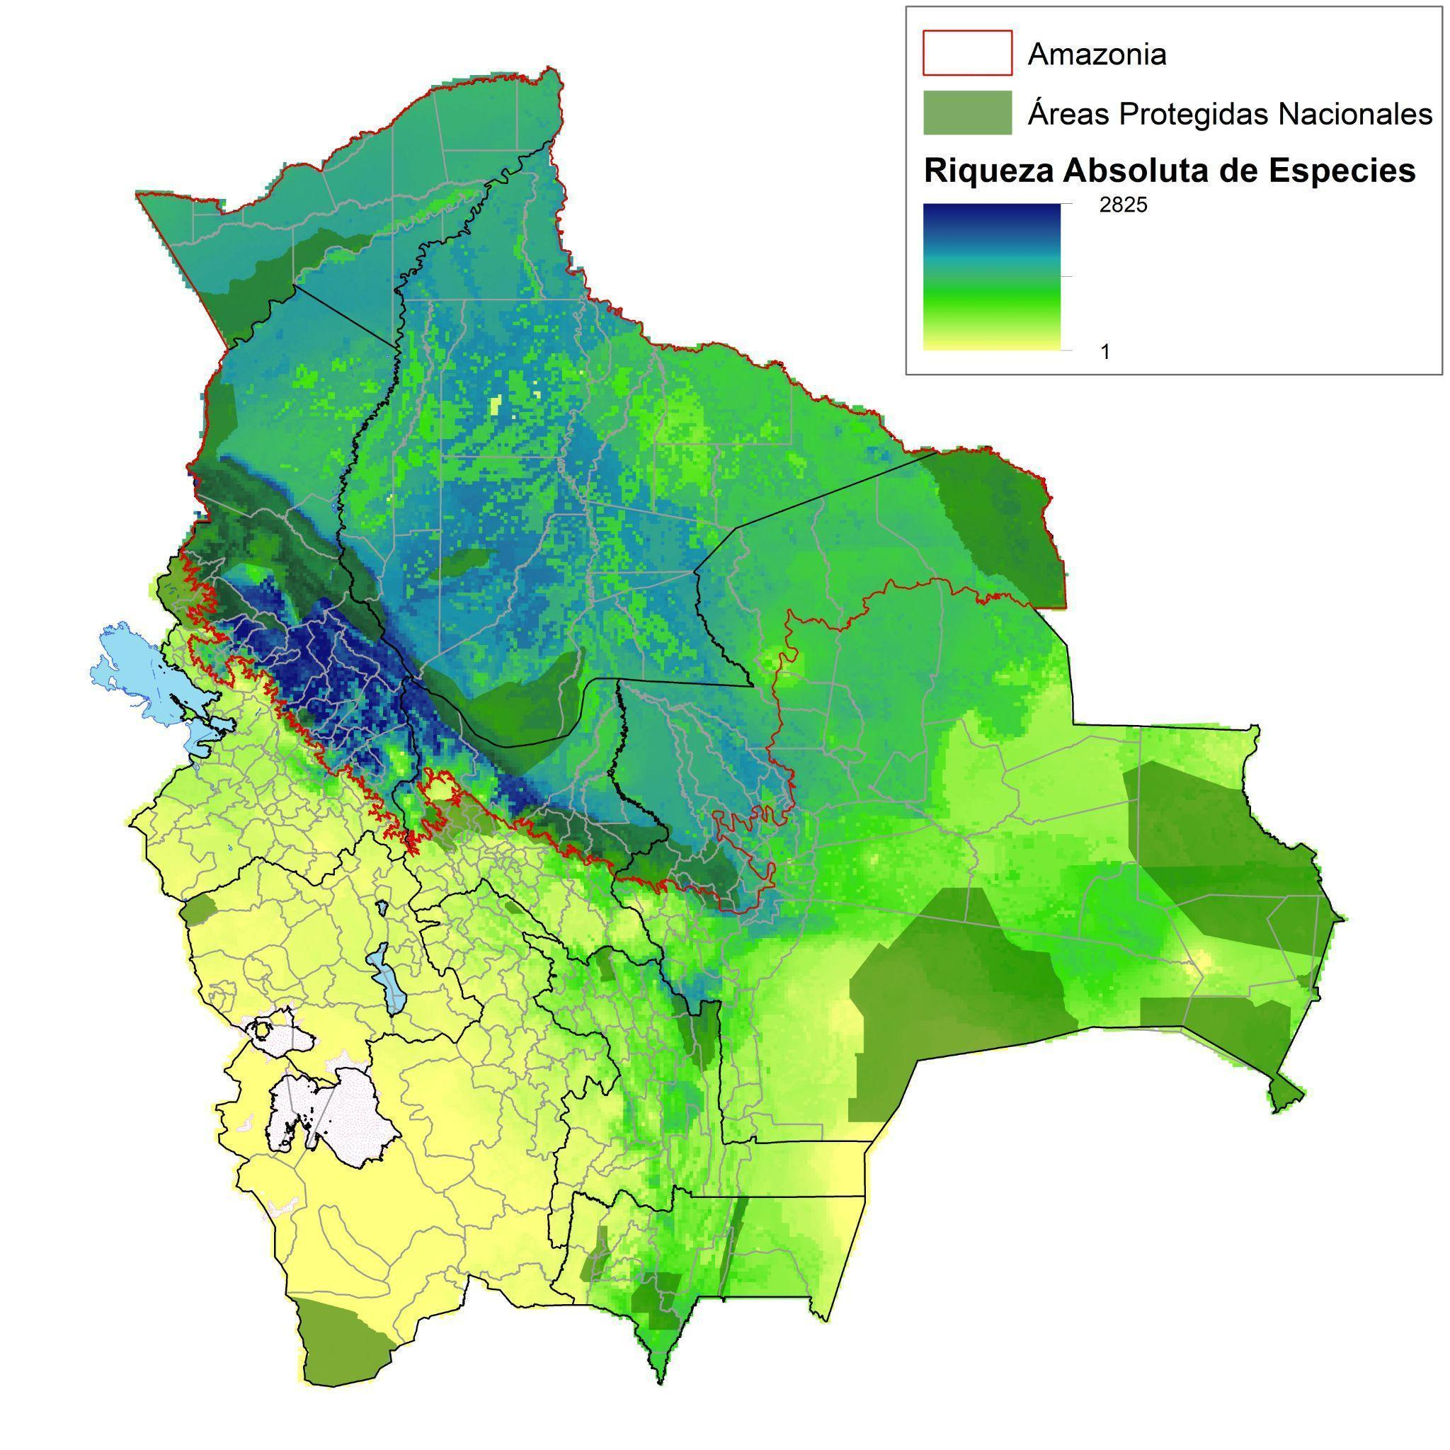
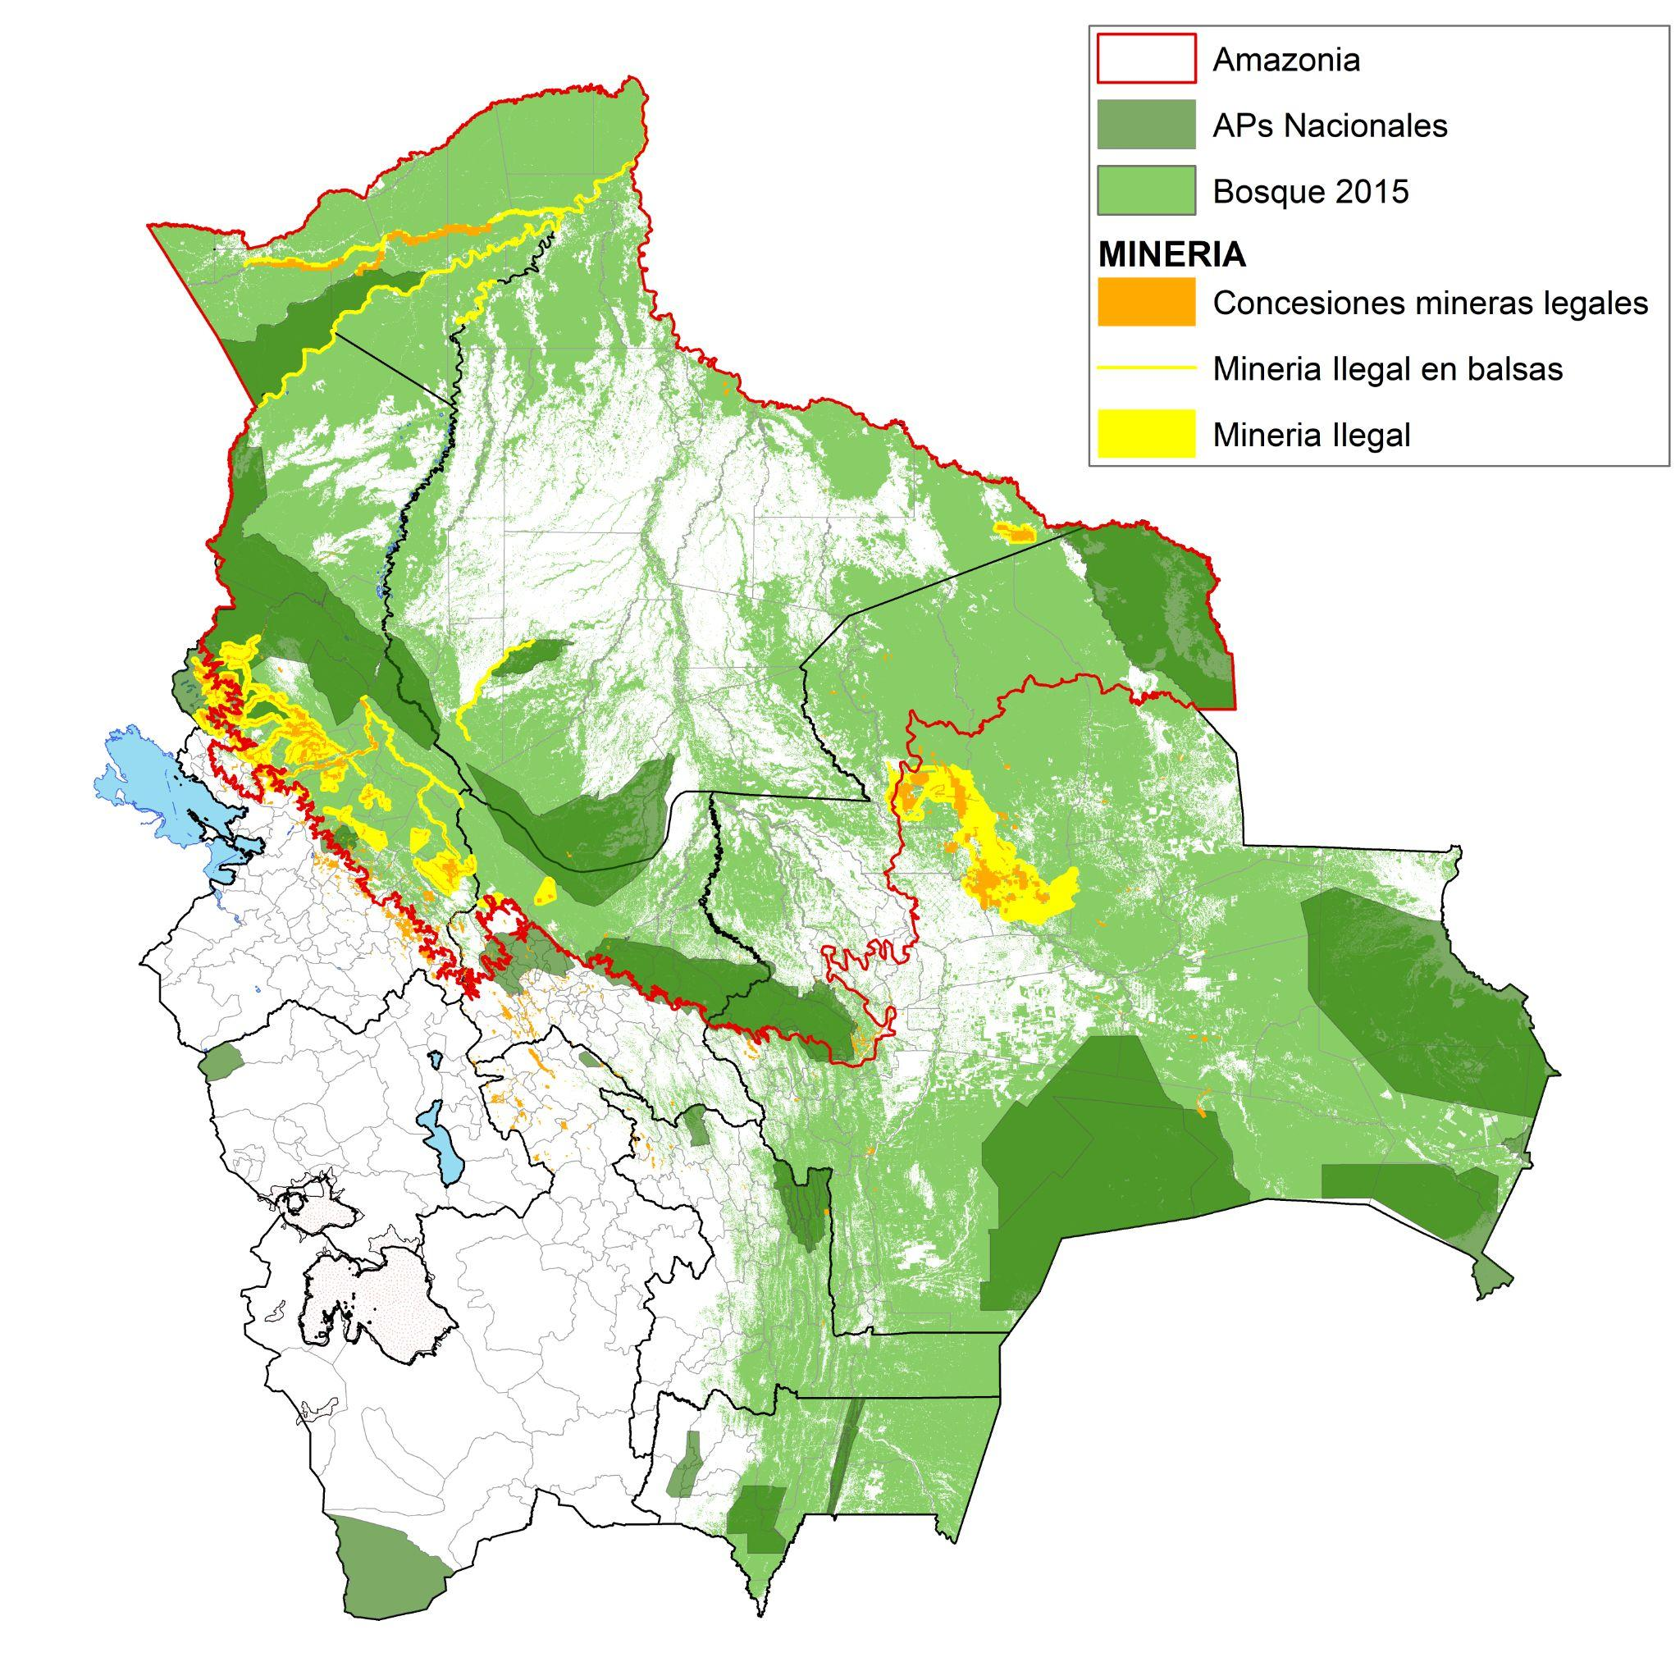
Bolivia: Priority Areas for the Pilot Case within Protected Areas
Map of Absolute Species Richness
2023 Map of Legal/Illegal Mining and National Protected Areas
Source: C. Nowicki, H. Sommer, A. Ley & P.L. Ibisch. 2004.
Source: RAISG 2023

Slide 9
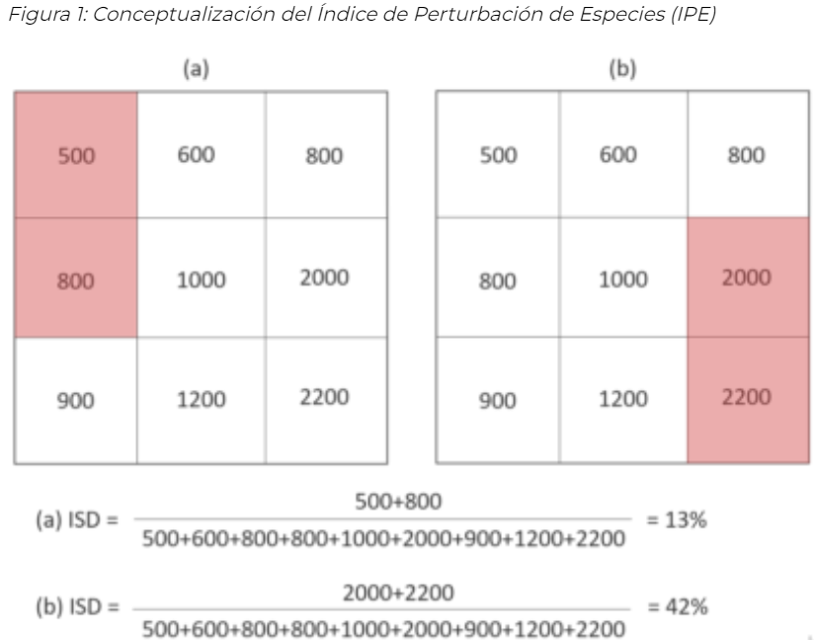
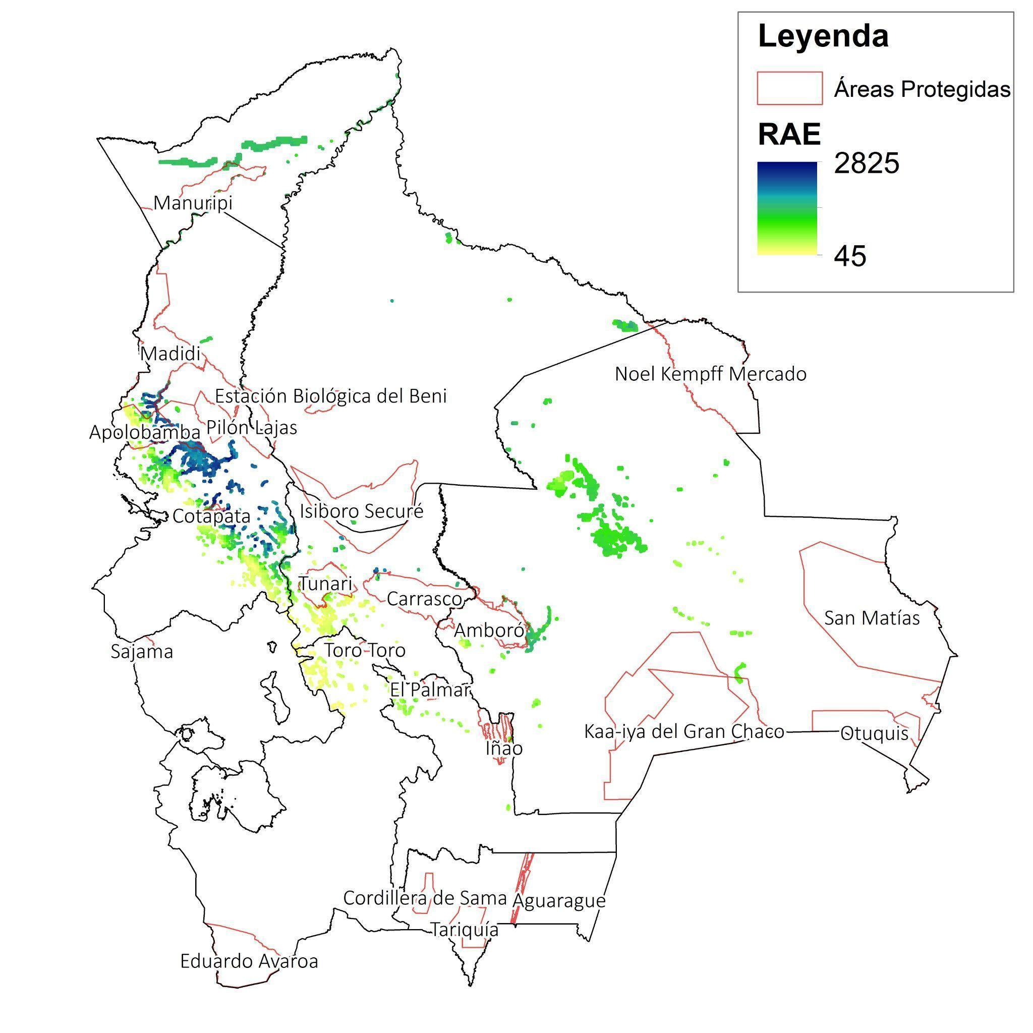
Methodology of the Species Perturbation Index (SPI)
Conceptualization of the Species Disturbance Index (SDI)
Map of the Species Disturbance Index (SDI) from ASM Mining in 2023 for Protected Areas
Source: SDSN Bolivia (2019).
Source: C. Nowicki, H. Sommer, A. Ley & P.L. Ibisch. 2004. & RAISG.

Slide 10
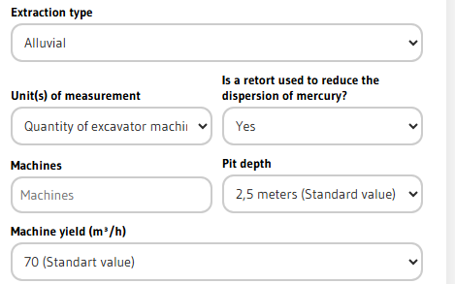
Case Study - Peru
To meet the needs of the Public Prosecutor’s Office in Peru regarding the adoption of the tool, it was requested that a new input unit be added:
  the number of excavator machines and their yield (m³/ha).
In other words, users will arrive at the same results, but now have an additional input option based on the number of machines used.

Slide 11
Case Study

Slide 12
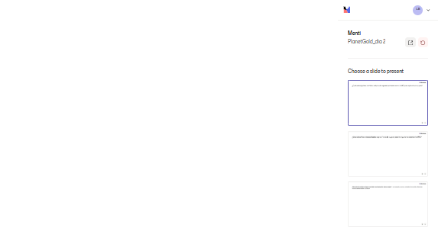
What would be the first change or adaptation you would need to make to the MIC to apply it in your country?

Slide 13
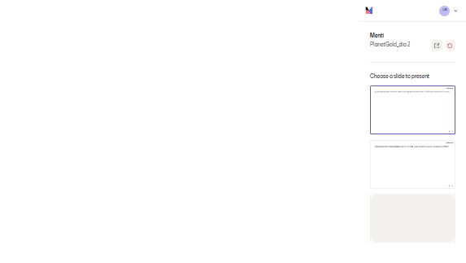
Group Discussion (Q&A) – National contexts and mining impacts
What specific challenges or needs in your country could the MIC help address?

Slide 14
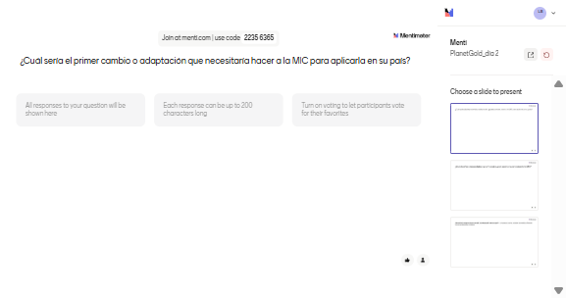
Group Discussion (Q&A) – National contexts and mining impacts
Would you need to adapt any input variables or methodology?
→ e.g., new units of measurement, different environmental or legal frameworks

Slide 15
Mini break
5 minutes

Slide 16
Breakout Session – Drafting a Fictional Case Study

Slide 17
Breakout sessions
Objective:
Participants collaborate in small groups to design a fictional case study showing how the Mining Impact Calculator (MIC) would be adapted and applied in a country of their choice.
Instructions:
Choose a fictional country or adapt from your own national context.
In 20 minutes, work together to answer the guiding questions and outline your case study.

Slide 18
Breakout sessions – Group Task
Context:
– Describe the country/territory and key mining challenges.
– Is the focus mercury use? Deforestation? Health? Legal enforcement?
Adaptations Required:
– Which variables or methods would need to be adapted in the MIC?
– Any new input units or adjustments for legal/policy context?
Key Stakeholders:
– Who would need to be involved in adopting the MIC?
– What kind of advocacy or institutional support is needed?
Expected Benefits:
– What would be the value or impact of applying the tool in this context?

Slide 19
Breakout Session – Next Steps (adoption)

Slide 20
Breakout Session – Next Steps (adoption)
Objective:
Country teams will collaborate to outline a strategic roadmap for adopting the Mining Impact Calculator (MIC).
This session will help identify key needs, realistic goals, and concrete next steps
Instructions:
You will have 20 minutes to discuss and fill out a simple roadmap template

Slide 21
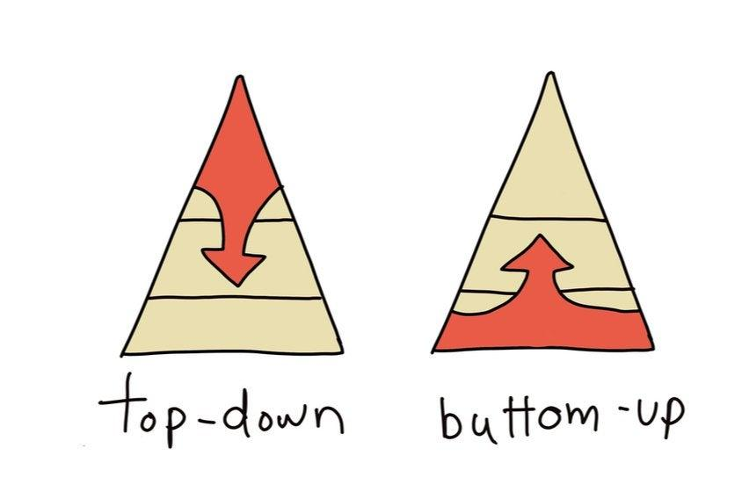
Adoption Strategy
Do experts have autonomy to choose the valuation methodology?
Publish examples of successful case studies or research
Is there political will to improve impact assessment?
Approve regulations or laws
Ministerial Decision / Law
Use by Experts

Slide 22
Roadmap – Breakout sessions
Approach:
– Will adoption require a top-down (governmental/policy) or bottom-up (field-level/user-driven) approach? Or both?
Vision:
– What does successful adoption look like in your country?
Next Steps (3–5):
– Define specific and realistic actions to move forward.
– Include steps related to institutional agreements, piloting, data collection, or training.
Support Needs:
– What kind of support would help you succeed? (technical, legal, political, training, communication, etc.)

Slide 23
Plenary – Report Back

Slide 24
Thank you.

