Slide 1








Monitoring landscape-level outcomes
17 October 2025
How LandScale can support JA/LA in Artisanal Small Scale Gold Mining (ASSGM)
Session B
Supported by:
Led by:
In partnership with:

Slide 2

Agenda
Recap of Session A
Enabling conditions: Landscape Initiative Maturity
Practical session: Building a LandScale profile
Identifying next steps for implementing holistic landscape monitoring
Notes:
JANET

Slide 3

Housekeeping rules for a collaborative learning space
  Where possible, keep your video on
  Keep your microphone on mute (unless you want to talk!)
  Use the chat function and reactions freely
  Ask questions
  Enjoy!
Notes:
JANET

Slide 4
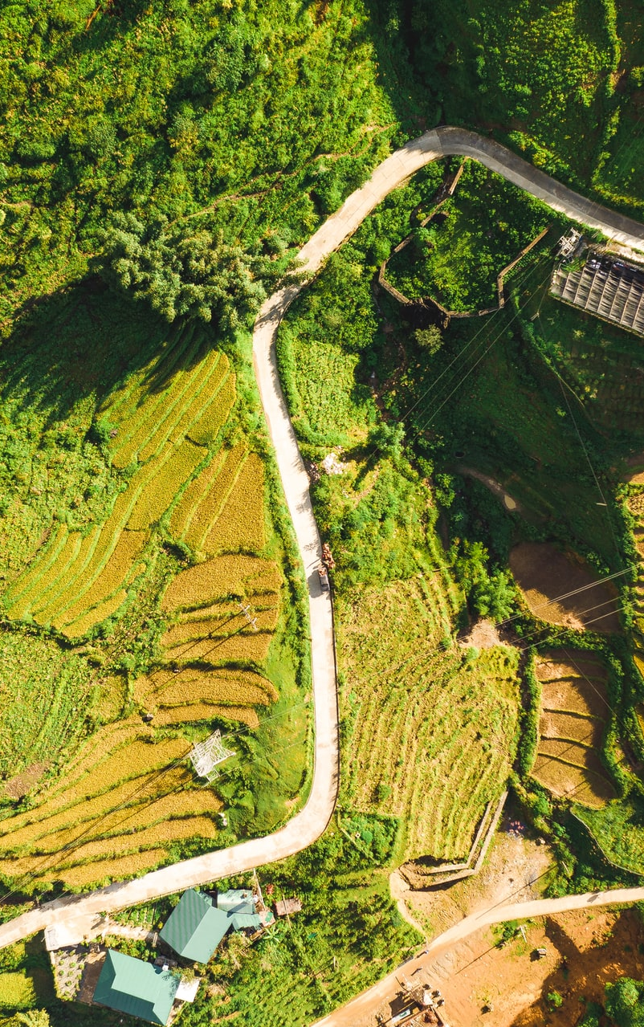

Intended Learning Outcomes
After this webinar, participants are able to:
Understand the enabling conditions needed for participatory, landscape-scale monitoring
Understand the core criteria for mature landscape initiatives
Understand how landscape profiling can be useful (and how to create a LandScale profile)
Identify tangible actions to progress towards conducting holistic landscape monitoring
Notes:
OM

Slide 5

Session A recap
Notes:
Menti

Slide 6
Vision
A future where people, nature and business prosper through sustainable landscape management.
Mission
LandScale equips local and global landscape stakeholders to access and report reliable information about landscape management and sustainability performance, enabling them to design and target interventions to deliver greater impact at scale.

Slide 7














Who Is Behind LandScale?
Steering group
Foundational partners
New
partners
Donors

Slide 8
DRIVERS
WHY LANDSCAPE APPROACH?
WHY LANDSCAPE MRV?
Regulatory pressure for accountability (eg CSDDD) & transparency (eg CSRD)
Credible landscape monitoring makes landscape approach more efficient and more effective:
Need to demonstrate robust Free, Prior and Informed Consent
Current approaches don’t go far enough
Data driven & participatory: shared understanding of baseline, shared ID of critical needs & interventions
Promotes robust participation & FPIC
Supports conflict resolution & long-term collaboration
Credibly measure change aligned to global frameworks
Credibly communicate support & contribution to outcomes
Stakeholder expectations
Siloes & conflicts limit project efforts
Addressing risk & securing business value
Challenges are getting greater
Need to tackle root causes
Legitimacy: accountable & social license
Collaboration for greater impact
Responsible business commitments
Increasingly ‘nowhere to hide’: civil society has more data & voice, & regulatory crackdown on greenwashing

Slide 9
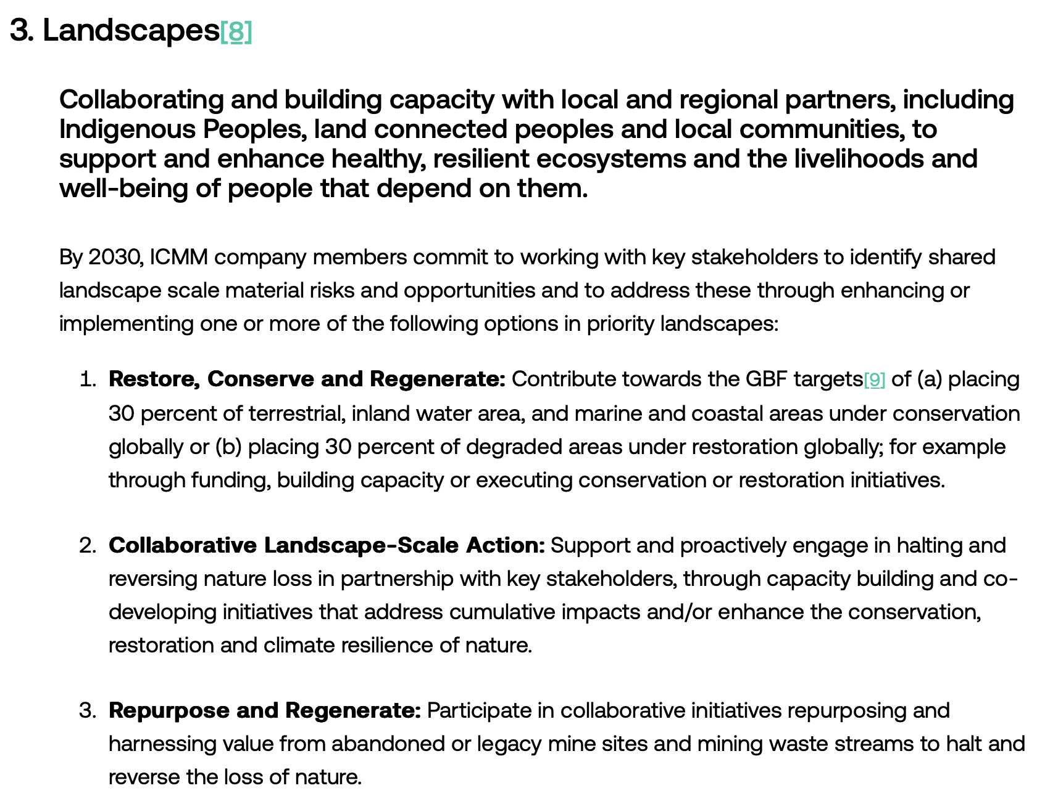

Mining & L/JAs
Targets & disclosure drivers:
TNFD: Additional Sector Guidance for Metals & Mining
ICMM: Landscape commitment
CDP: Disclosures on Landscape and Jurisdictional Approaches
SBTN: Land targets
  Landscape approach enables better management of negative impacts while enhancing the benefits of economic activity
  Understands issues as complex & interrelated to better understand cause, effect & best interventions
  multi-stakeholder engagement and broad participation supports local buy-in, sustained collaboration & maximizing co-benefits
Notes:
Growing demand for transition minerals to meet net zero
Minerals often in critical nature frontiers & where could impact rights of Indigenous Peoples & local communities
More and more companies and governments are investing in multi-stakeholder landscape approaches as a way to tackle the urgent systemic challenges we face in a more efficient and effective way, and realise more resilient supply chains.
For example, since CDP first introduced questions about engagement in landscape and jurisdictional approaches into their questionnaires, there has been a significant increase in the number of both companies and states and regions reporting engagement

Slide 10
How can LandScale support?
Risk and Impact Assessment at landscape Level
Support mining companies assessing and mitigating the impact of their operation through the assessment (e.g. water, biodiversity, social impact and stakeholders' consultation), LandScale can be used as an M&E system to track impacts beyond site level, as most of these idssues cannot be addressed at site level.
Biodiversity
Support mining companies restoring legacy mines, assessing landscape level connectivity, and wildlife management
Stakeholder Engagement
Supporting mining companies set goals in collaboration with key stakeholders in the landscape, through a standardized and well-established framework.
Step wise approach
Using LandScale can be an intermediary step towards certification, if there is an alignment in indicators.

Slide 11
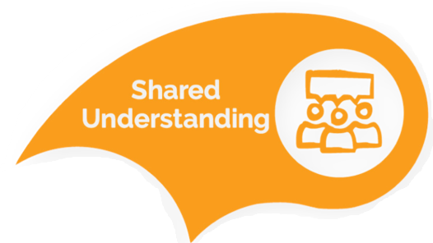


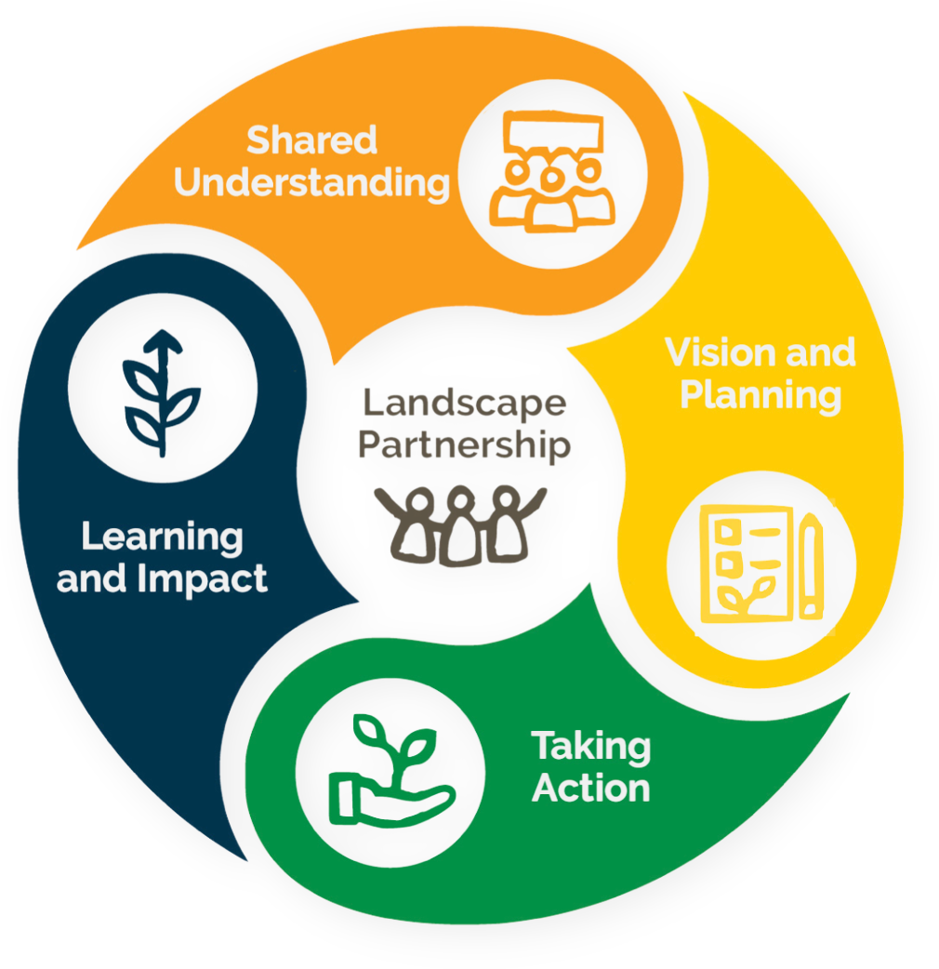

The ILM elements
Notes:
In the previous session we looked at the ILM elements and how LandScale can support
Partnership: support participatory approach through framework, process and platform, mandatory local review for published results. Provide a platform for stakeholder engagement
Shared understanding: Identify landscape stakeholders and conduct workshops, platform for coordination and repository for landscape data and results communication. Foster collaboration and co-development and problem solving
Vision and planning: stakeholder meetings to identify shared goals and vision
Taking action: baseline assessment results feed into action plans.
Learning and impact: reassess baselines to monitor changes or trends over time. Comprehensive approach enables users to assess how efforts have influenced change in the landscape and inform adaptive management.

Slide 12
Landscape initiative journey
For continual improvement in landscape monitoring and ILM
Landscape initiative convening
Landscape baseline assessment
Landscape management & finance strategy
Landscape initiative maturity assessment
Public profiling
Activity monitoring
Outcome monitoring
Holistic re-assessment
Shared understanding of current state
Informs priority interventions
Roadmap for continual improvement
Profile raising and storytelling across multiple platforms
Tracking key outcomes and linking to activities (claims)
Recalibration of critical issues
Shared agreement of critical needs
Informs investment asks
Signals investment-ready
Build confidence through validation with business
Credible claims (process assurance and third party content assurance)
Ensure avoiding displacement

Slide 13
LandScale raising the standard
Overarching principles: Landscape-scale; holistic; participatory; evidence-based; transparent
Health of the landscape:
LandScale assessment
Health of the landscape initiative:
Landscape Initiative Maturity
Ecosystems / human wellbeing / governance / production
Scale / multi-stakeholder governance / collective goal & actions / collective monitoring
Measure changes over time (outcomes)
Roadmap for continual improvement
Indicator packages
Indicator packages
Indicator packages
Notes:
To do this, we have two key frameworks:
The Assessment Framework, which helps initiatives track progress in holistic outcomes over time, and
The Landscape Initiative Maturity Framework, which acts as a roadmap for strengthening the initiative's governance and systems.
Today, we’ll be focusing on the LIM framework.

Slide 14

Our solution: LandScale’s integrated system
Assessment Framework
Conduct an assessment using
the holistic framework and
guidance on the online platform.
Validation Mechanism
Gain more confidence in your insights through local review
and LandScale validation.
Online
Platform
Share your results on the
public-facing side of platform
and make credible claims.

Slide 15
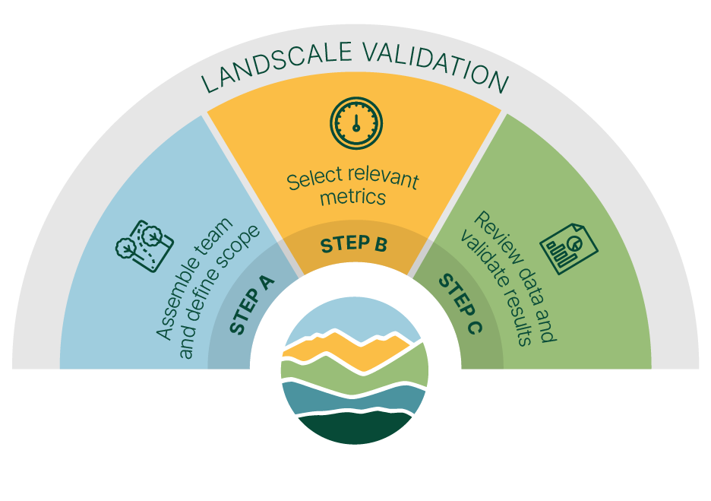
Here’s How It Works
Measures
Select indicators
Select metrics
Identify data needs
Screen data suitability
Evaluate data quality
Boundary
Identify landscape boundary
Compile background information about landscape
Data
Generate results
Set optional targets & milestones
Preparation
Local review of data sources & results
Recruit assessment team
Set landscape goals & assessment objectives
Prepare stakeholder engagement plan
Reporting
Generate report
Publish results

Slide 16
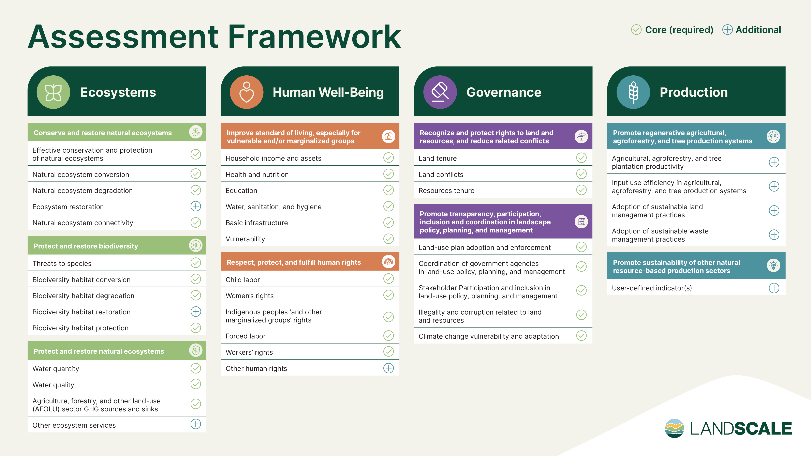
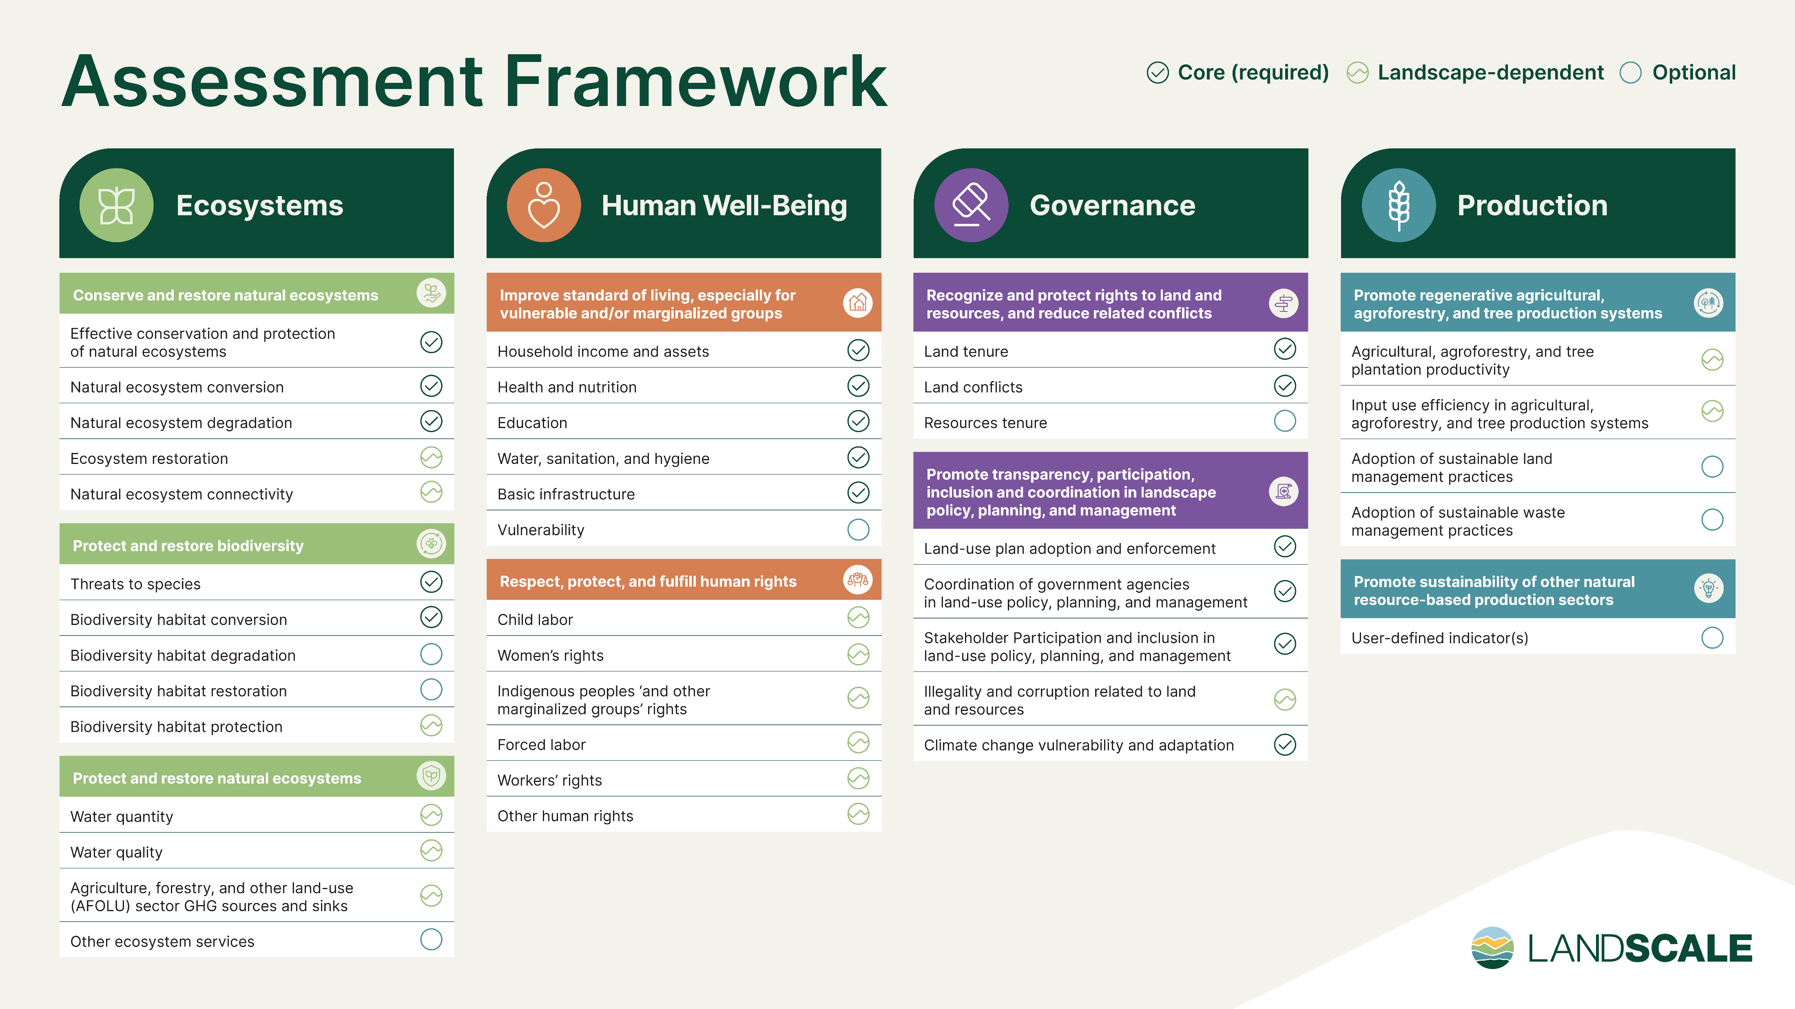

Slide 17


Our two-step validation process
This process enable decision-makers to place a high
degree of trust in the accuracy of the assessment results.
LandScale validation
Local review
The LandScale team carry out a review after each step of the assessment is completed to check that:
  The LandScale guidelines have
  been followed
  The data used is of sufficient quality
For each result, someone with expertise in the subject matter and knowledge of the region conducts a review to determine if:
  The data used is suitable
  The results reflect the actual conditions in the landscape

Slide 18





LandScale
users
worldwide
Alicante River Canyon
Location: Colombia
Size: 111,187 ha
Main economic activities: Agriculture, forestry and animal farming
Krong Nang district, Daklak
Location: Vietnam
Size: 62,000 ha
Main economic activities: Agriculture, forestry and animal farming
35+ landscapes being assessed in over 20 countries
Haut Niger
Location: Mali
Size: 9,929,800 ha
Main economic activities: Agriculture, mining, manufacturing
Coconut Landscape of Alabel, Malapatan, Malungon, Polomolok, Tampakan, and Tupi
Location: Philippines
Size: 297,174 ha
Main economic activities: agriculture and agri-related activities/services
Lamas
Location: Peru
Size: 200,000 ha
Main economic activities: Agriculture, forestry and animal farming

Slide 19
Enabling conditions:
Landscape initiative maturity

Slide 20
LandScale raising the standard
Overarching principles: Landscape-scale; holistic; participatory; evidence-based; transparent
Health of the landscape:
LandScale assessment
Health of the landscape initiative:
Landscape Initiative Maturity
Ecosystems / human wellbeing / governance / production
Scale / multi-stakeholder governance / collective goal & actions / collective monitoring
Measure changes over time (outcomes)
Roadmap for continual improvement
Indicator packages
Indicator packages
Indicator packages
Notes:
To do this, we have two key frameworks:
The Assessment Framework, which helps initiatives track progress in holistic outcomes over time, and
The Landscape Initiative Maturity Framework, which acts as a roadmap for strengthening the initiative's governance and systems.
Today, we’ll be focusing on the LIM framework.

Slide 21
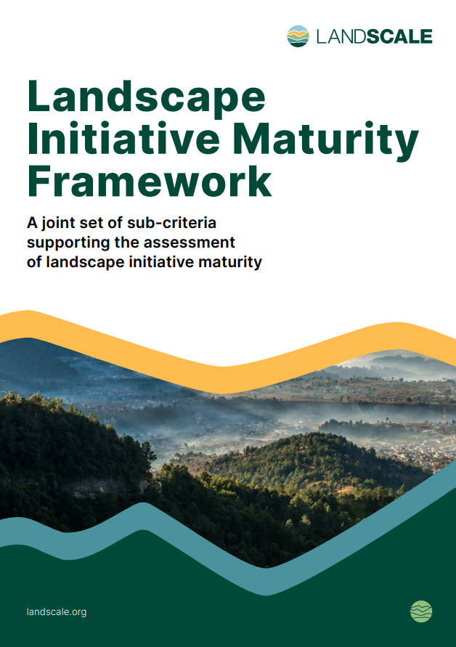
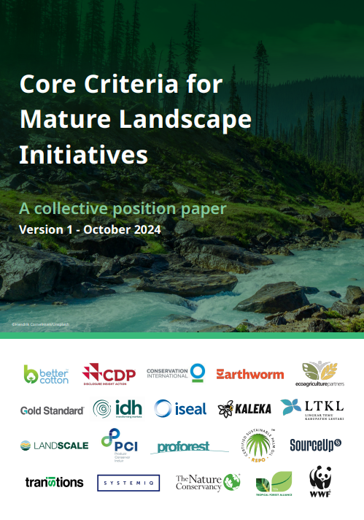
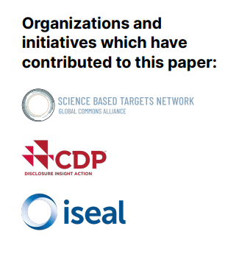
Landscape Initiative Maturity
Notes:
As many of you know, in early 2024, we collaborated with CDP, ISEAL, and SBTN to co-develop and publish the original LIM framework.
This was a major milestone—bringing alignment across organizations on a common set of sub-criteria.
Later that year, ISEAL convened a broader working group to refine the framework based on feedback from a more diverse set of stakeholders.
The updated version was published in October 2024—and that’s the version we’re working with now.
There are three main reasons we’ve updated:
Broader recognition and endorsement, which boosts credibility and adoption.
Stronger alignment across initiatives—notably with SourceUp.
Influence on disclosure frameworks—for instance, CDP is now adopting this refined version.
Why should your initiative transition to the updated version? Because demand is growing.
For example, the Forest Positive Coalition now requires landscapes to report their maturity progress through SourceUp.
We encourage all RA landscapes to stay ahead of this trend
Broader recognition and endorsement
Now backed by a range of prominent organizations, increasing credibility and uptake.
Stronger alignment across initiatives
Co-interpreted with SourceUp to ensure coherence and coordination.
Influence on reporting & disclosure frameworks
Interpretation was shared with CDP, which references it in their disclosure guidance.
Increasing demand
We anticipate increasing demand from corporates for this format (e.g., Forest Positive Coalition requiring landscapes to report maturity progress on SourceUp).

Slide 22
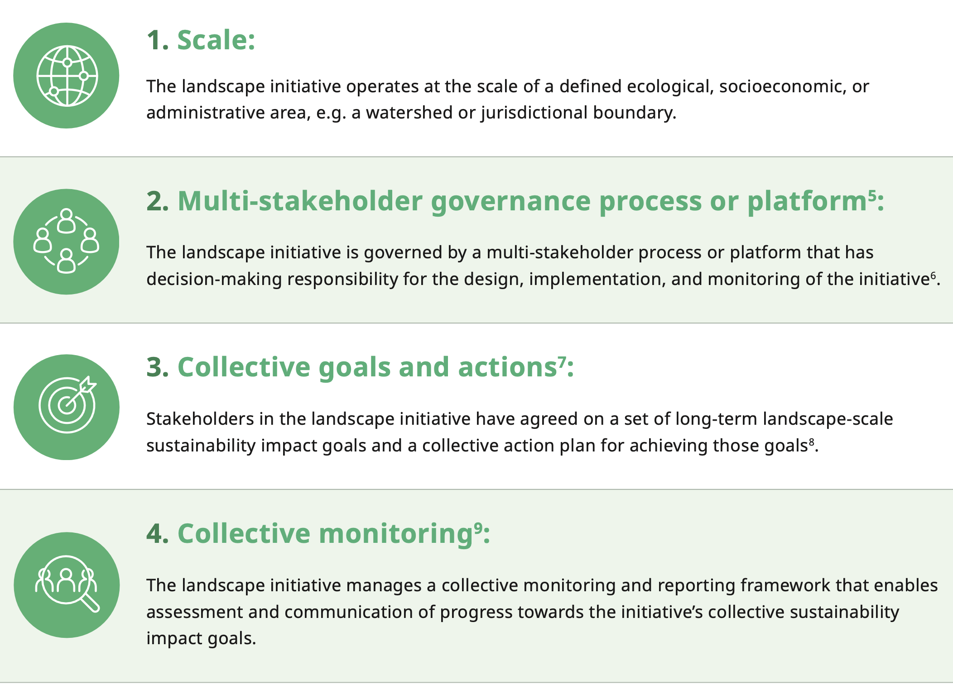
Landscape Initiative Maturity
Notes:
Each core criteria has a set of sub-criteria – what good looks like

Slide 23
Use cases
Improvement – high-level guidance, provide building blocks to improve quality, resilience and durability
Assessment – For reporting or disclosure frameworks
Claims – As prerequisites to support robust claims
Investment -
Engagement – Increase and facilitate collaboration across stakeholders
Learning – Framework establishing common language, facilitate knowledge exchange
Notes:
Improvement: As high-level guidance to landscape initiatives on the building blocks that will improve their quality, resilience, durability, and impact, as well as a gap assessment for organisations funding or supporting these initiatives.
Assessment: For reporting and disclosure frameworks to assess the quality and maturity of initiatives that companies or governments are reporting on18, or to validate the maturity of an initiative to be able to showcase to potential donors or investors
Claims: As prerequisites that support robust claims about the initiative, such as for credible disclosure of corporate engagement in landscape initiatives or when a landscape investment qualifies as contributing towards a company target
Investment: As a means of signalling opportunities for different types of investment and mitigating risk of those investments based on maturity and/or resilience of the landscape, and building confidence in landscape initiatives as a coherent investment theme.
Engagement: For supply chain companies, investors, and governments to have confidence collaborating with landscape initiatives, and to strengthen the position of local governments in leveraging private sector funding to achieve collective objectives
Learning: Providing an overall design framework that establishes a common language to talk about landscape initiatives and facilitate knowledge exchange between conceptual models, public policies, and practical implementation of landscape initiatives.

Slide 24
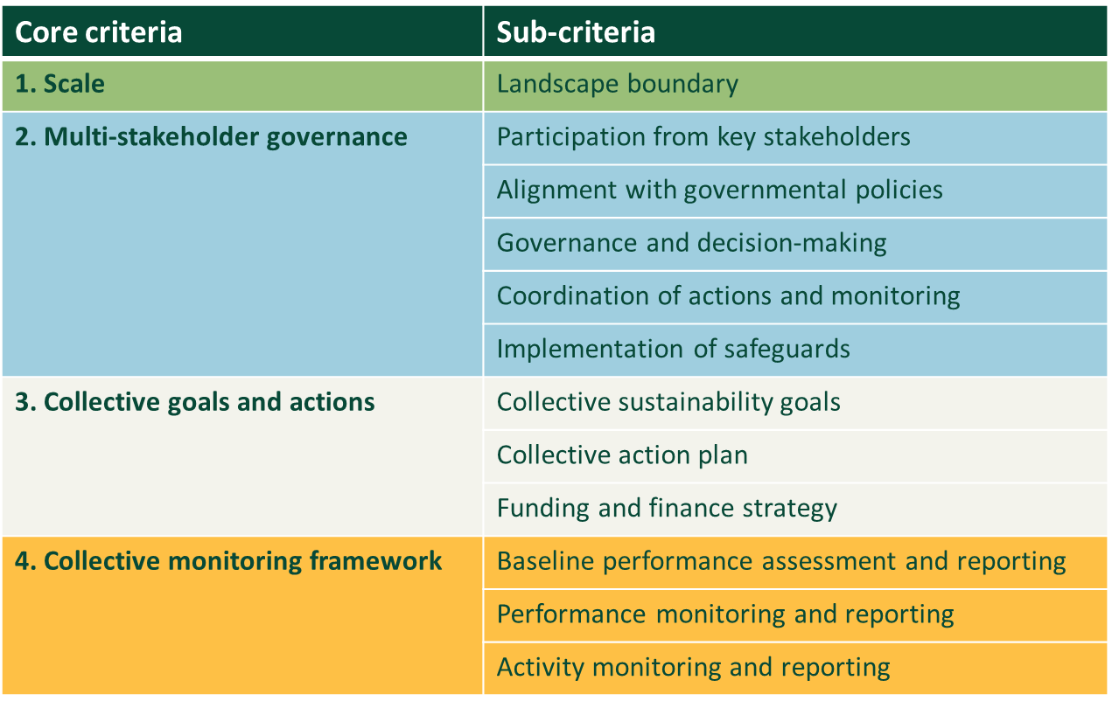
Notes:
Improvement: As high-level guidance to landscape initiatives on the building blocks that will improve their quality, resilience, durability, and impact, as well as a gap assessment for organisations funding or supporting these initiatives.
Assessment: For reporting and disclosure frameworks to assess the quality and maturity of initiatives that companies or governments are reporting on18, or to validate the maturity of an initiative to be able to showcase to potential donors or investors
Claims: As prerequisites that support robust claims about the initiative, such as for credible disclosure of corporate engagement in landscape initiatives or when a landscape investment qualifies as contributing towards a company target
Investment: As a means of signalling opportunities for different types of investment and mitigating risk of those investments based on maturity and/or resilience of the landscape, and building confidence in landscape initiatives as a coherent investment theme.
Engagement: For supply chain companies, investors, and governments to have confidence collaborating with landscape initiatives, and to strengthen the position of local governments in leveraging private sector funding to achieve collective objectives
Learning: Providing an overall design framework that establishes a common language to talk about landscape initiatives and facilitate knowledge exchange between conceptual models, public policies, and practical implementation of landscape initiatives.

Slide 25
Landscape Initiative Maturity
Core criteria | Sub-criteria
1. Scale | Landscape boundary
2. Multi-stakeholder governance | Participation from key stakeholders
 | Alignment with governmental policies
 | Governance and decision-making
 | Coordination of actions and monitoring
 | Implementation of safeguards
3. Collective goals and actions | Collective sustainability goals
 | Collective action plan
 | Funding and finance strategy
4. Collective monitoring framework | Baseline performance assessment and reporting
 | Performance monitoring and reporting
 | Activity monitoring and reporting
Notes:
Why is this important for LandScale?
Following publication, we collaborated closely with SourceUp to ensure our interpretation of the framework was aligned and fit for measurement.
We adapted the refined framework into a clear, evaluable set of sub-criteria.
This measurable interpretation has also been shared with CDP as the agreed basis for assessing maturity.
By assessing their maturity, landscape initiatives can:
Highlight strengths and achievements to key stakeholders, including supply chain companies, donors, and investors.
Identify priority areas for further development and resource allocation.
Strengthen governance and strategic planning to improve long-term resilience.

Slide 26
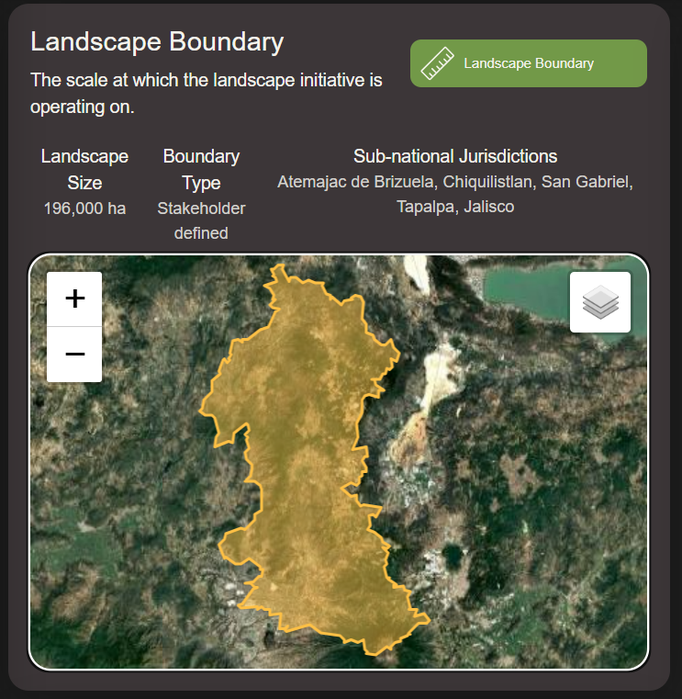
Scale
1.Landscape boundary
Landscape initiative operates at the scale of a defined ecological, socioeconomic, or administrative area
e.g. a watershed, jurisdictional boundary or stakeholder-defined boundary
10,000 ha +
Scale can influence systemic conditions underlying its sustainability goals, such as through land use planning or policy reform
Enables coherent area-level management by the multi-stakeholder governance process.
​
Notes:
The landscape initiative operates at the scale of a defined ecological, socioeconomic, or administrative area, e.g. a watershed or jurisdictional boundary.
Landscape initiatives typically operate at a scale of hundreds of thousands of hectares but can often be larger or occasionally smaller, depending on the landscape context.
Can influence systemic conditions underlying its sustainability goals, such as through land use planning or policy reform
Enables coherent area-level management by the multi-stakeholder governance process.

Slide 27
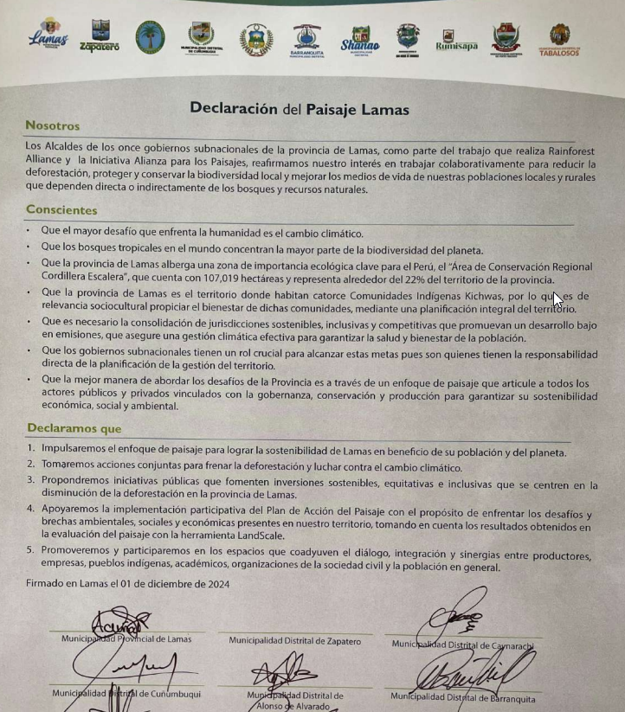
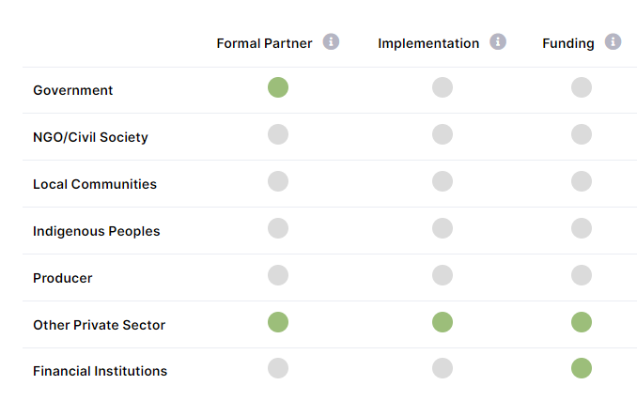
Multistakeholder governance
2. Participation from key stakeholders
3. Alignment with governmental policies
4. Governance and decision-making
5. Coordination of actions and monitoring
6. Implementation of safeguards
The landscape initiative is governed by a multi-stakeholder process or platform that has decision-making responsibility for the design, implementation, and monitoring of the initiative.
Includes active participation from key stakeholders in the landscape, including local community representatives in particular
Engages with local government directly and seeks to align with progressive local, sub-national, or national government priorities and policies
Implements safeguards, including grievance mechanisms, that minimise the risks of negative human rights or environmental impacts, while enhancing positive results for people and nature within the landscape
Notes:
The landscape initiative is governed by a multi-stakeholder process or platform that has decision-making responsibility for the design, implementation, and monitoring of the initiative.
includes active participation from key stakeholders11 in the landscape, including local community representatives in particular
engages with local government directly and seeks to align with progressive local, sub-national, or national government priorities and policies;
implements safeguards, including grievance mechanisms, that minimise the risks of negative human rights or environmental impacts, while enhancing positive results for people and nature within the landscape

Slide 28
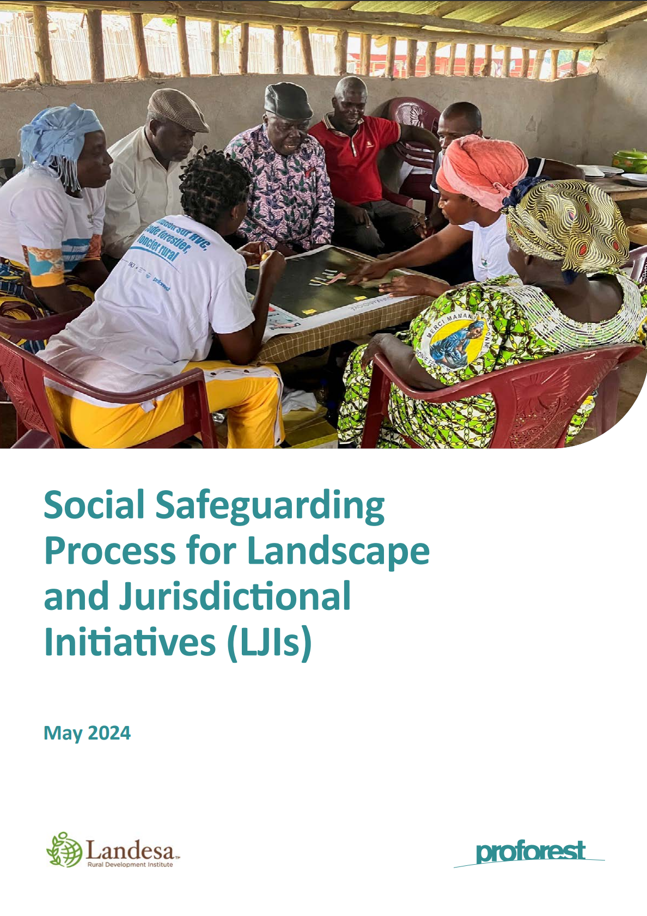
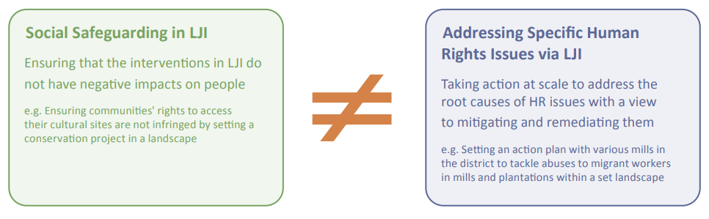
Implementing social safeguards
Ensure LJIs deliver positive outcomes without causing harm to local people and communities.
https://www.proforest.net/knowledge-and-resources/publications/social-safeguarding-process-for-landscape-and-jurisdictional-initiatives-ljis/
Notes:
Social Safeguarding Process for Landscape and JurSocial Safeguarding Process for Landscape and Jurisdictional Initiatives (LJIs) - Proforest
isdictional Initiatives (LJIs) - Proforest

Slide 29
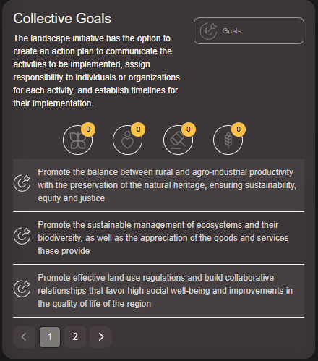
Collective Goals and Actions
7. Collective sustainability goals
8. Collective action plan
9. Funding and finance strategy
Stakeholders in the landscape initiative have agreed on a set of long-term landscape-scale sustainability impact goals and a collective action plan for achieving those goals
Collective sustainability goals: are informed by a context analysis or similar effort to understand current landscape conditions and stakeholder priorities for action; encompass social, environmental, and economic priorities are each accompanied by measurable metrics, baseline data, and short and medium-term milestones
Collective action plan: A collective action plan that aims to contribute to meeting the defined landscape goals has been developed and is publicly available; addresses systemic issues by focusing on long-term solutions that can be embedded in local governance; lays out strategies and actions to achieve defined milestones and make progress towards the sustainability goals
Collective action plan is accompanied by a finance or funding strategy

Slide 30
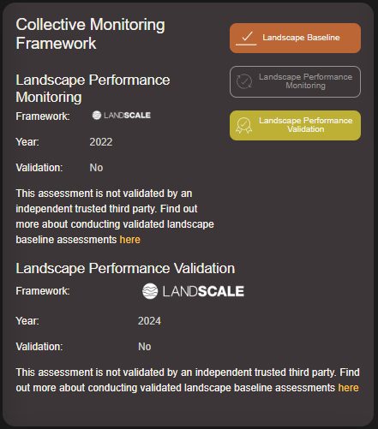
Collective Monitoring Framework
10. Baseline performance assessment and reporting
11. Performance monitoring and reporting
12. Activity monitoring and reporting
The landscape initiative manages a collective monitoring and reporting framework that enables assessment and communication of progress towards the initiative’s collective sustainability impact goals
a locally validated baseline performance assessment of the ecological and socio-economic conditions of the landscape;
Performance monitoring at a landscape scale against defined performance metrics and milestones for the collective sustainability goals
Activity monitoring that assesses progress in implementing activities included in the action plan
Robust and transparent reporting
Notes:
Activity monitoring: Regular reports are produced to describe the progress implementing the activities included in the action plan​
Landscape baseline: A baseline assessment of the ecological and social condition of the landscape has been conducted and is publicly available. This should include at least 1 indicator that is relevant to each landscape goal​
Landscape performance monitoring: A time-series including at least 2 results (the baseline result and a more recent result) must be publicly available for all indicators included in the baseline assessment​
Landscape performance validation: All results included in the baseline assessment of landscape performance, or subsequent assessments of landscape performance, have been validated by an entity with some degree of independence from those involved in conducting the assessment and the landscape initiative

Slide 31
Which core criteria do you feel are most developed in your landscape? Can you give an example?
Where do you feel most work is needed? What are the barriers?

Slide 32
Landscape Initiative Maturity (LIM)
Take home messages
LIM allows you to evaluate the health of the landscape initiative, identifying strong and weak points
Core criteria provide a roadmap for continual improvement – not a way to ‘score’ LIs
Facilitate transparent reporting and signal investment readiness through validated LIM
Notes:
3. By completing validated LIM evaluation, initiatives not only gain visibility and credibility but also receive structured feedback from the LandScale team on which sub-criteria they have achieved and where further development is needed.
Stop for questions

Slide 33
Building a LandScale profile

Slide 34
What is a LandScale profile?
Creating a LandScale profile is the first step in establishing your landscape initiative on the platform. Your profile serves as a central hub to showcase your initiative’s work, providing visibility to key stakeholders, funders, and partners.
Why build a LandScale profile?
Profile raising – visibility on LandScale’s landscape explorer, connect to other landscapes
Storytelling – showcase actions, stakeholders and investments in the landscape
Evaluate & validate Landscape Initiative Maturity - provide roadmap for improvement, demonstrate investment readiness, report to CDP
Conduct landscape monitoring - generate credible, validated landscape- level insights
It’s free!
Notes:
A free LandScale profile provides an overview of your landscape, including its geographic boundary, key characteristics, and involved stakeholders. By setting up a profile, you create a foundation for greater engagement, transparency, and collaboration. Once your profile is set up, you can expand it by evaluating your landscape initiative maturity or conducting a LandScale assessment, allowing you to showcase deeper insights into your sustainability efforts. Your profile also allows you to share information publicly through a dedicated link, making it a useful tool for disclosures, reporting, and attracting potential investors or partners. Additionally, it enables you to explore and connect with other landscape initiatives, fostering collaboration and knowledge exchange.

Slide 35
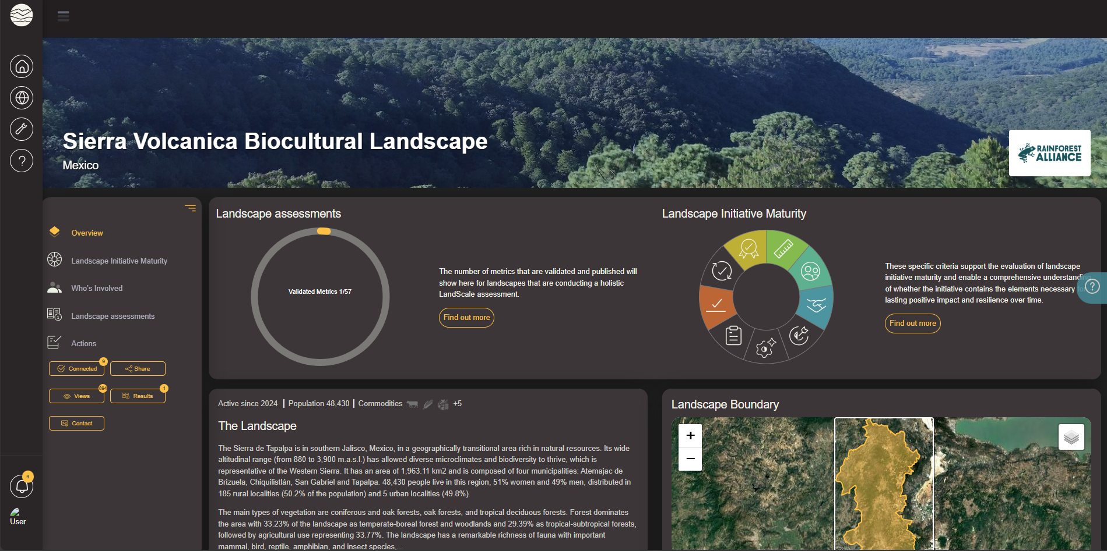

Slide 36
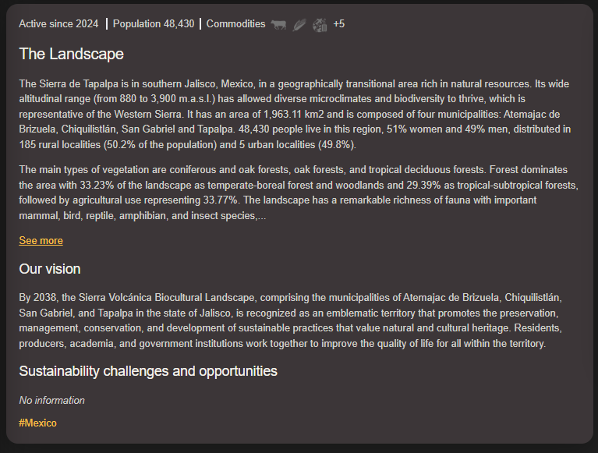
Landscape Overview
Landscape profile description → Document key characteristics and context of the landscape
Economic activities
Demographic information
Vision → Landscape initiatives vision for the landscape
Sustainability challenges and opportunities
Notes:
Geography
Based on Initiative’s knowledge, desk-based research and stakeholder input
This should include key sustainability-related trends threats, and/or risks; climate change impacts; other physical, geological, or ecological threats or dynamics; social challenges and trends; governance challenges or risks; changes in market characteristics, demand, incentives, or investmen
Link to supporting documentation or links to websites etc.

Slide 37
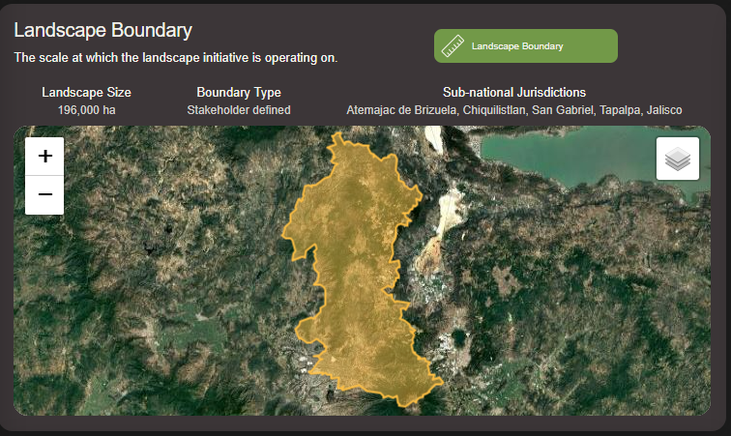
Landscape Boundary
Georeferenced polygon → .shp, JSON or KML
Landscape size → typically >10,000ha
Boundary type → Jurisdictional, watershed or stakeholder defined

Slide 38
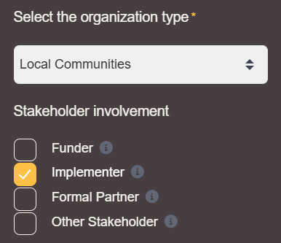
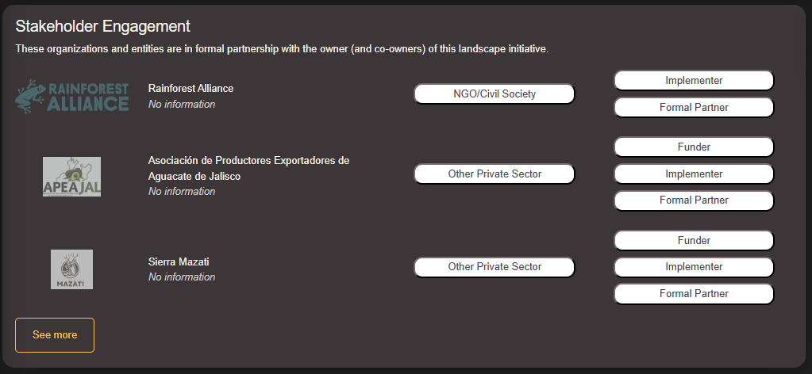
Who’s involved?
Organization(s) responsible for the LandScale profile
Stakeholder engagement → organization type and stakeholder involvement
Formal partnership → share whether a partnership agreement has been formalized between multiple landscape stakeholders

Slide 39
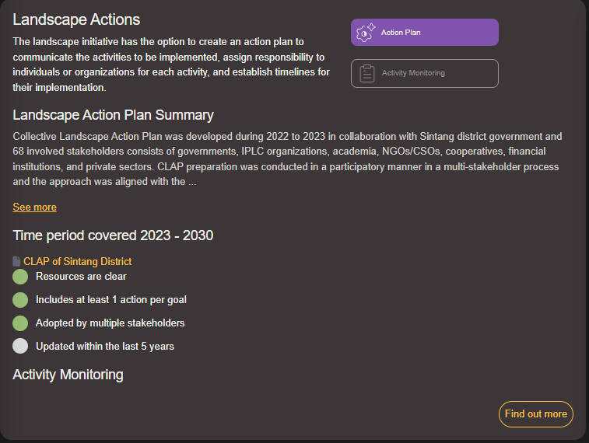
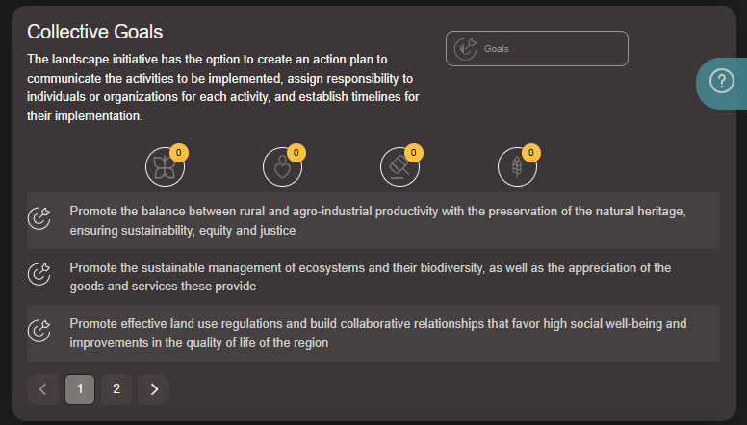
Actions
Create an action plan → communicate activities to be implemented
Assign responsibility to individuals/organizations
Establish timelines for implementation
Document goals defined by landscape initiative

Slide 40
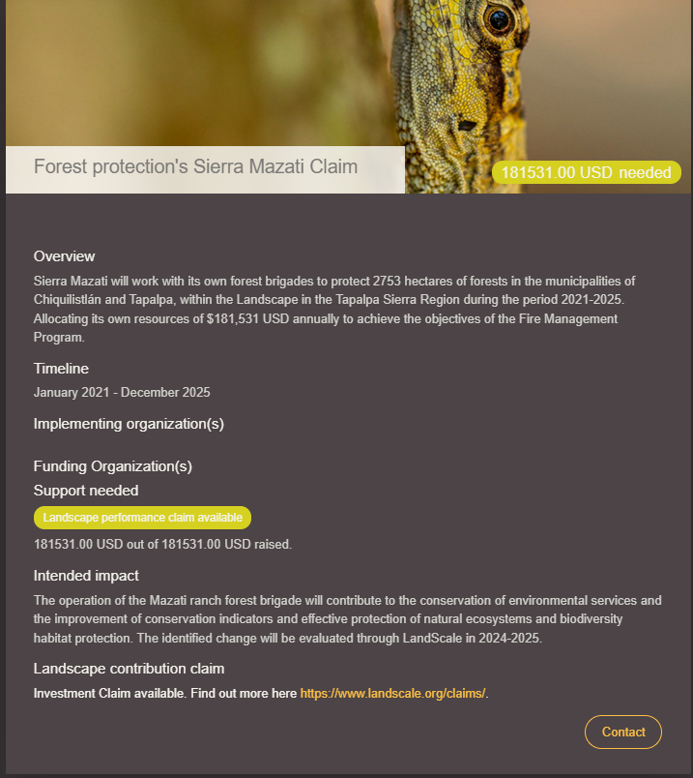
Actions – Claims pilot
LandScale piloted contribution claims for investment into landscapes
Landscape Actions tab provides a space to showcase validation investment claims
Currently working on impact claims

Slide 42
What’s next?
Make your profile public
Share your profile and connect with others
Evaluate the maturity of your landscape initiative
Assess landscape health through a baseline assessment
Generate validated baseline results
Reassess baseline to monitor change over time

Slide 43
Building a LandScale profile Take home messages
It’s free to create a LandScale profile for your landscape
Creating a LandScale profile is the first step in establishing your landscape initiative on the platform
Your profile serves as a central hub to showcase your initiative’s work, providing visibility to key stakeholders, funders, and partners.
Once your profile is set up, you can expand it by evaluating your landscape initiative maturity or conducting a LandScale assessment, allowing you to showcase deeper insights into your sustainability efforts.
Notes:
Stop for questions

Slide 44
Short break
5 min

Slide 45
Practical exercise: Building a LandScale profile

Slide 46


Step 1 – register to the LandScale platform
Go to: https://www.landscale.org/
Go to: Log in (if you have an account) or Get started
This will take you to the LandScale platform.
Go to: Sign up
Sign up easily with Gmail, or create an account with your chosen email address
Verify account

Slide 47
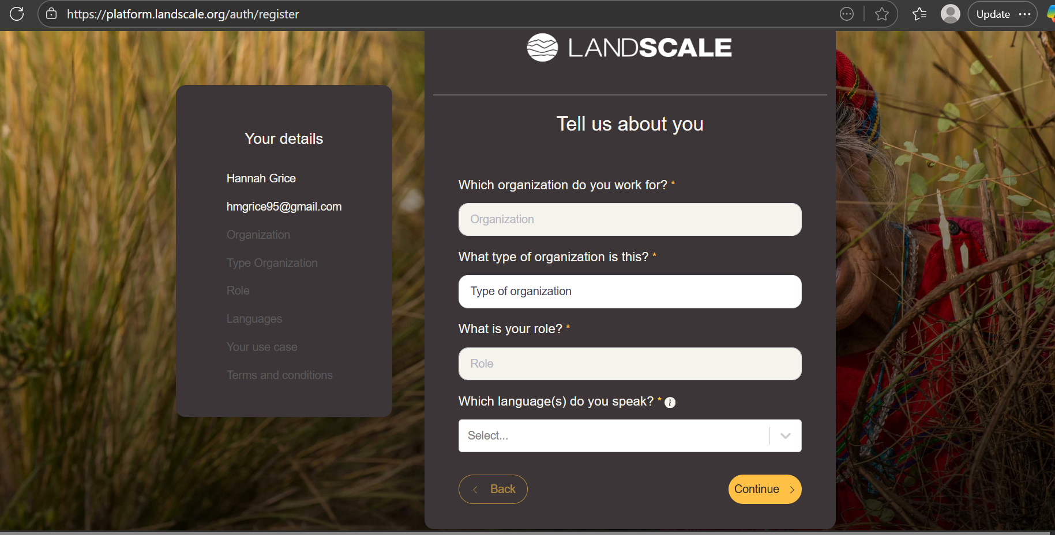

Slide 48
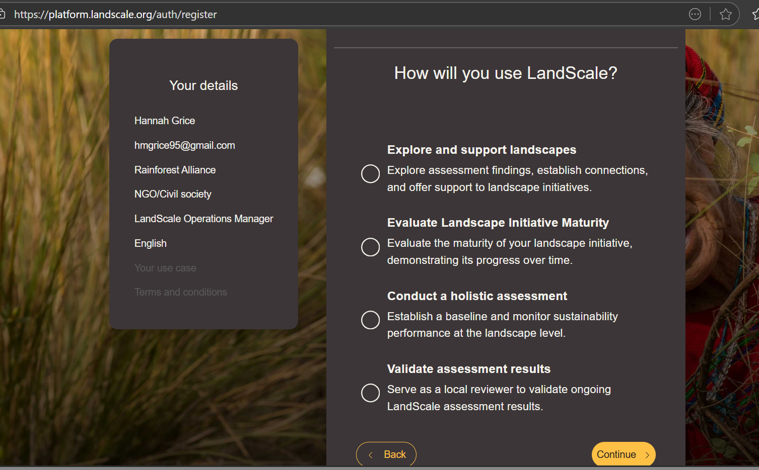

Slide 49
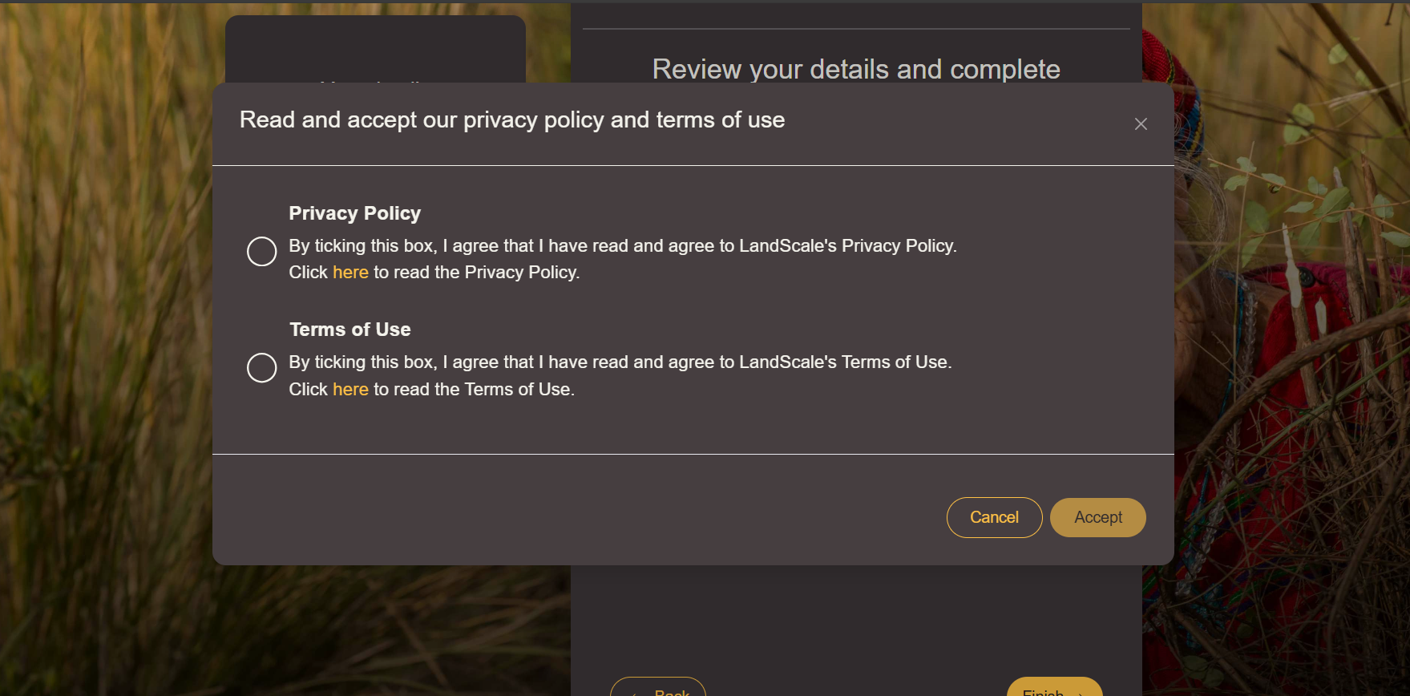

Slide 50
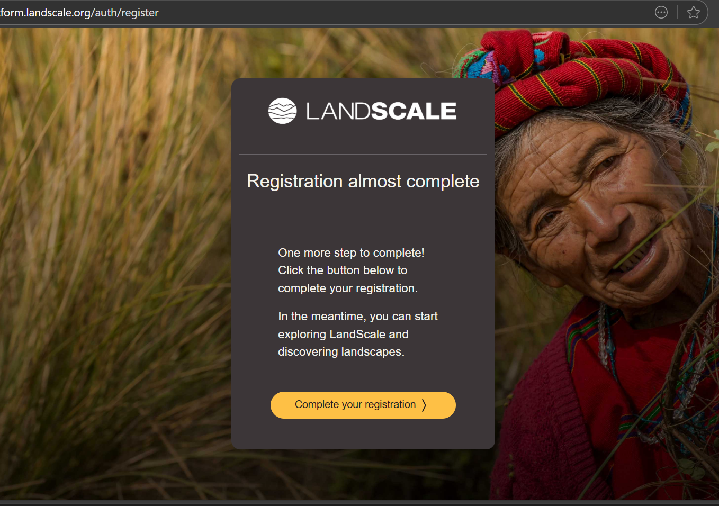

Slide 51
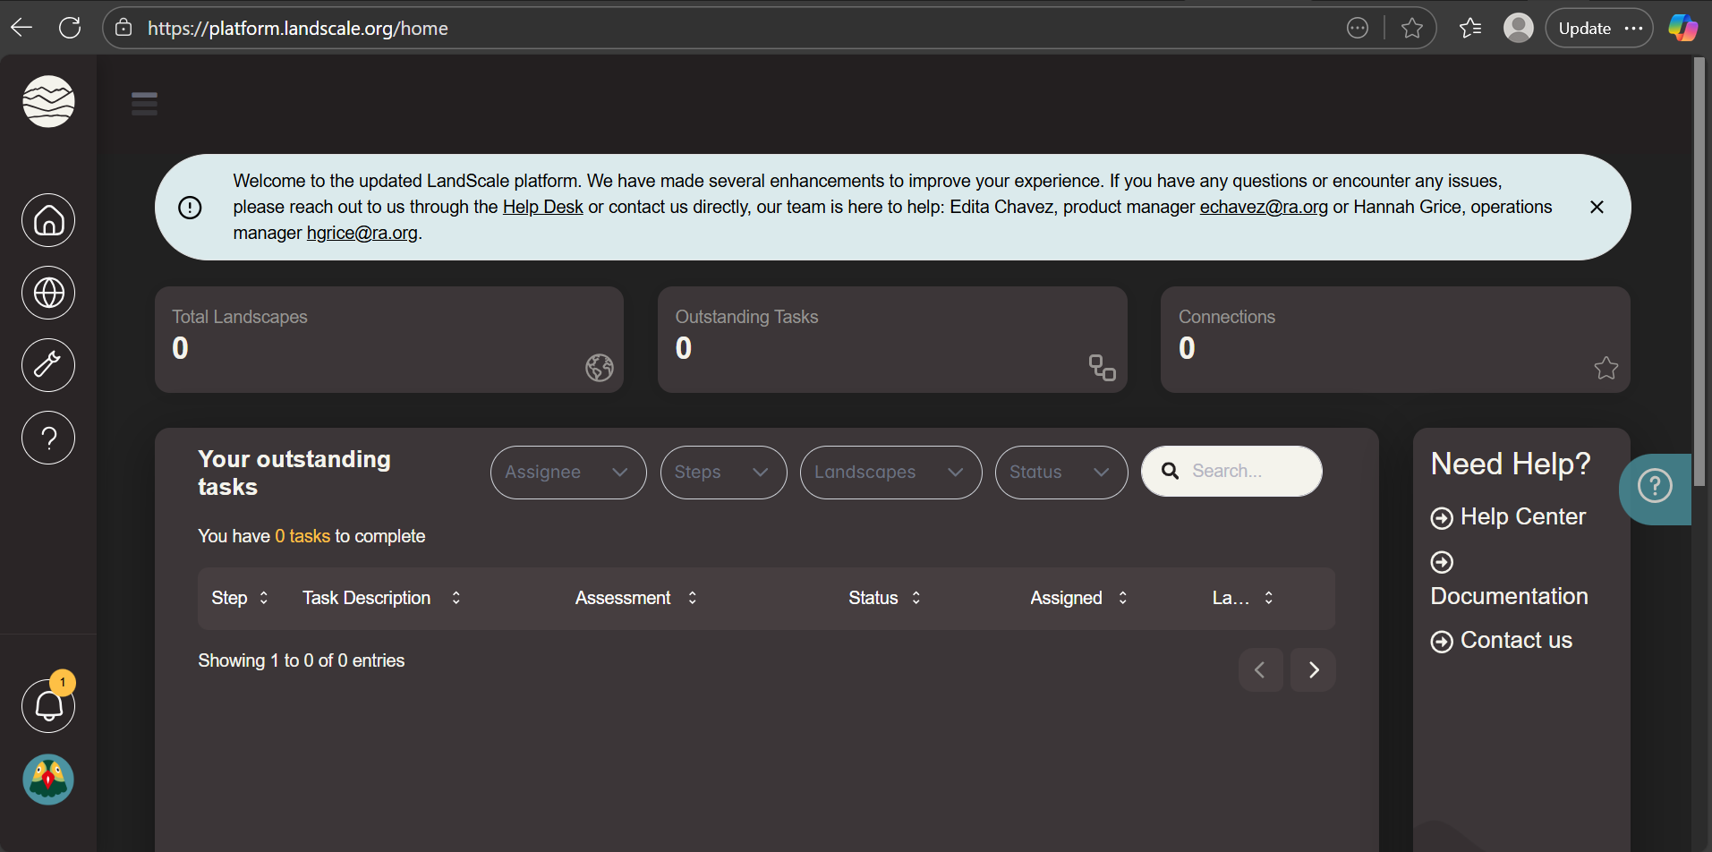

Slide 52
Step 2 – Create your landscape
Navigate to the bottom of the home page
In the ‘Your landscapes section, select ‘Create a new landscape’
Once you have created a new landscape, you can edit your profile

Slide 53
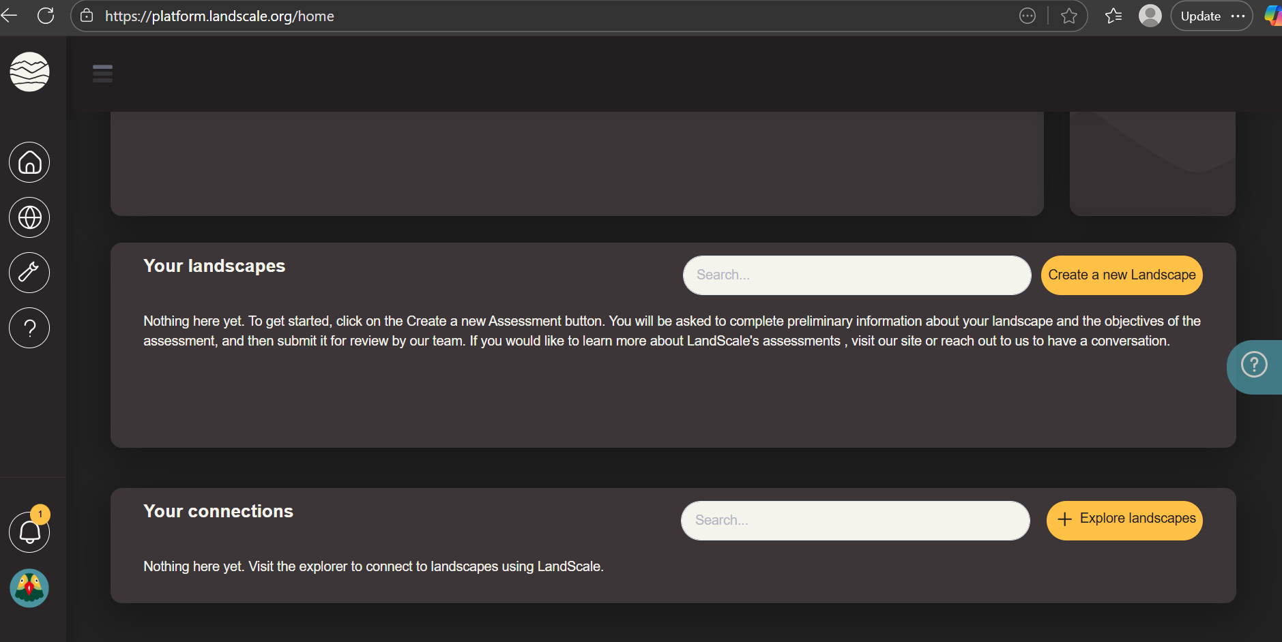

Slide 54
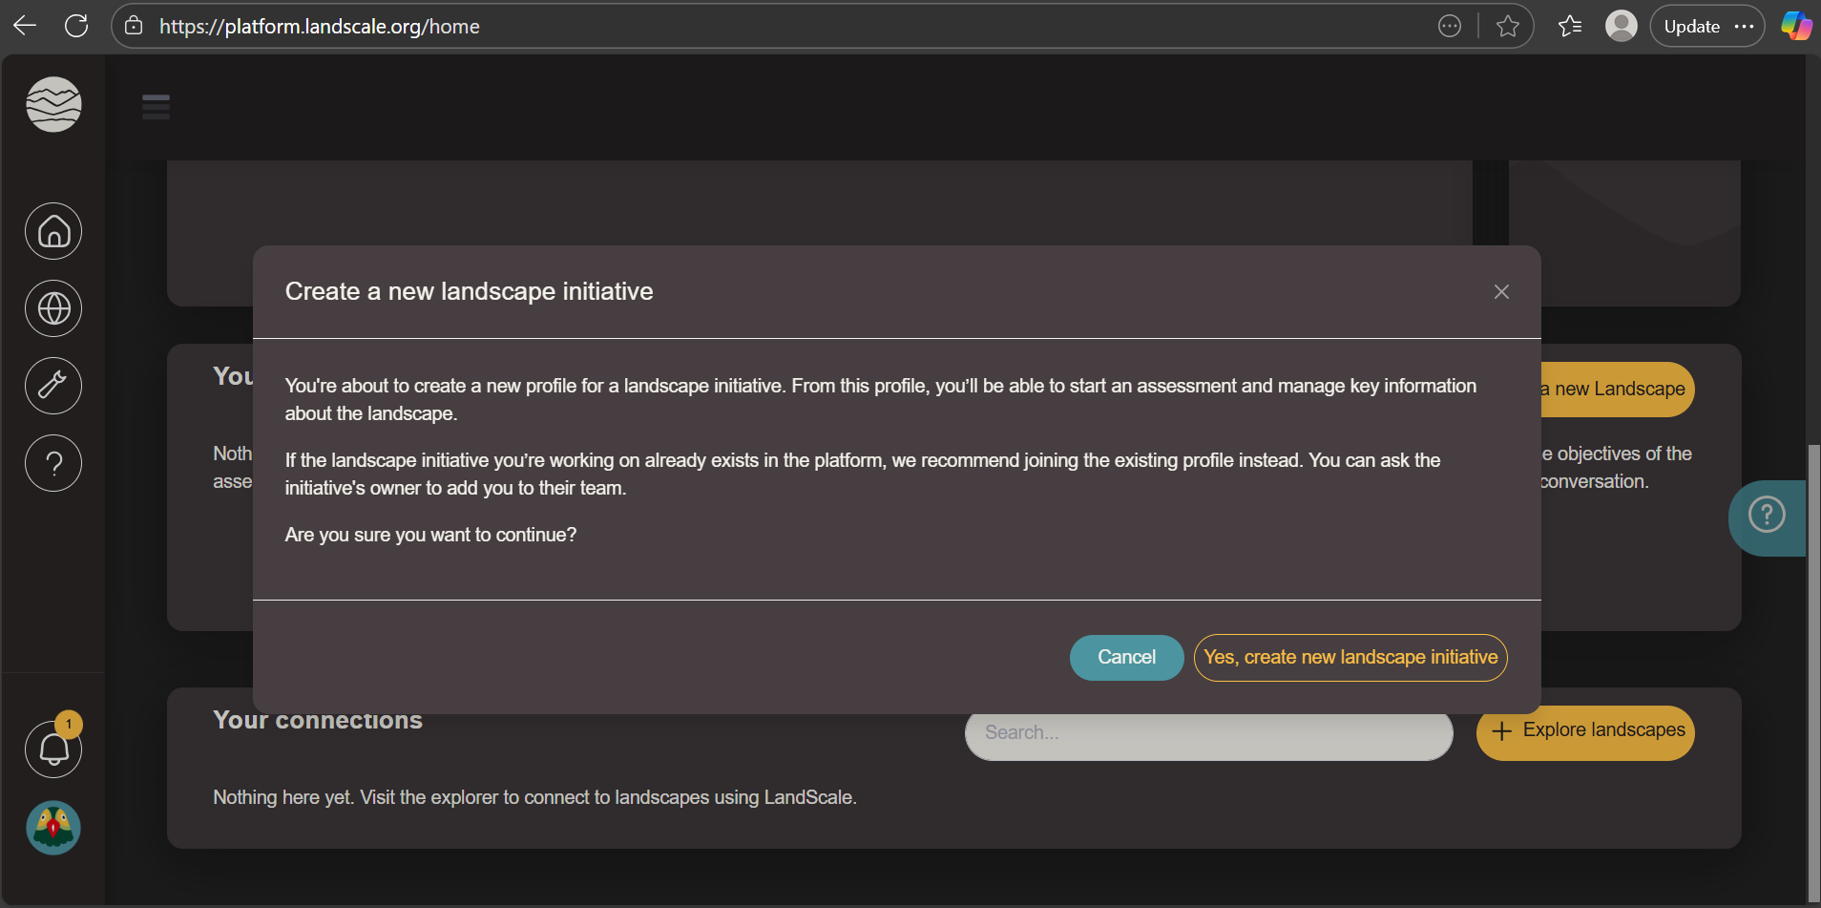

Slide 55
Step 3 – Start building your landscape profile
At the top right of the landscape profile, select ‘Edit mode’
Explore the various sections and tabs
In the ‘Overview’ tab, scroll down to the Landscape overview section, select ‘Edit’. Populate your landscape overview (Name, vision, description..)
Next, edit and complete the ‘Landscape boundary’ section (Upload shapefile, select boundary type…)

Slide 56
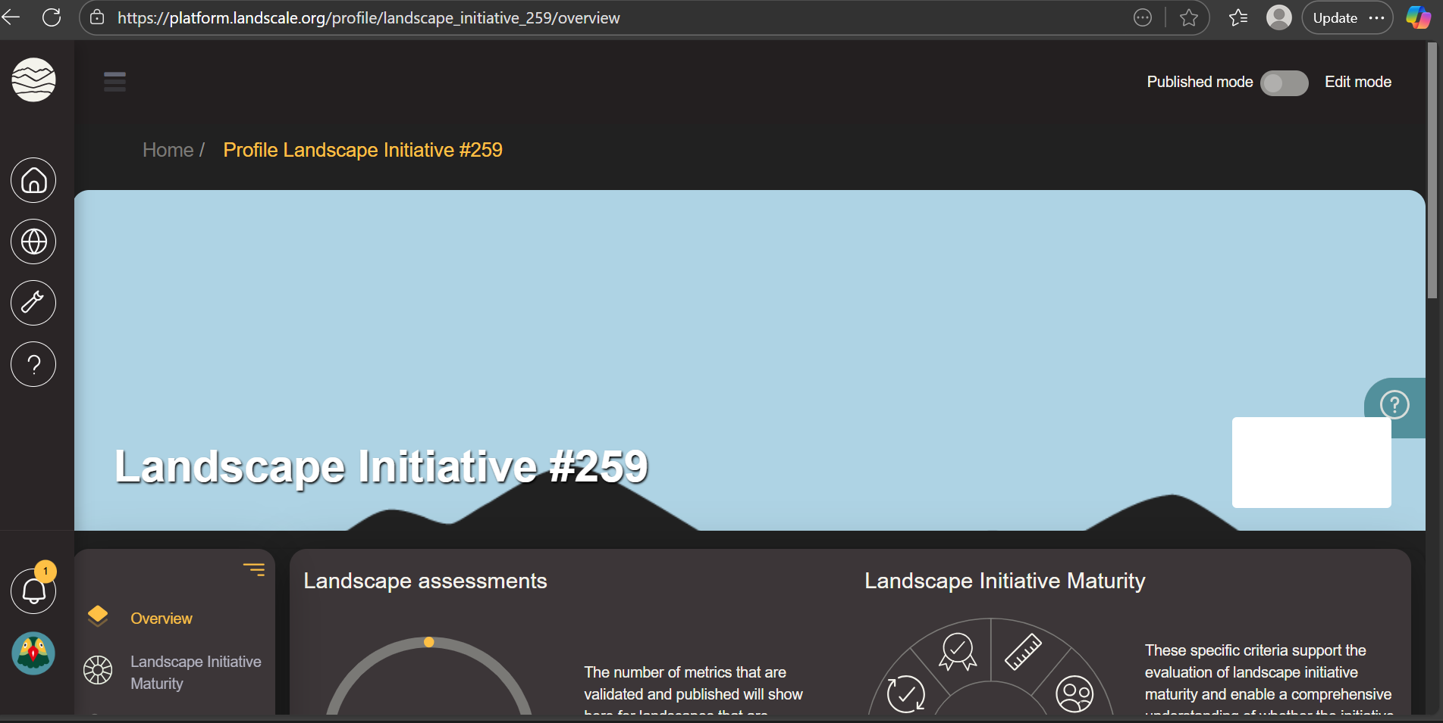
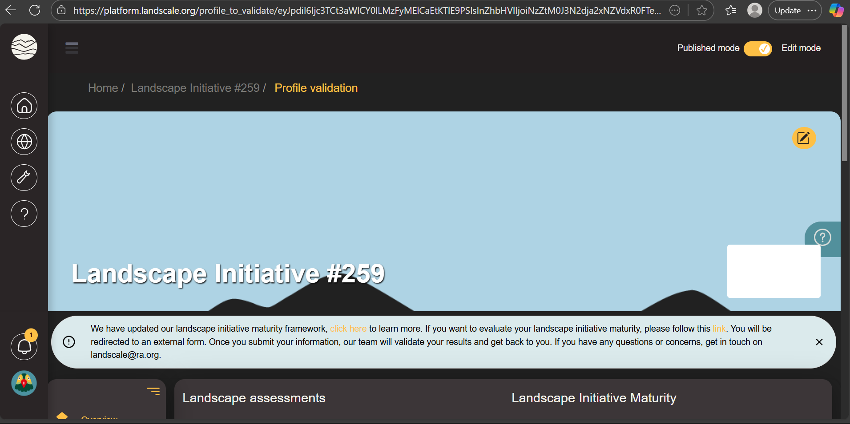

Slide 58
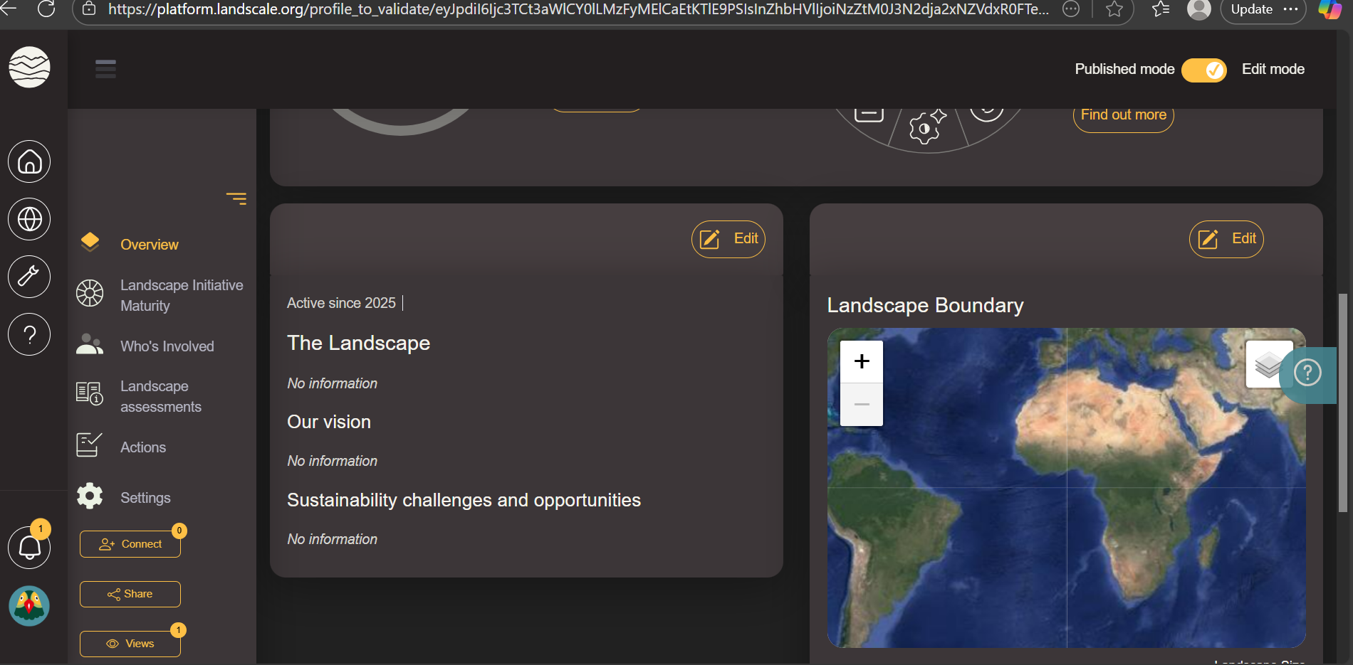

Slide 59
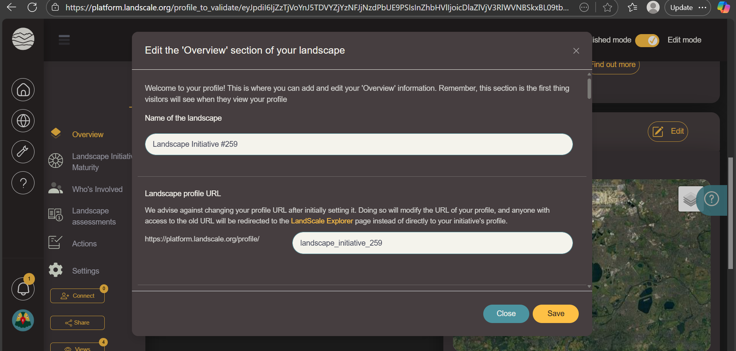

Slide 60
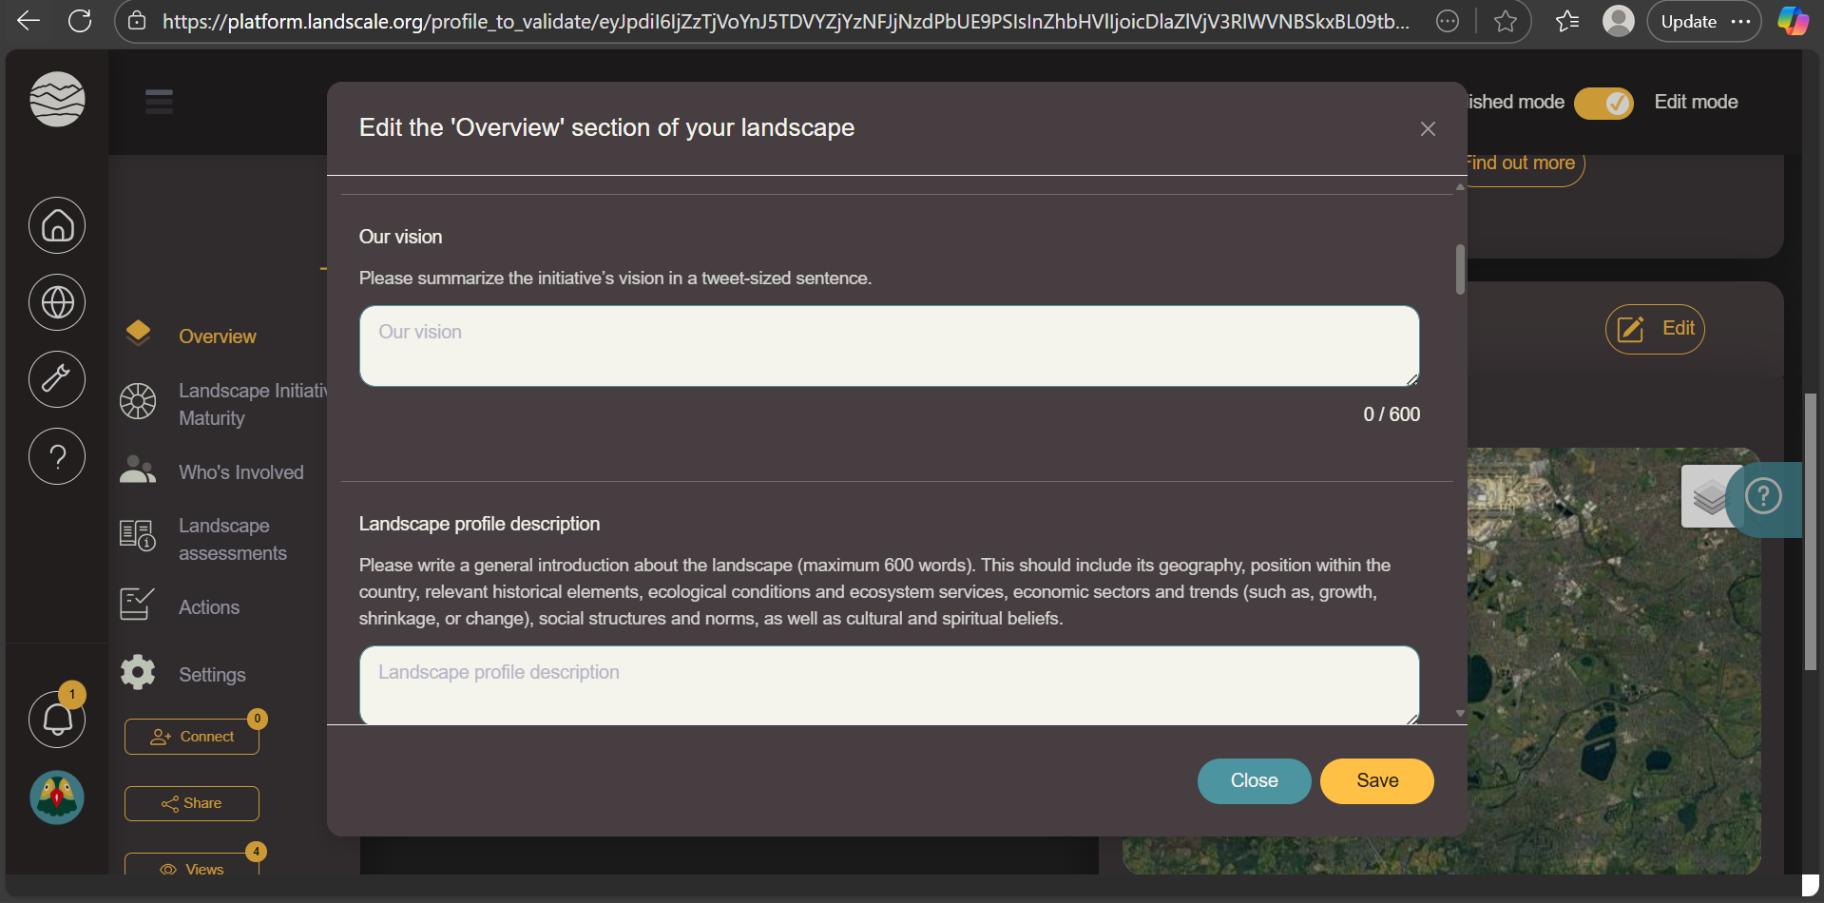

Slide 61
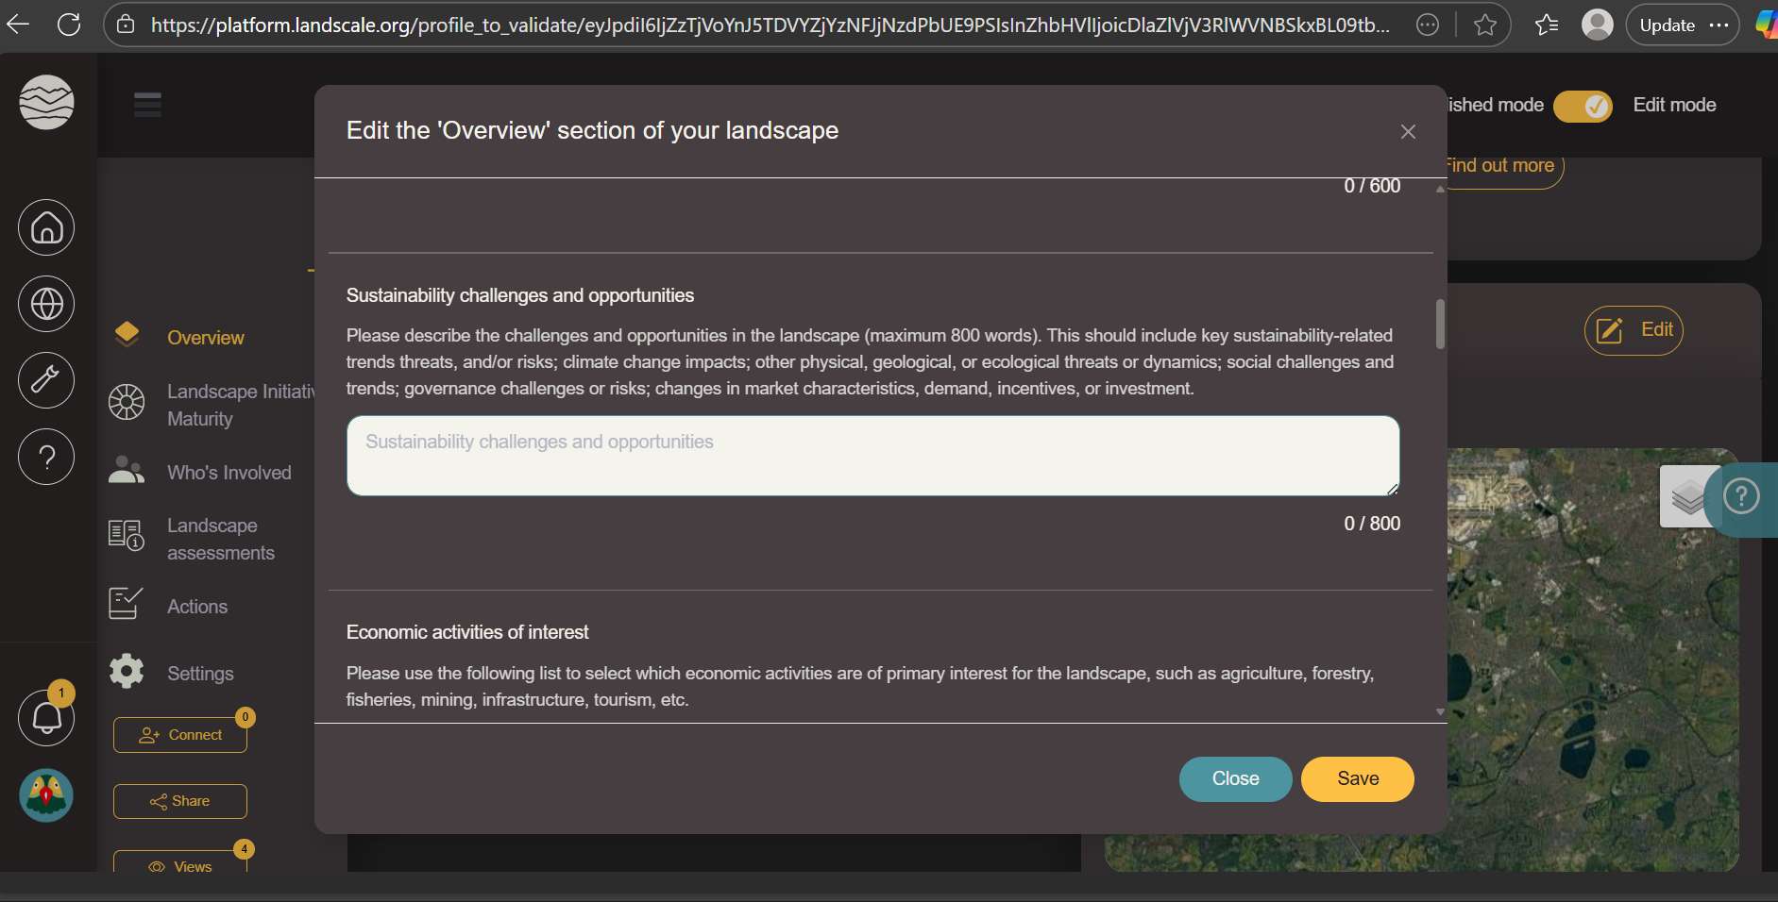

Slide 62
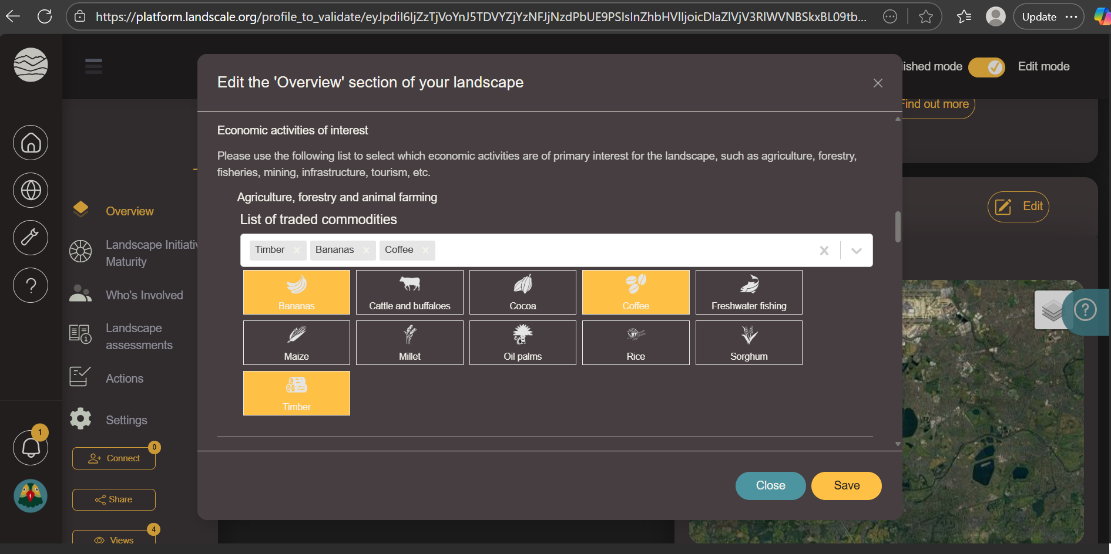

Slide 63
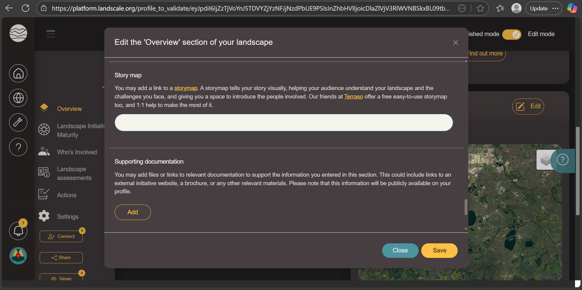

Slide 65
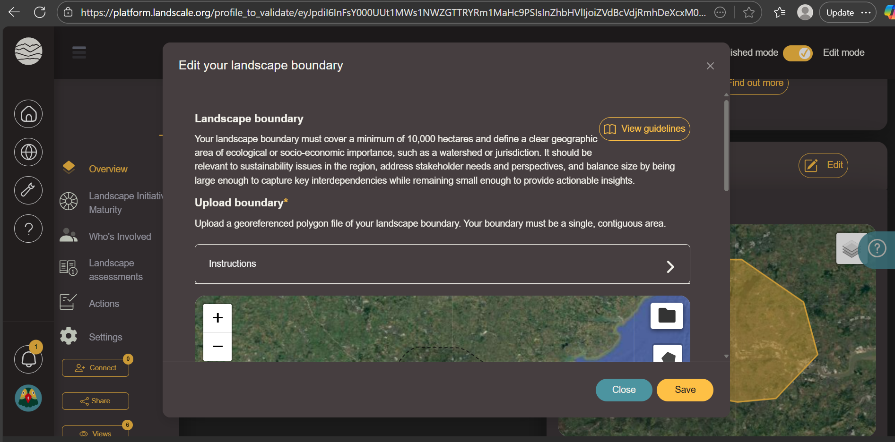

Slide 66
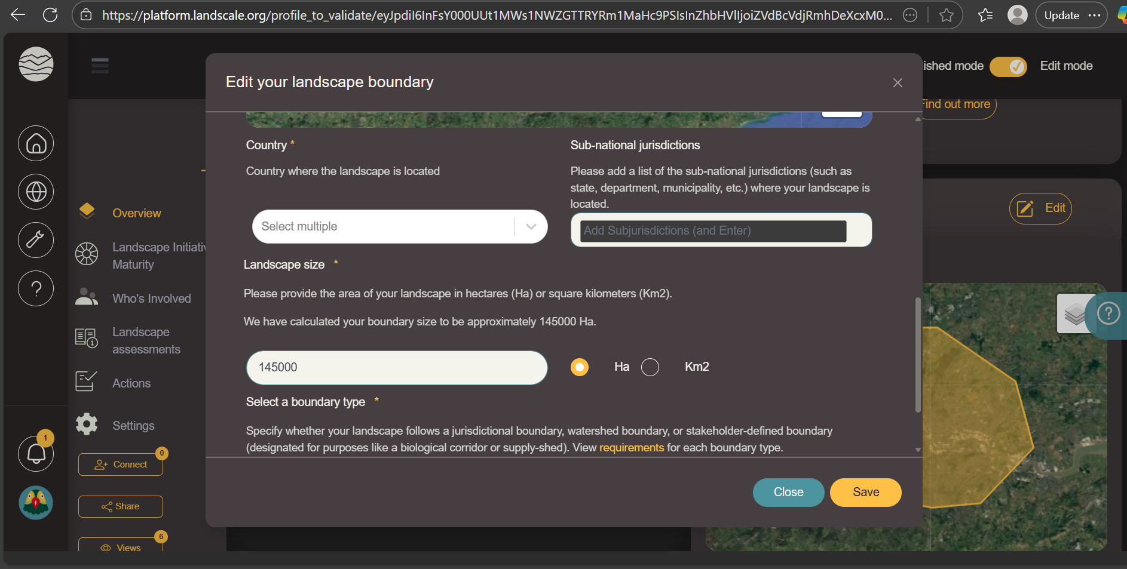

Slide 67
Let's get to work!
Guided discussion
Notes:
2 rooms

Slide 68
Which core criteria do you feel are most developed in your landscape? Can you give an example?
5 minutes

Slide 69
2. Where do you feel most work is needed? What are the barriers?
5 minutes

Slide 70
3. What steps could you take to improve?
5 minutes

Slide 71
4. What is one tangible action you will take to progress?
5 minutes

Slide 72
Thank you for listening!
If you would like additional support to set up your landscape profile, or would like to learn more, please reach out to hgrice@ra.org or atovar@ra.org
Access LandScale’s guidance documentation: Welcome to the LandScale documentation | LandScale Documentation
Access the Core Criteria for Mature Landscape initiatives: Core Criteria for Mature Landscape Initiatives (2024) | ISEAL Alliance
Learn more about Social Safeguards for LJIs: Social Safeguarding Process for Landscape and Jurisdictional Initiatives (LJIs) - Proforest

Slide 73
Thank you.

